Slide 1


The ATS and SMS Satellite Proof of Concept Years Before the GOES Program Approval
by
Thomas H. Vonder Haar
John M. Forsythe
Department of Atmospheric Science and Cooperative Institute for Research in the Atmosphere
Colorado State University
January 28, 2026
Joint Panel Discussion J11 - Fifty Year History of GOES
Joint Session with the 27th Conference on Satellite Meteorology, Oceanography, and Climatology and 22nd Symposium on Operational Environmental Satellite Systems
2026 AMS Annual Meeting, Houston TX

Slide 2
The Pre-GOES GEO METSAT period was 1965-1975
NASA and NOAA led the:
Satellite Technology Tests,
Instrument Proof of Concept,
Ground system development and Forecast Product Demonstrations
In collaboration with the Universities of Wisconsin and Colorado State and Hughes Aircraft and Ford Aerospace
4 satellites were launched :
ATS-1 (1966): Spin Scan Cloud Camera
ATS-3 (1967): Multicolor Spin Scan Cloud Camera (MSSCC)
SMS-1 (1974): Visible and Infrared
Spin Scan Radiometer (VISSR)
SMS-2 (1975): VISSR

Slide 3
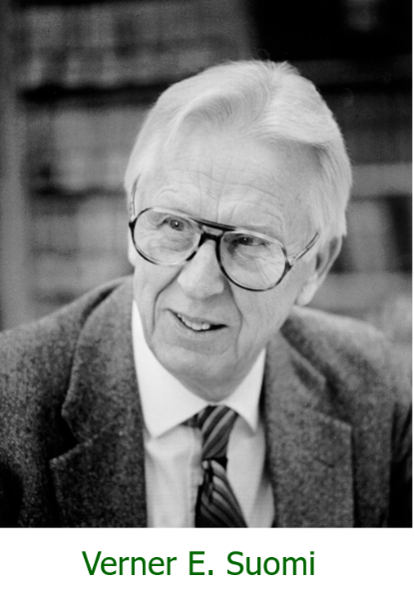
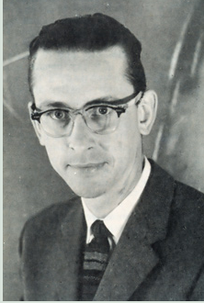
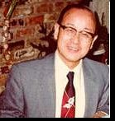
Three Leading Pioneers in Satellite Meteorology
Verner Suomi
David Johnson
Ted Fujita

Slide 4
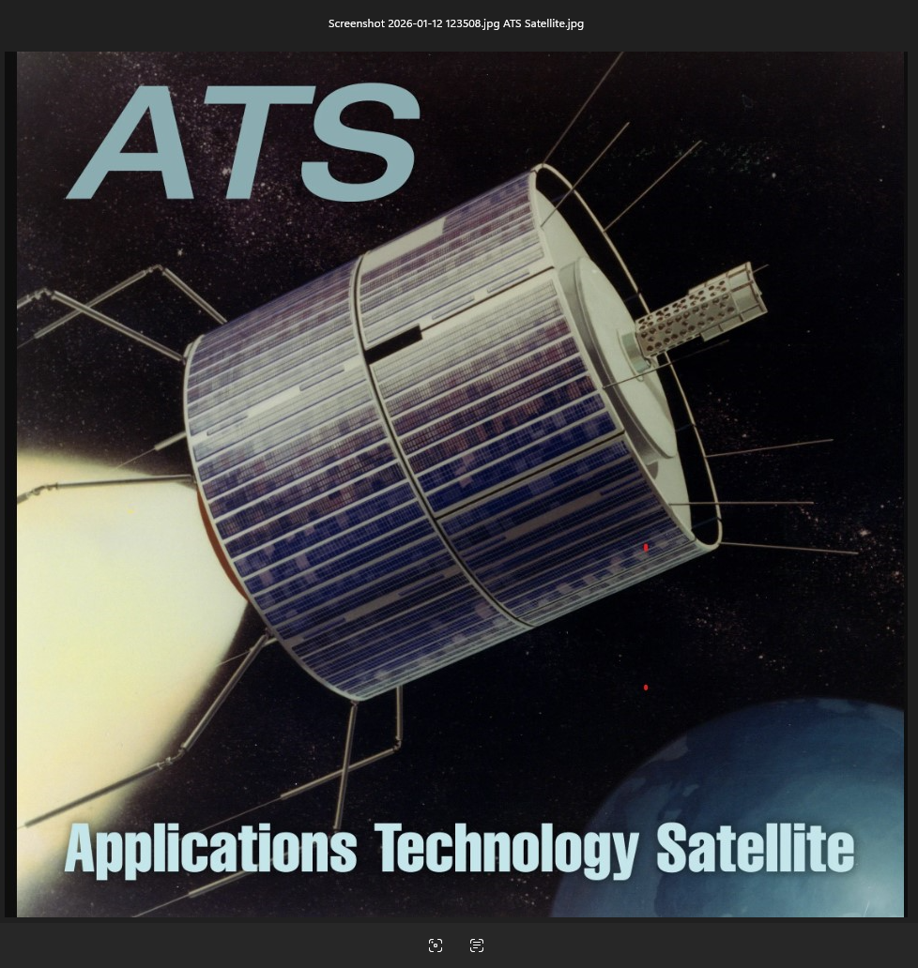
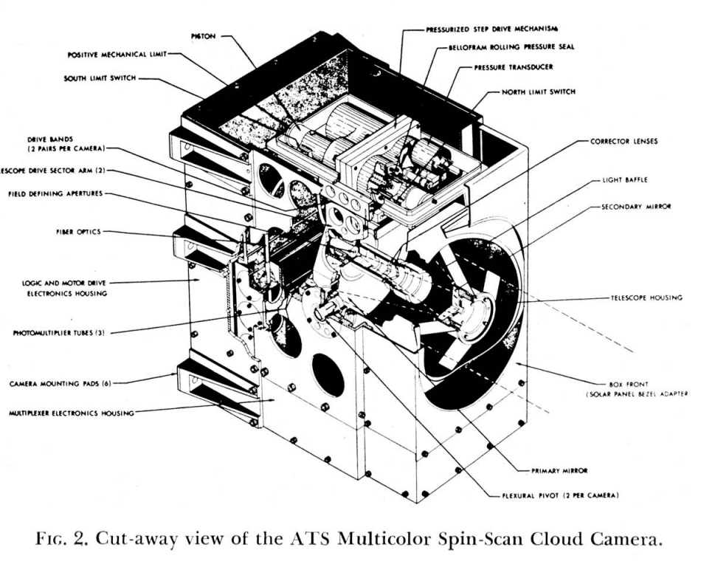
Spin Rate | 100 RPM
Payload | 350 kg
MSSCC Mass | 10.5 kg
Primary Mirror | 13 cm

Slide 5
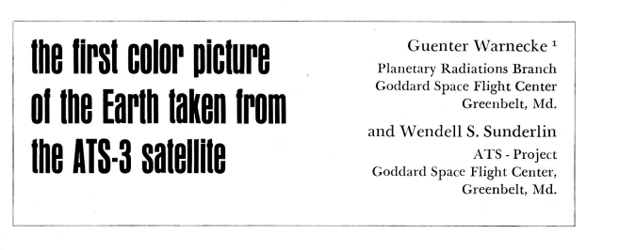
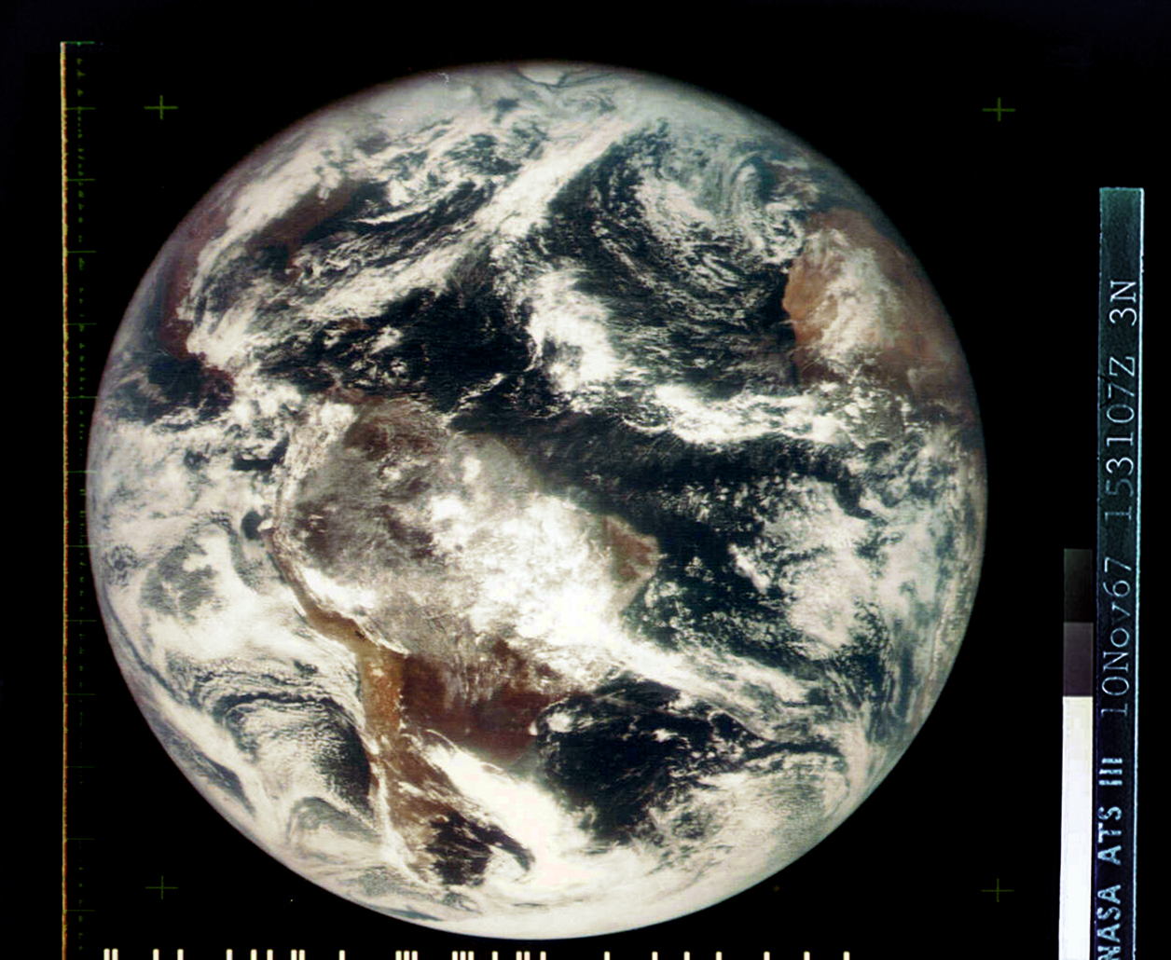
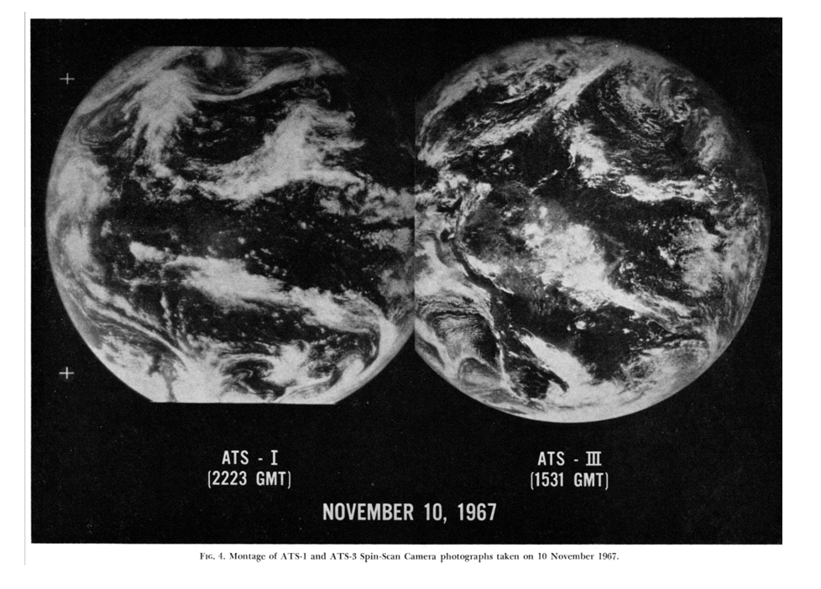
Also V. Suomi and R. Parent, same BAMS issue
BAMS, Feb.1968

Slide 6
From ATS-3 (1968)
Severe convective storms and tornadoes over Southern Great Plains.
Zoom showing most intense, brightest storms for forecast and warning. Vonderhaar (1969), J.Geo. Res.

Slide 7
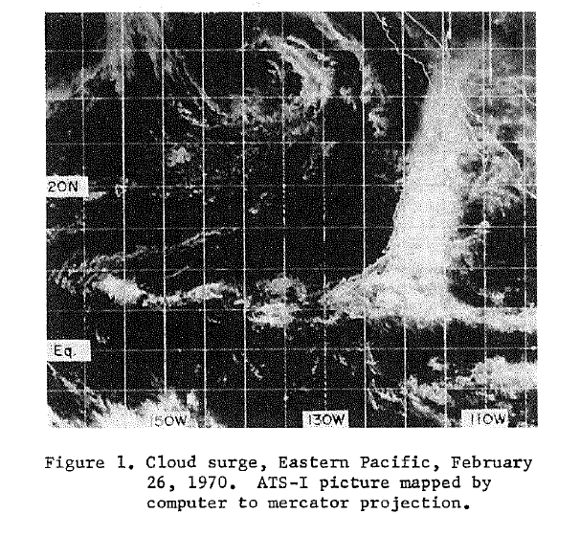
First Satellite Observations of “Cloud Surges or Tropical Intrusions” Reported in 1970
From the first experimental geosynchronous satellite carrying the first spin scan cloud radiometer / camera (Suomi and Parent) with only one visible light channel.
Anderson and Oliver, 1970: Some examples of the use of synchronous satellite images for studying changes in tropical cloudiness. Proceedings AMS Tropical Meteorology Conference.

Slide 8
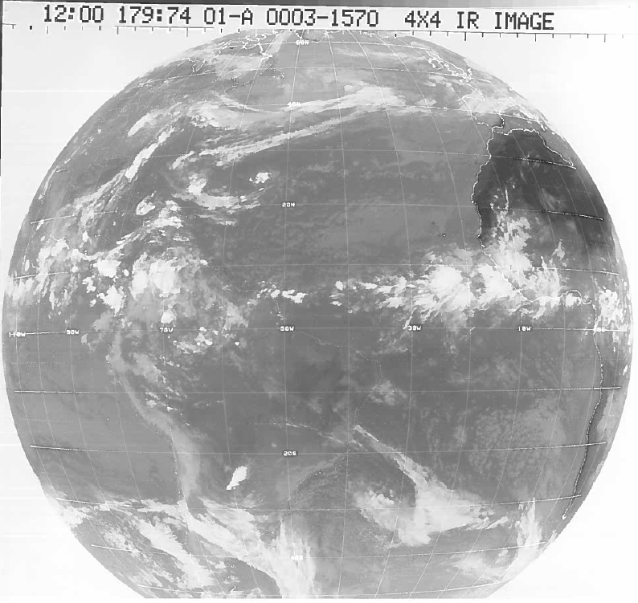
The first infrared images from a GEO.
SMS-1 from NASA / NOAA in 1974.
SSP 45°W

Slide 9
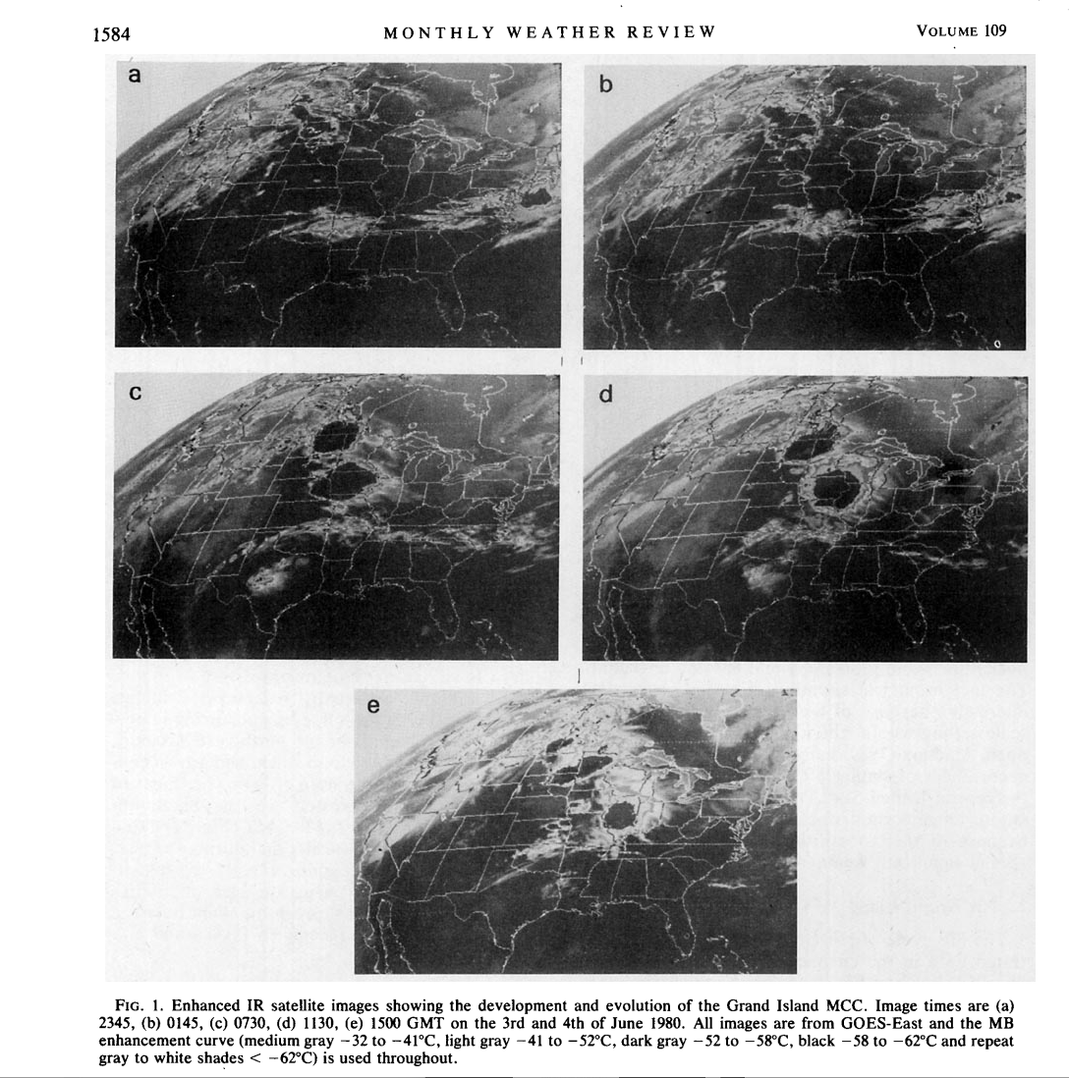
GOES IR allowed detection of Mesoscale Convective Clusters (MCC’s) which became very important in forecasting heavy precipitation over the U.S. and other regions.
Maddox (MWR, 1981)

Slide 10
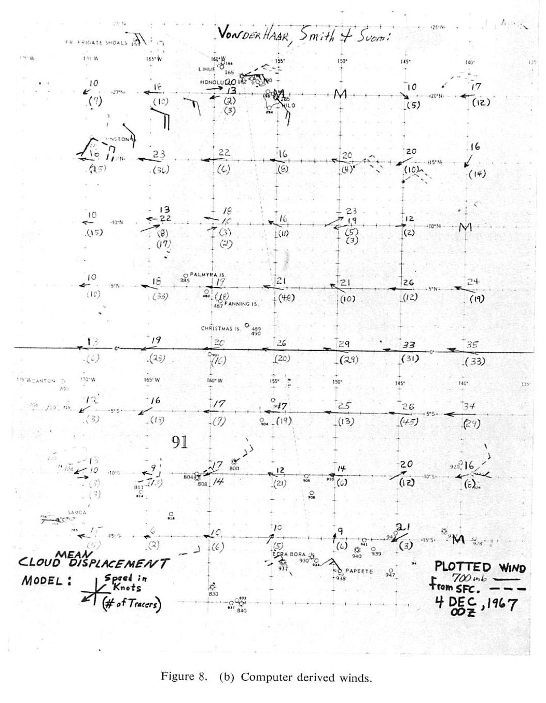
Gridded average cloud drift winds from ATS-1 over broad area of the Pacific V. Suomi (1968) Conf. On Global Circ. of Atmos., London [ Note height assignment problem when 2 vectors were measured…… the first IR data arrived from SMS-1 in 1974.]
The first computer-derived wind vectors from cloud motion (1967)
It took several decades of R & D for global atmospheric motion vectors to impact global model forecasts.
0°N
150°W

Slide 11
Summary
..In the pre-GOES era many lessons were learned to assist a US operational GOES Program as well as the rapidly developing GEO programs in Europe and Japan.
…and we thank all the several hundred engineers and meteorologists who pioneered the US Geostationary weather satellite systems.
References
Kidder, S. Q., and T. H. Vonder Haar, (1995): Satellite Meteorology: An Introduction, Elsevier, 466 pp. https://www.sciencedirect.com/science/article/pii/B9780080572000500055?via%3Dihub
Goodman, S. J. et al., Eds, (2020), The GOES-R Series, A new generation of geostationary environmental satellites, Elsevier, 283 pp.

Slide 12
Backup Slides

Slide 13
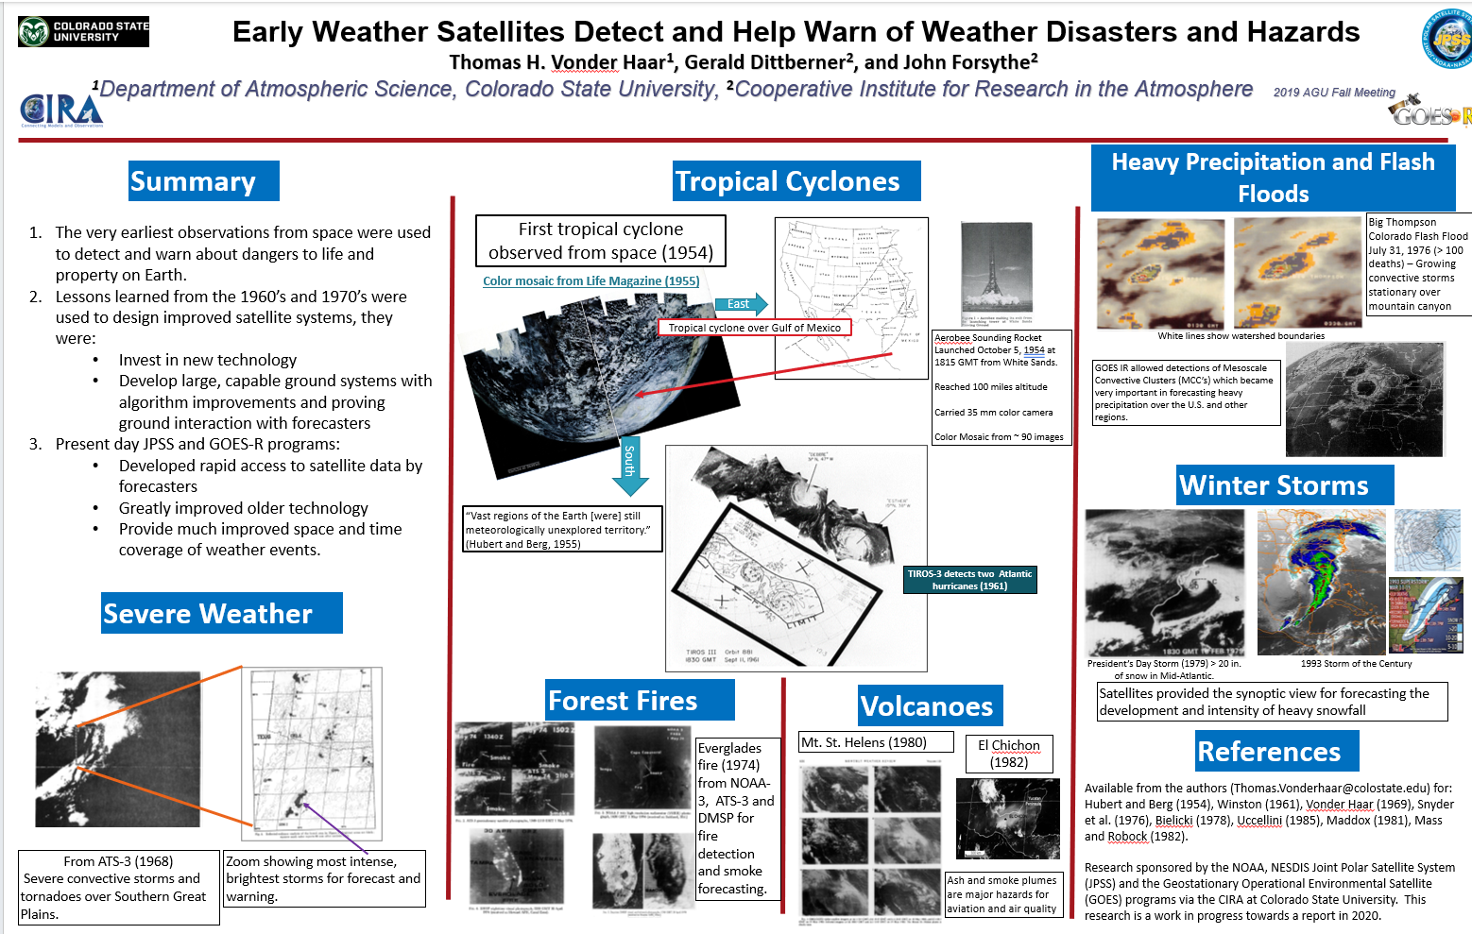

Slide 14
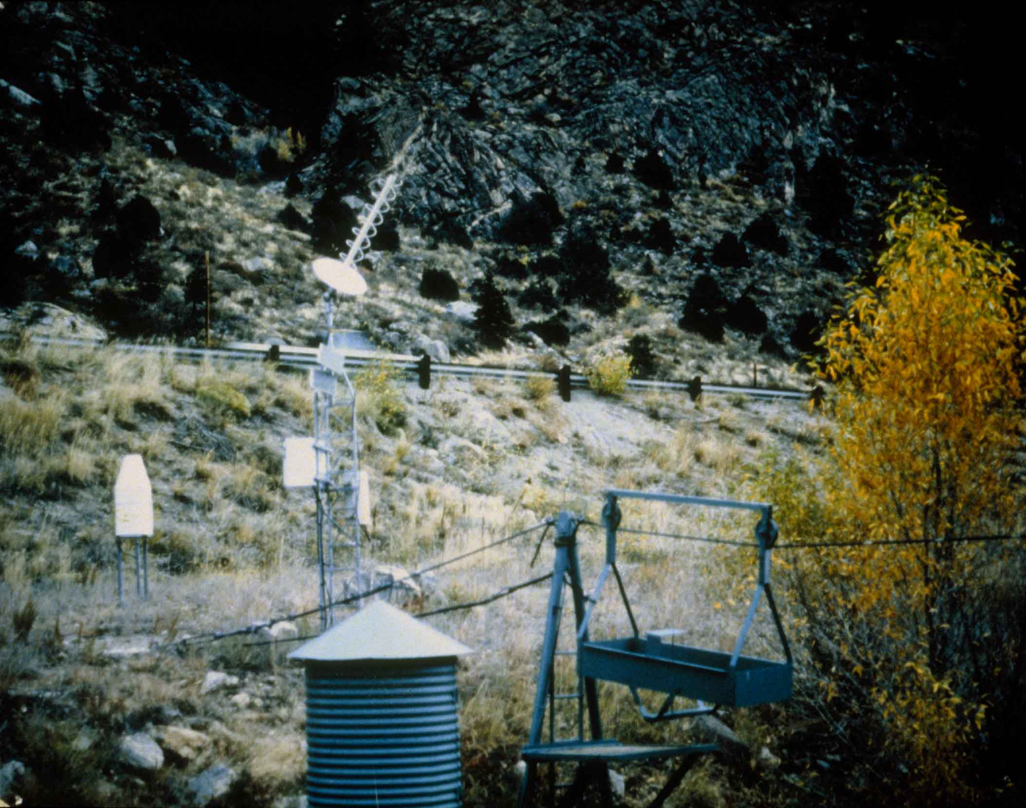
Data Collection Platforms (DCP) reported surface and ocean measurements through the GOES and POES operational satellites in the late 1970’s and early 1980’s.

