Slide 1
TPW
00Z – 12Z
14 Nov 2025

Slide 2
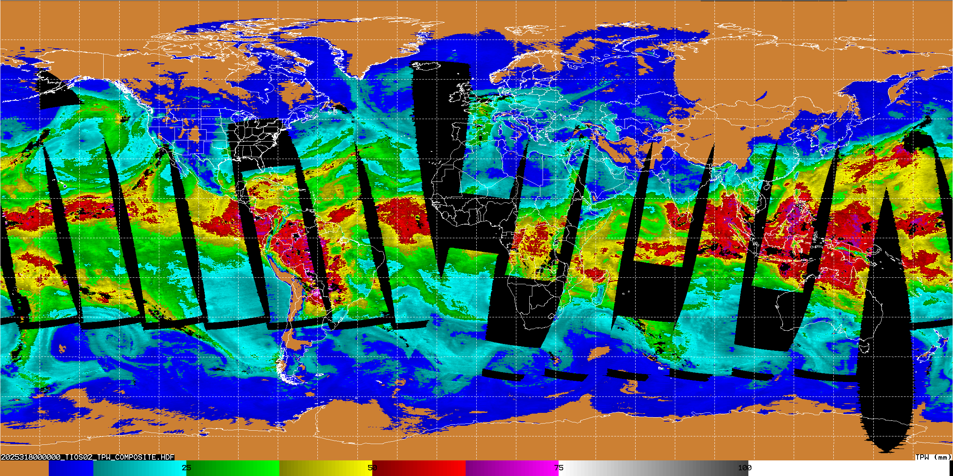
Tomorrow-S2

Slide 3
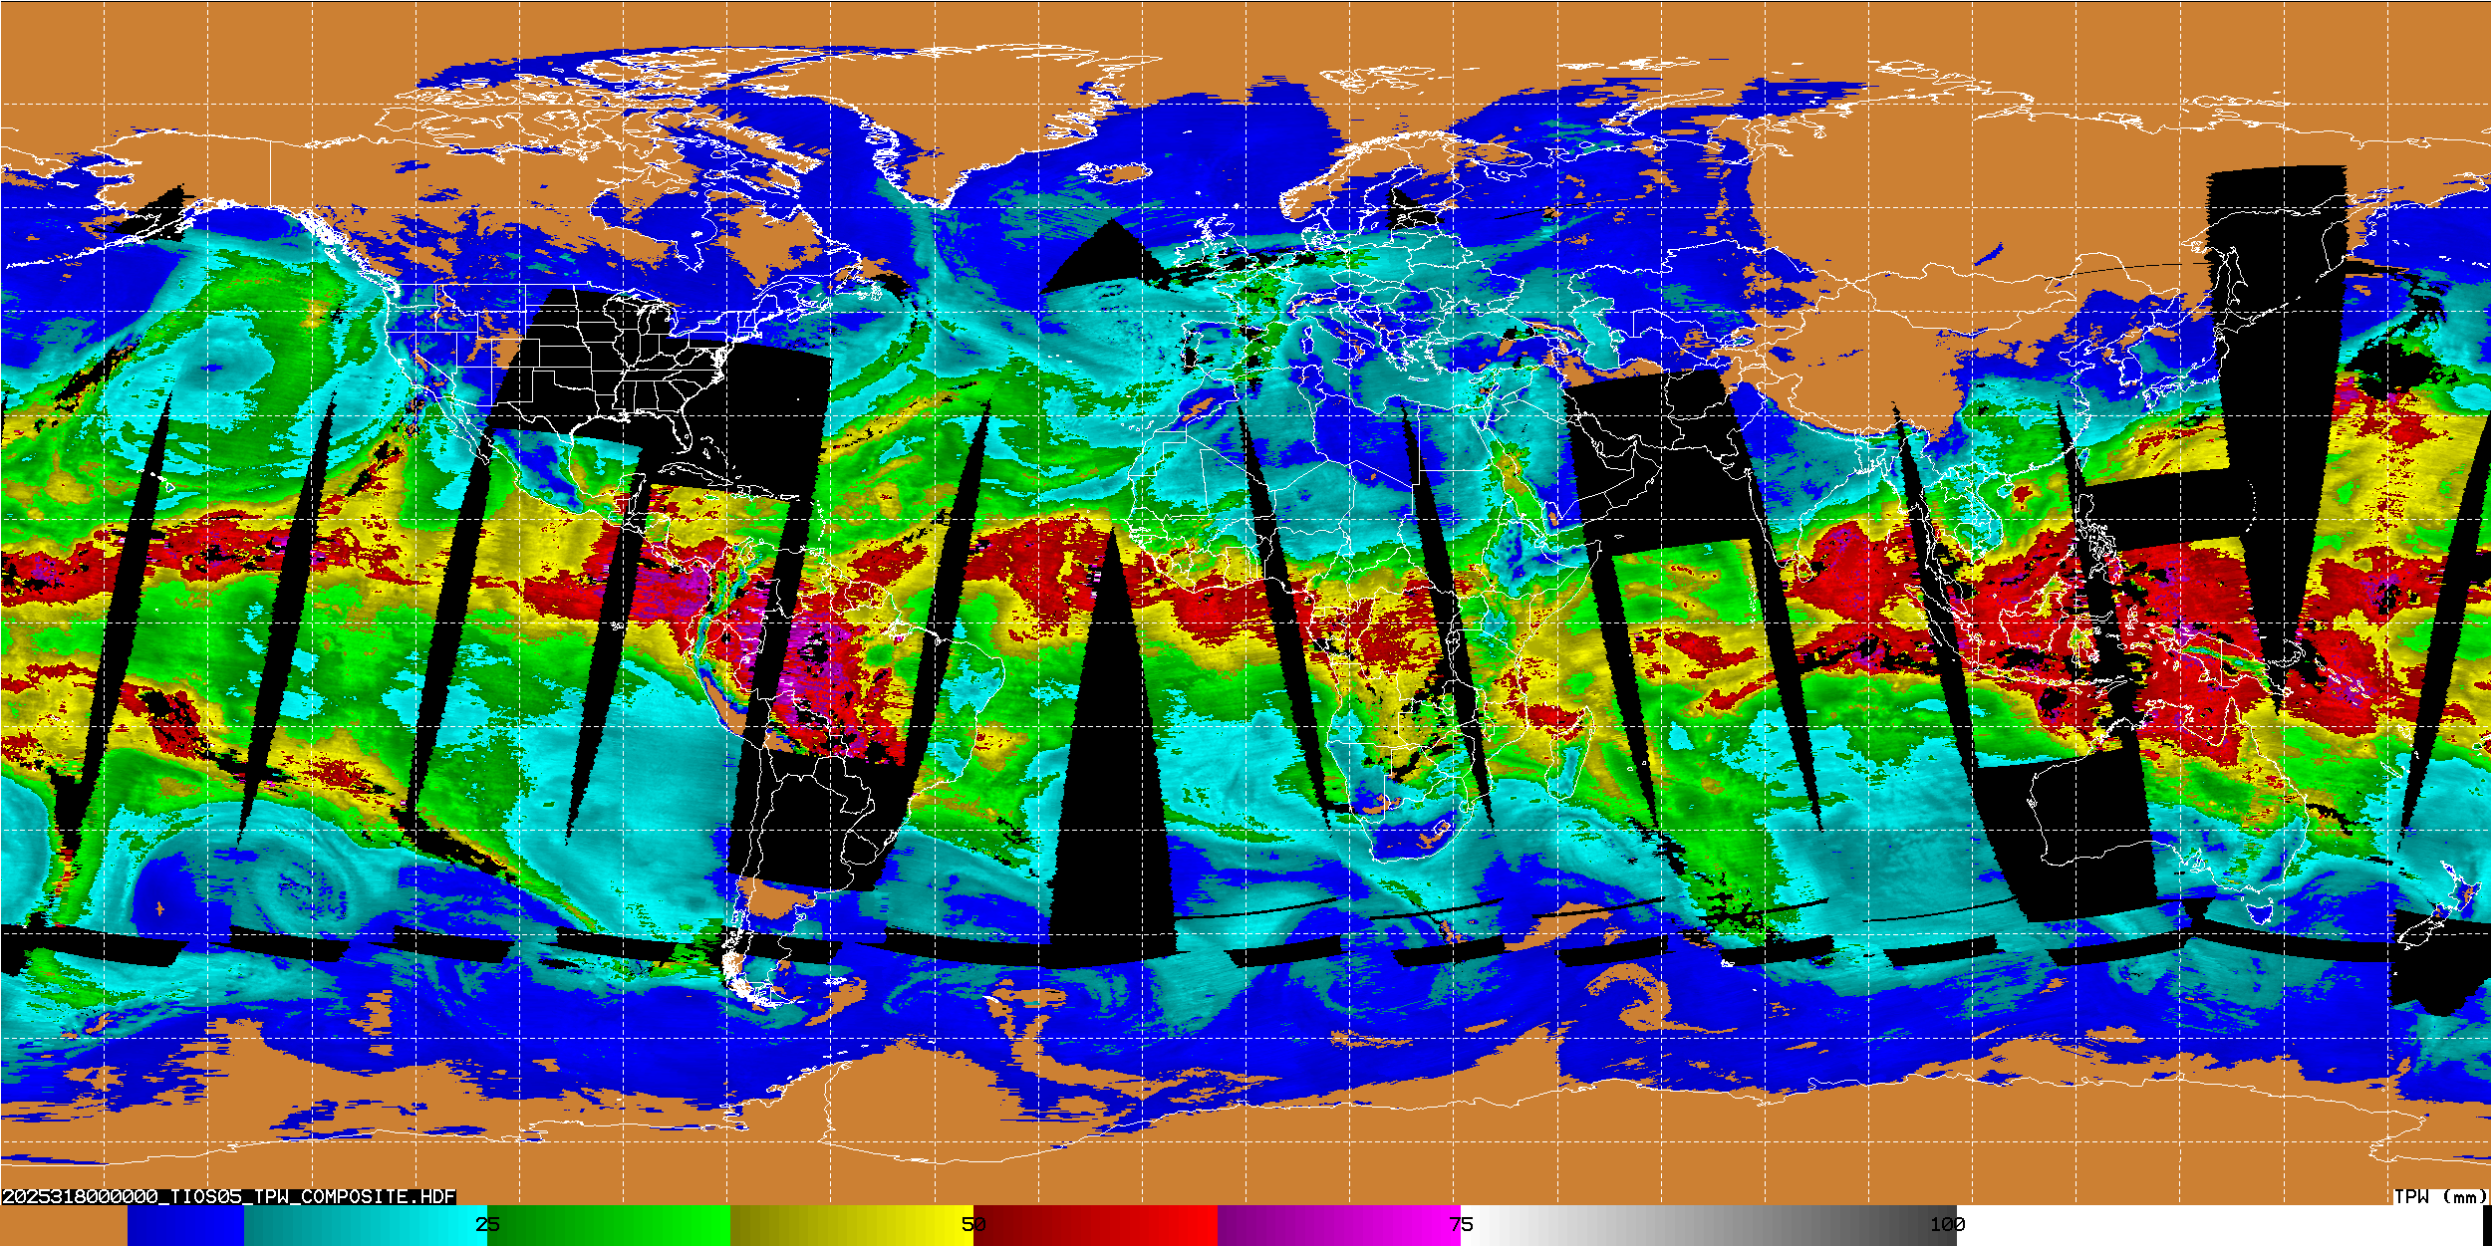
Tomorrow-S5

Slide 4
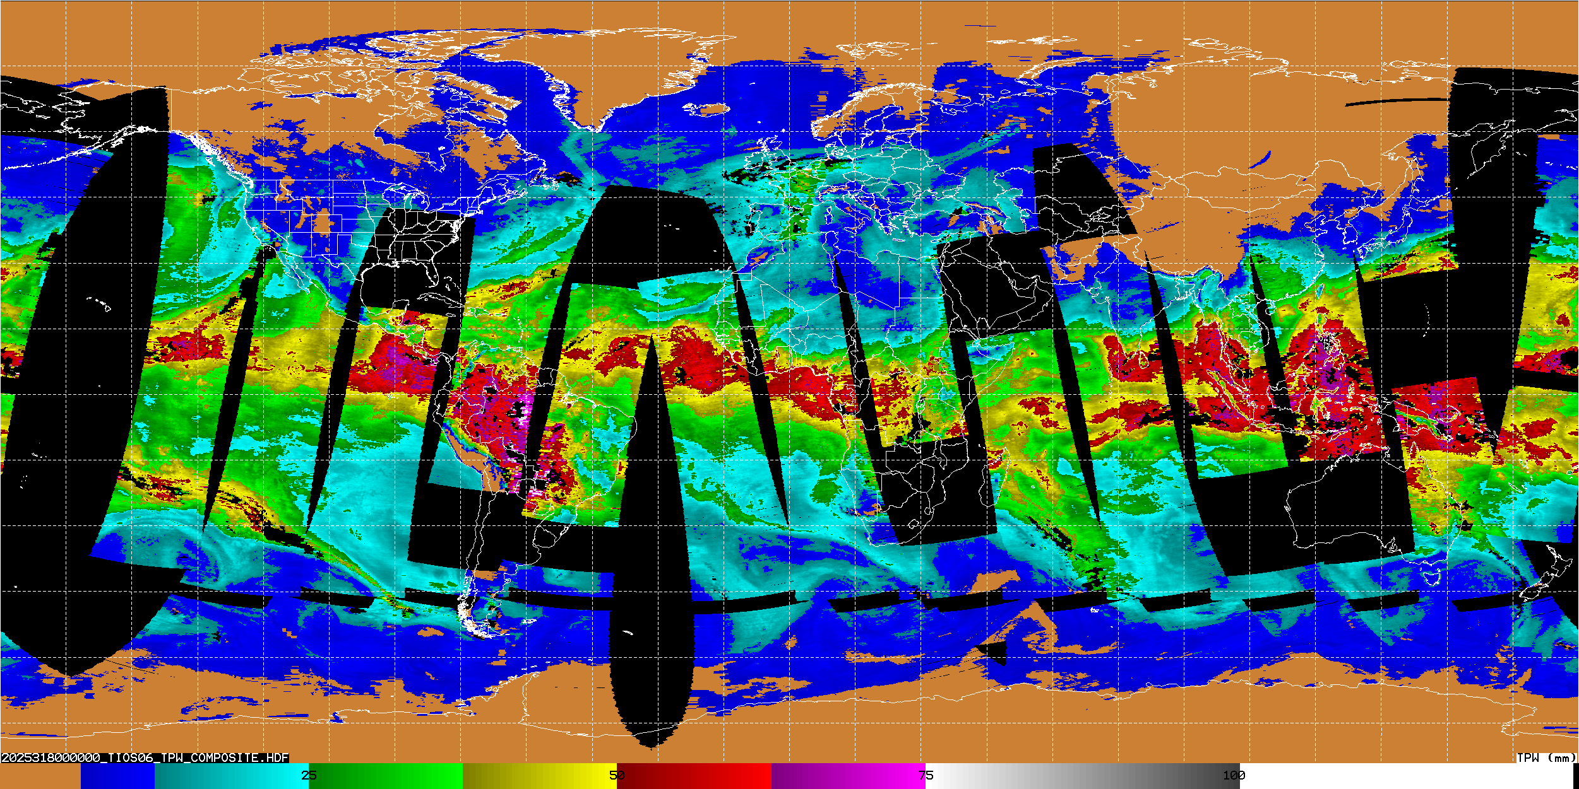
Tomorrow-S6

Slide 5
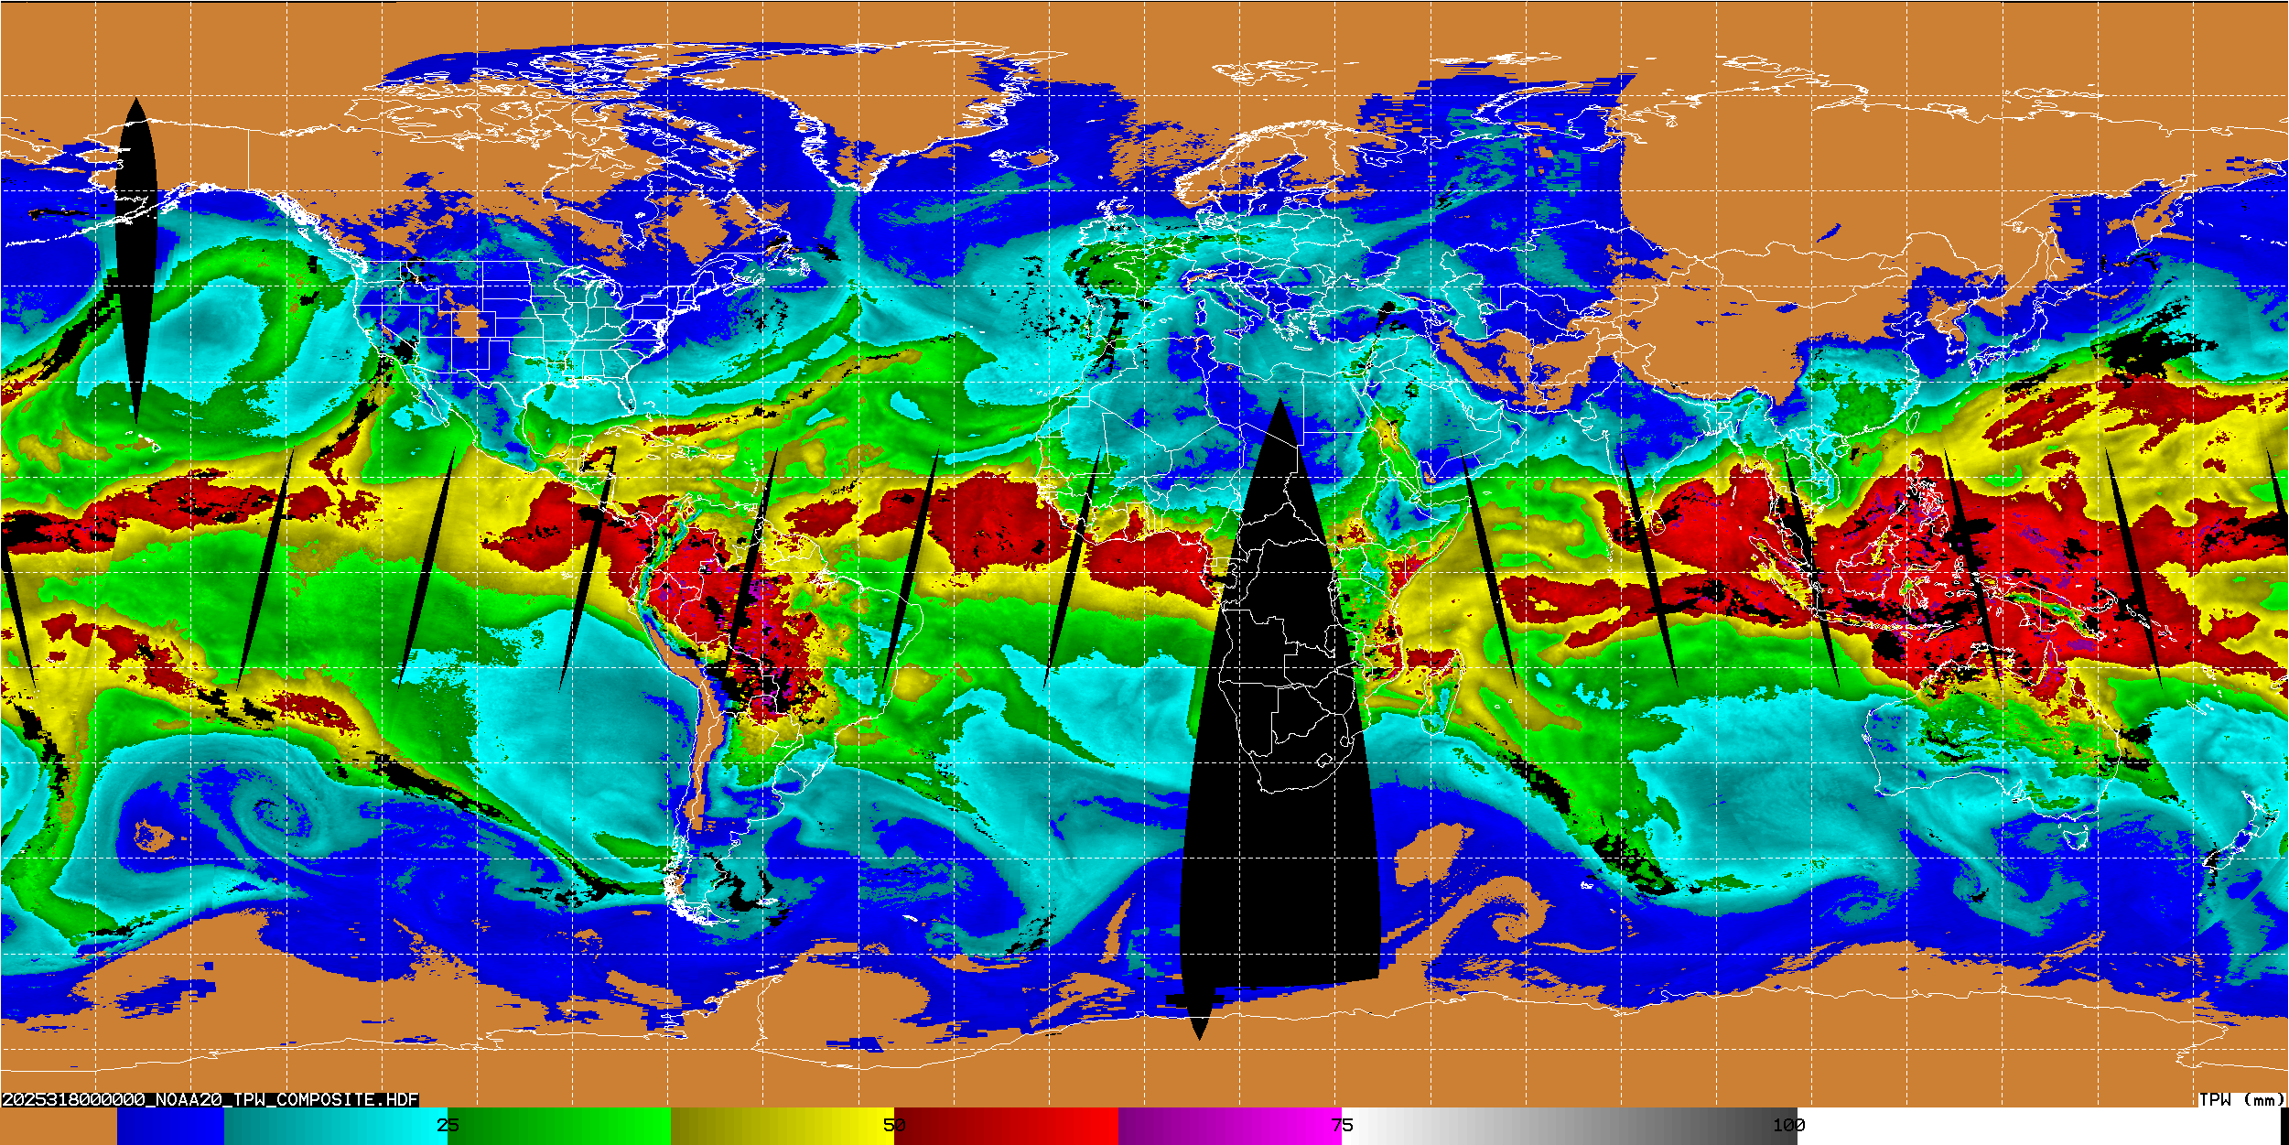
NOAA 20

Slide 6
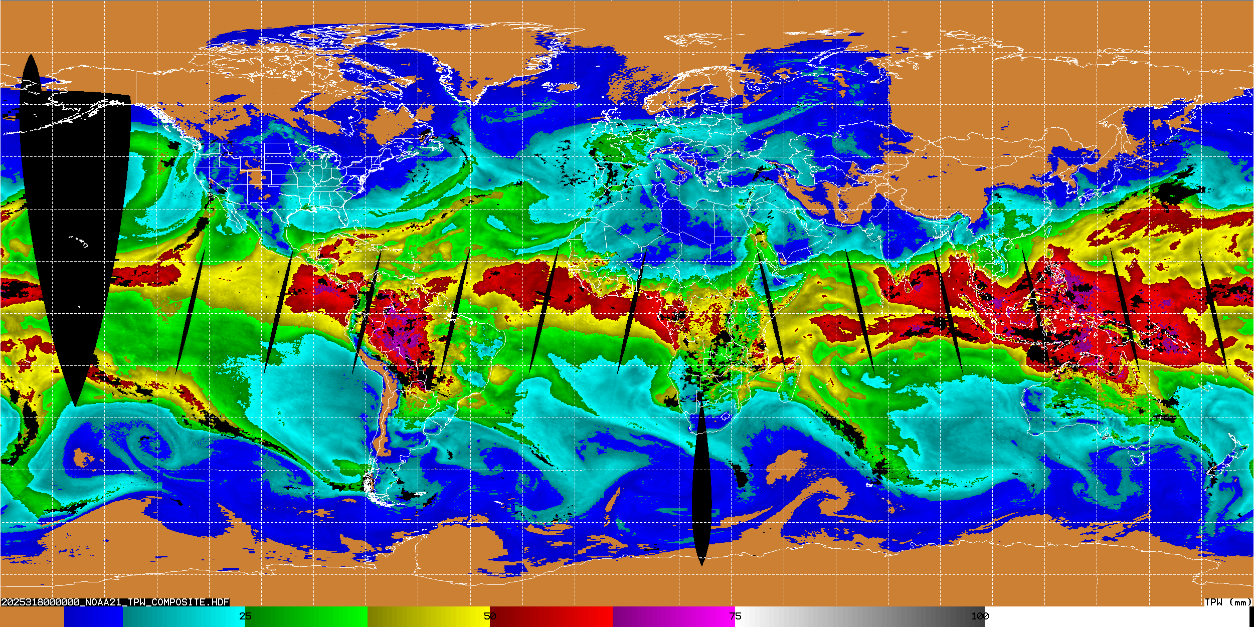
NOAA 21

Slide 7
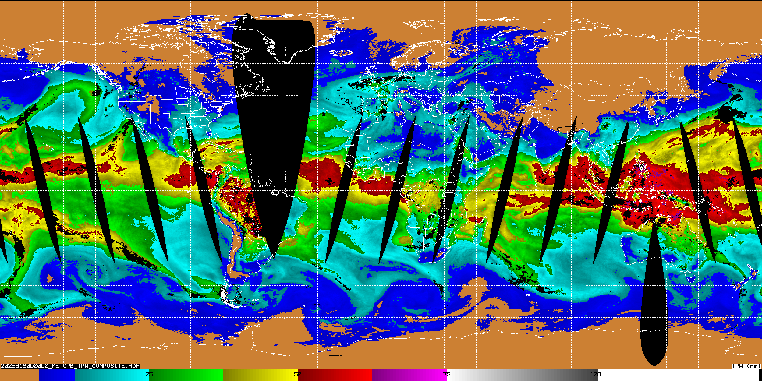
METOP-B

Slide 8
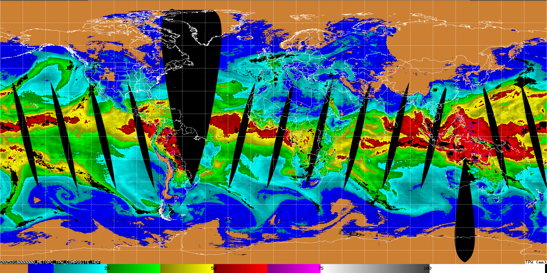
METOP-C

Slide 9
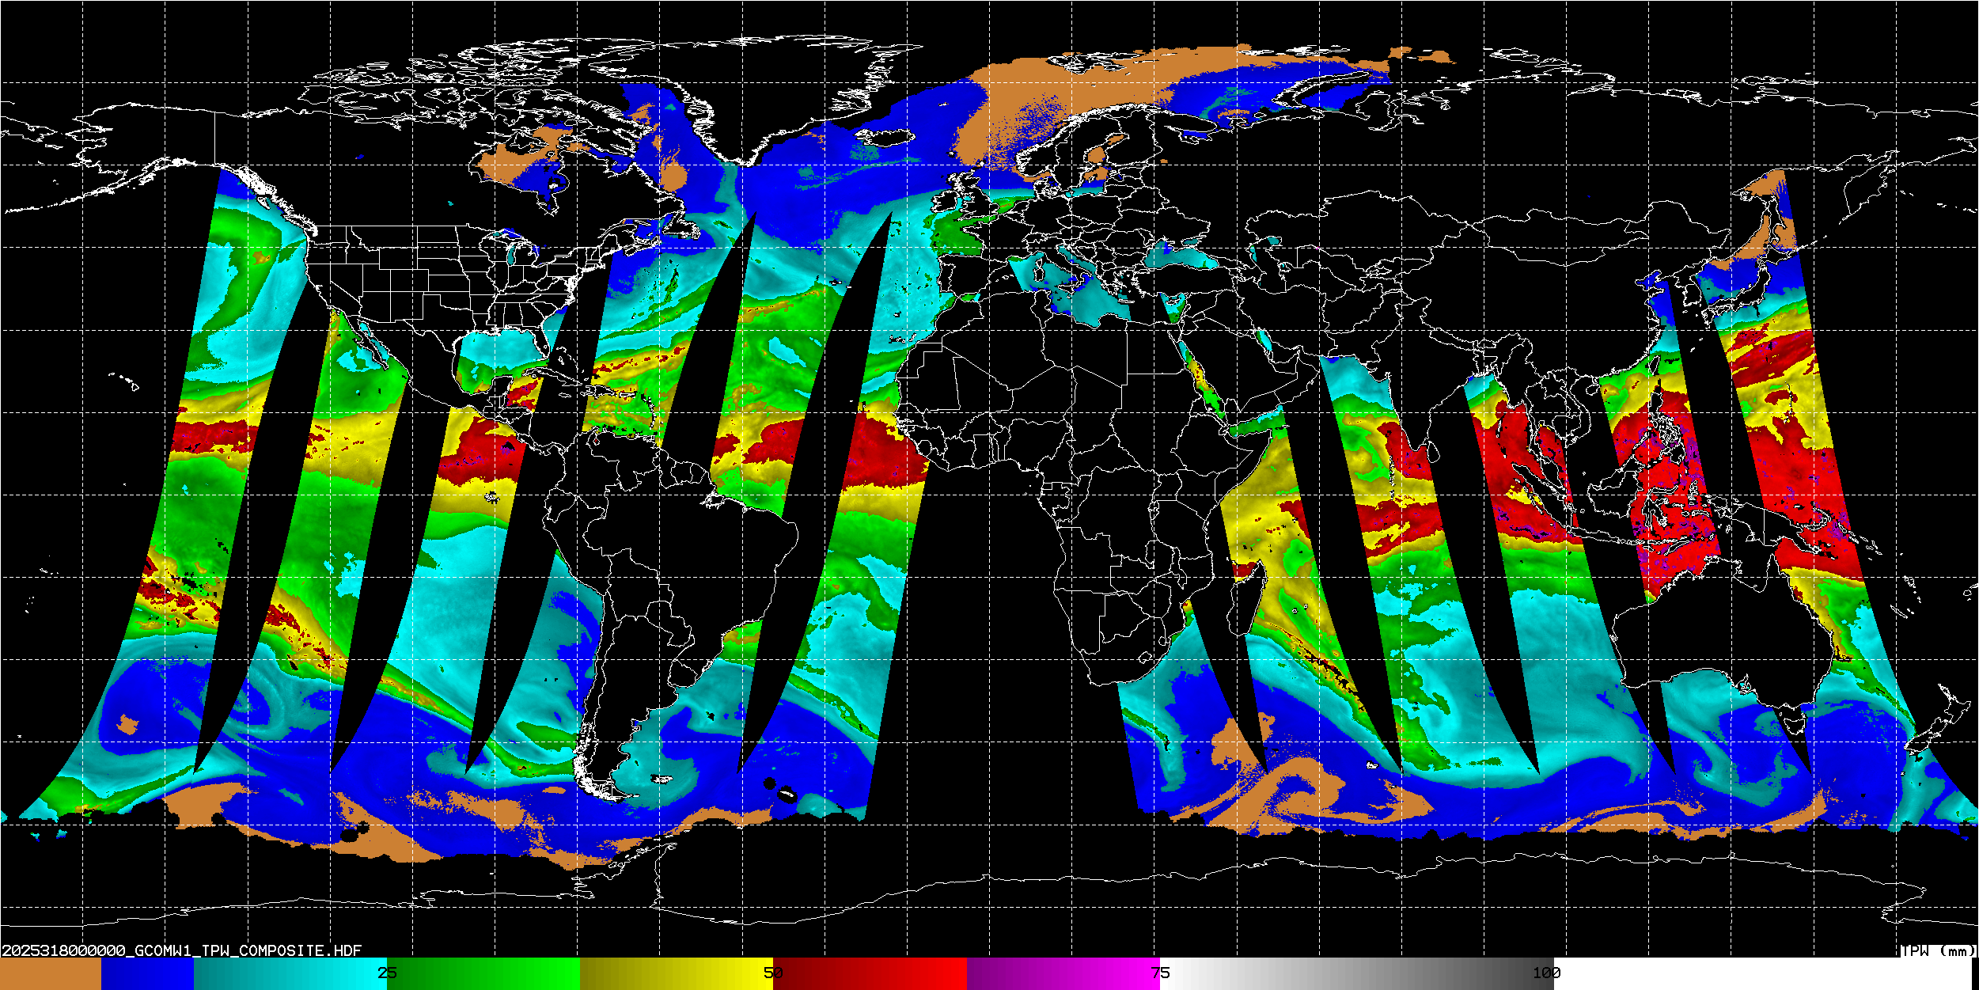
GCOM-W1

Slide 10
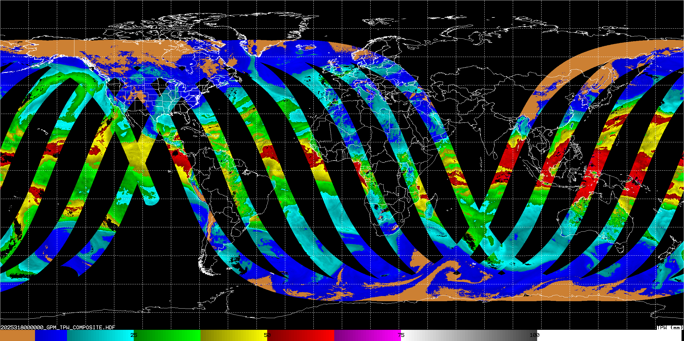
GPM

Slide 11
ALPW Created Using Current Operational Configuration (9 hour reachback)

Slide 12
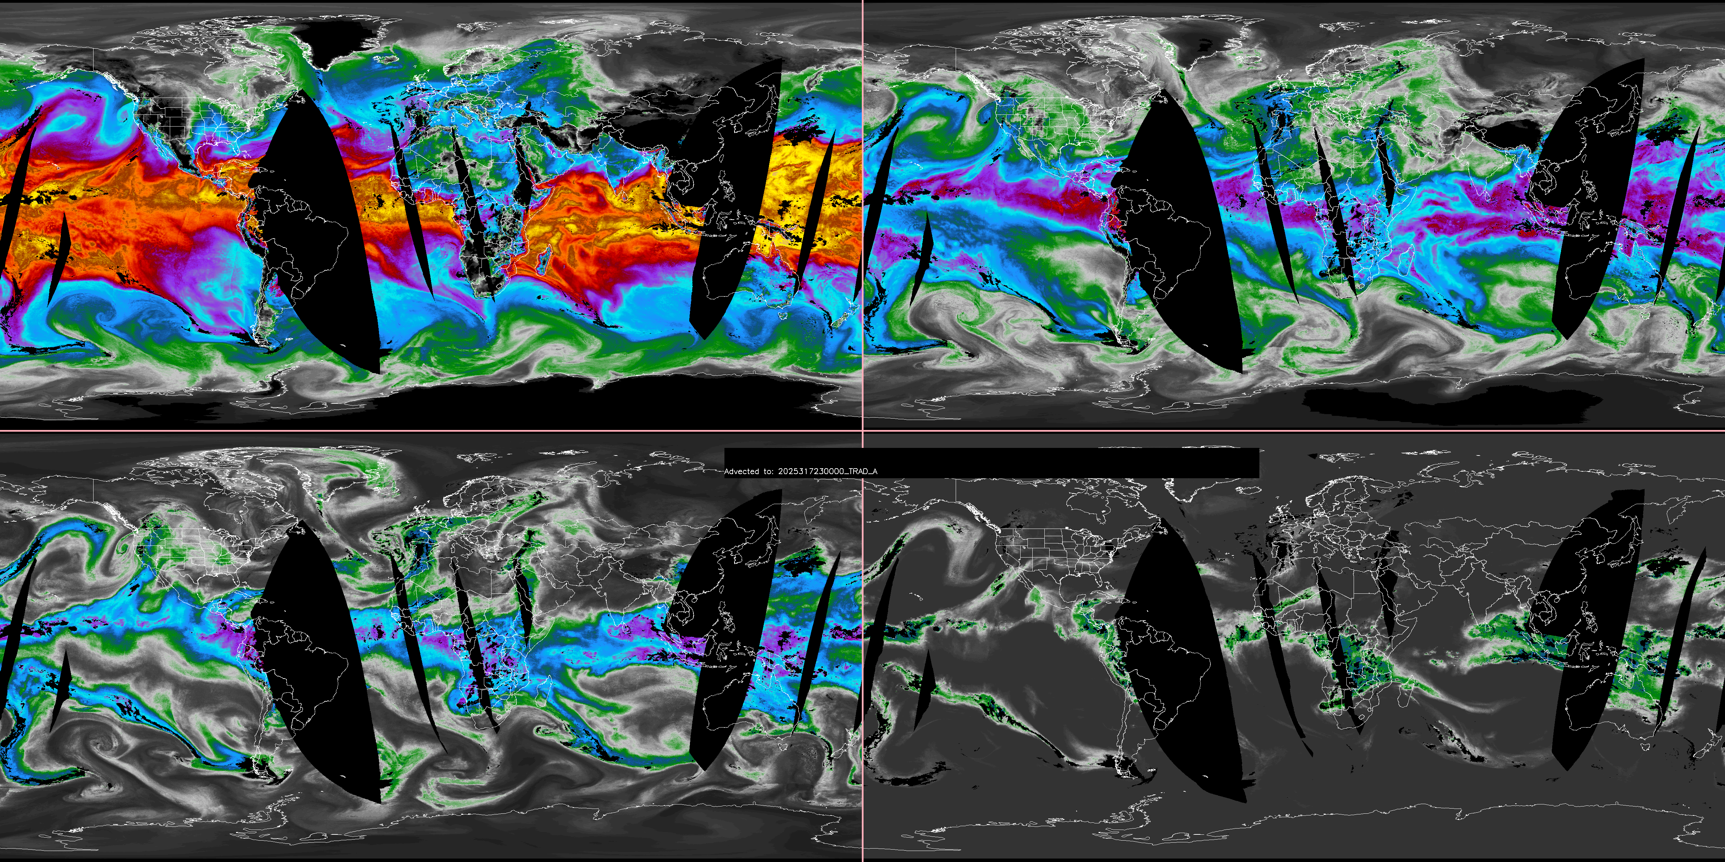
Sfc-850
850-700
700-500
500-300
“Traditional” Advected to 2025-NOV-13 23:00

Slide 13
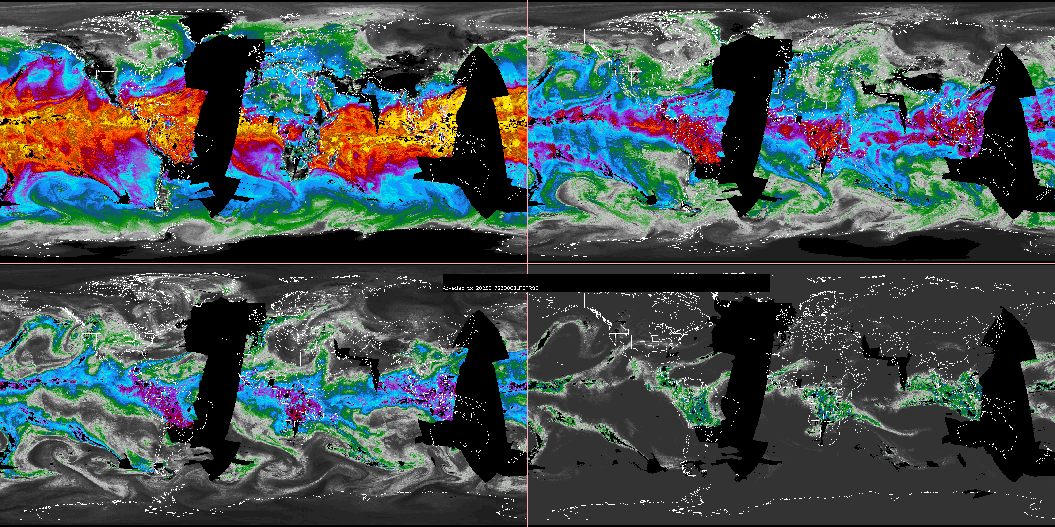
TIO (S02, 05,06) -Only Advected to 2025-NOV-13 23:00

Slide 14
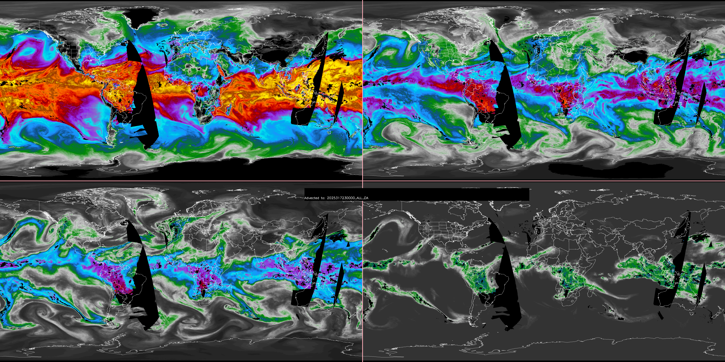
Traditional + TIO Advected to 2025-NOV-13 23:00

