Slide 1

Operational Multisensor Water Vapor Products for Forecasters
John Forsythe
(John.Forsythe@Colostate.edu)
Cooperative Institute for Research in the Atmosphere (CIRA)
Colorado State University
Daniel Bikos, Jack Dostalek, Sheldon Kusselson, Natalie Tourville, Stan Kidder, Jorel Torres
NOAA COLLABORATORS: NOAA Weather Prediction Center,
Daniel Leins (NWS Raleigh, NC), Chris Gitro (NWS Albany, NY), Michael Jurewicz (NWS State College, PA), NOAA MiRS Team
AMS Annual Meeting, Houston TX Jan 26, 2026
Session 4A: Special Topics on Operational Environmental Satellite Systems

Slide 2
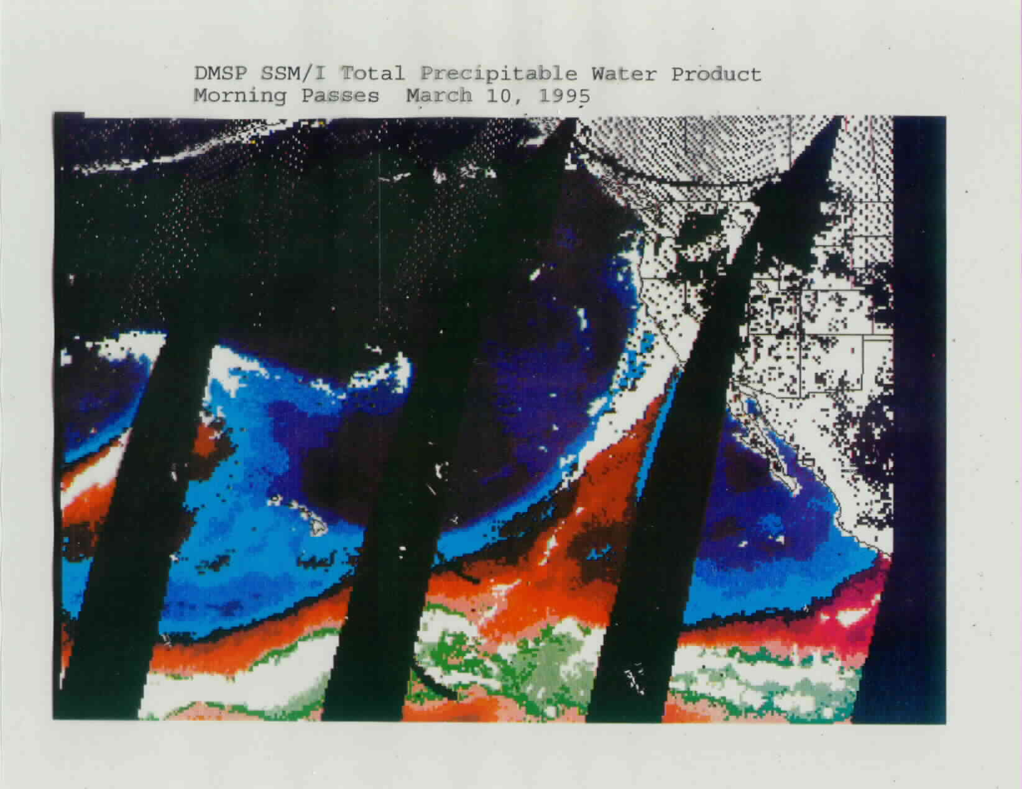
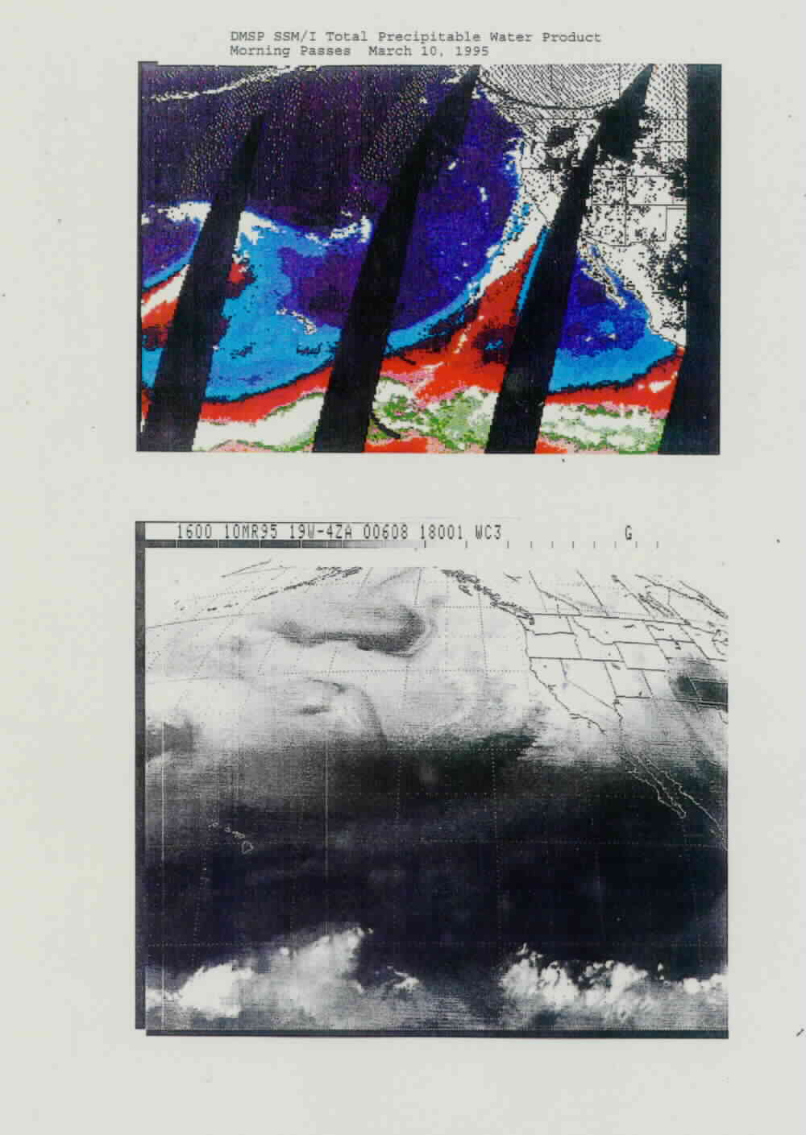
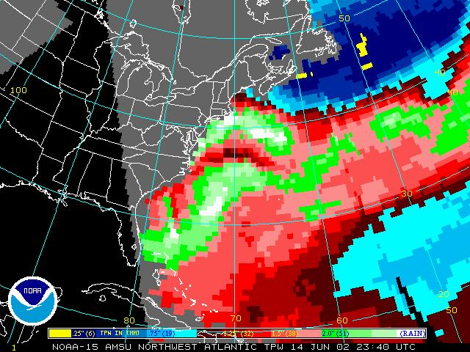
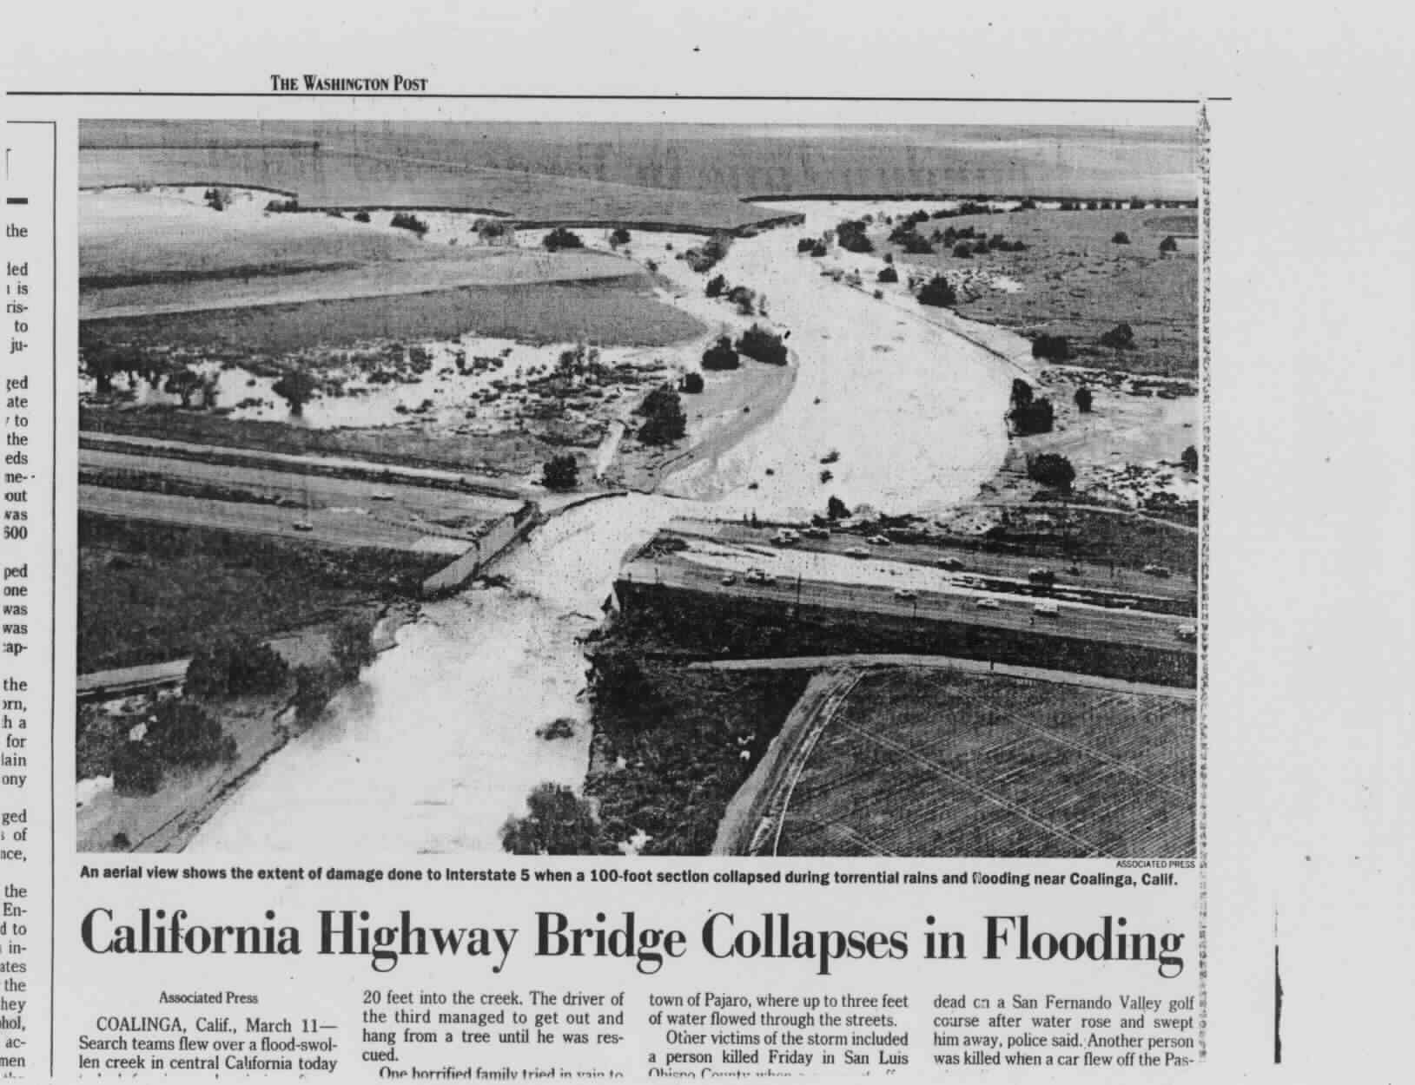
GOES Water Vapor
SSM/I Total Precipitable Water
CA
Mar 10 1995
Atmospheric river not apparent
“The Moment NWS WFO Monterey First Took Serious Notice of Microwave”
The next day…
Morning Mar 10, 1995
Courtesy Sheldon Kusselson

Slide 3
Water Vapor Product | Operational? | Resolution | Comments
Blended TPW | Yes | Hourly 16 km grid
Blended TPW Anomaly | Yes | Hourly 16 km grid | Historical record needs updating
Advected Layer Precipitable Water (ALPW) | Yes | Hourly 16 km grid Four Layers (sfc-850, 850-700, 700-500, 500-300)
ALPW Percentile Ranking | No, but requested to transition | Same as ALPW | Experimental NRT .nc flow to WPC Work in progress on testing historical record (LPW back to 2013, or a reanalysis like MERRA-2)
Layer Vapor Transport (LVT) | No, but requested to transition | Hourly 16 km grid Four Layers (sfc-850, 850-700, 700-500, 500-300) | Experimental NRT .nc flow to WPC

Slide 4
Since the early 1990’s when microwave water vapor products were only available at National Centers, there have been many advances to make them a routine part of forecasting:
Many more satellites carrying microwave sensors
A blended product framework – “one stop shopping” for forecasters (began in 2009)
Sustainment of NOAA Enterprise Microwave Integrated Retrieval System (MiRS); performs retrievals over land!
Vertical profiles enabled layer precipitable water
Advective blending (pioneered by CIMSS MIMIC TPW)
Derived products (percent of normal and percentiles, layer vapor transport)
Training for forecasters via VISIT program

Slide 5
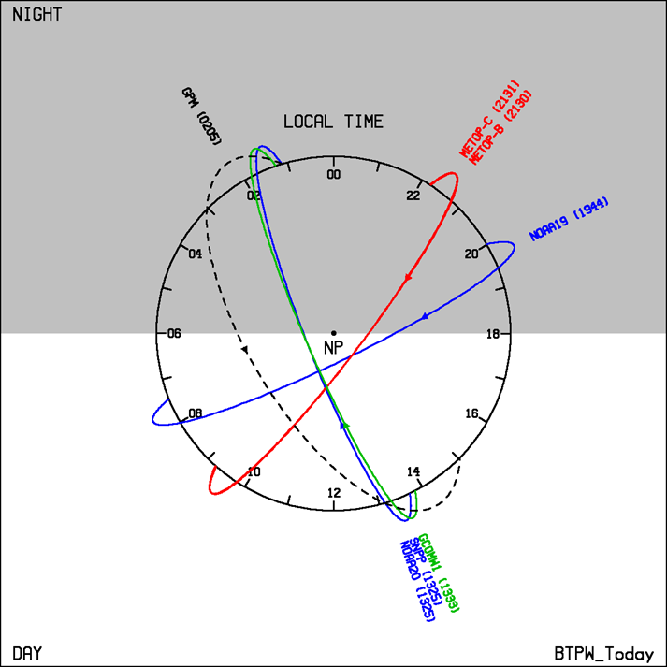
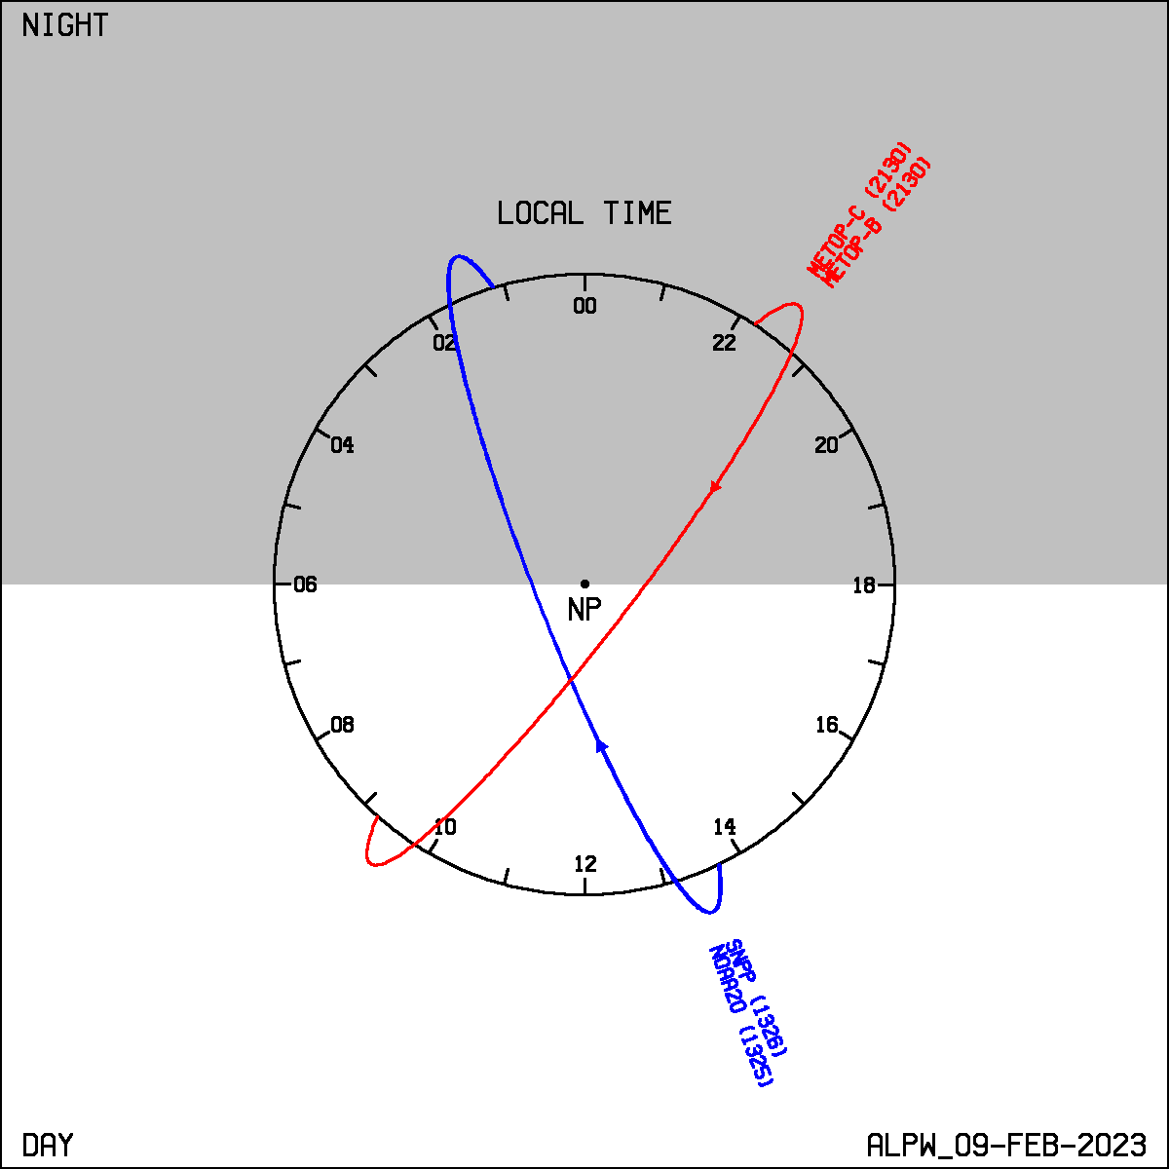
Current LEO Constellations
Blended TPW
ALPW
QuickSounder 2026 will fill a key gap
Blended TPW also uses GOES-E/W and GPS

Slide 6
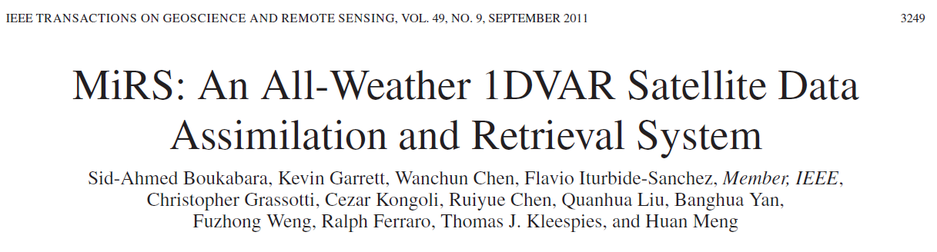
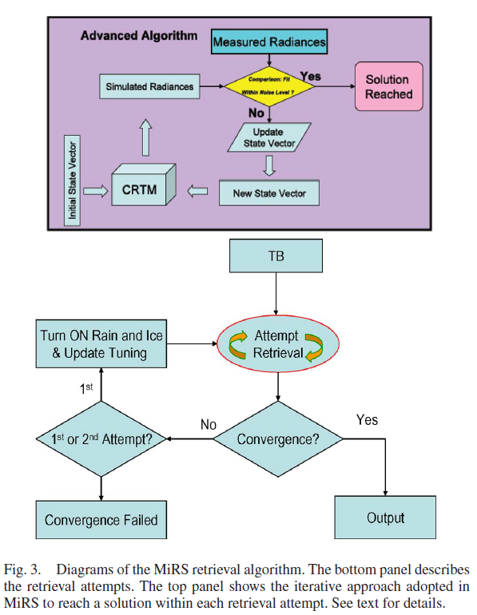
Key Feature: MiRS does not use a dynamic NWP model and performs retrievals in cloudy conditions
NOAA operational MiRS retrieval system used to produce Blended TPW and ALPW
Uses passive microwave data including 183 GHz water vapor absorption line

Slide 7
Examples from Texas Hill Country Flood
4 July 2025

Slide 8
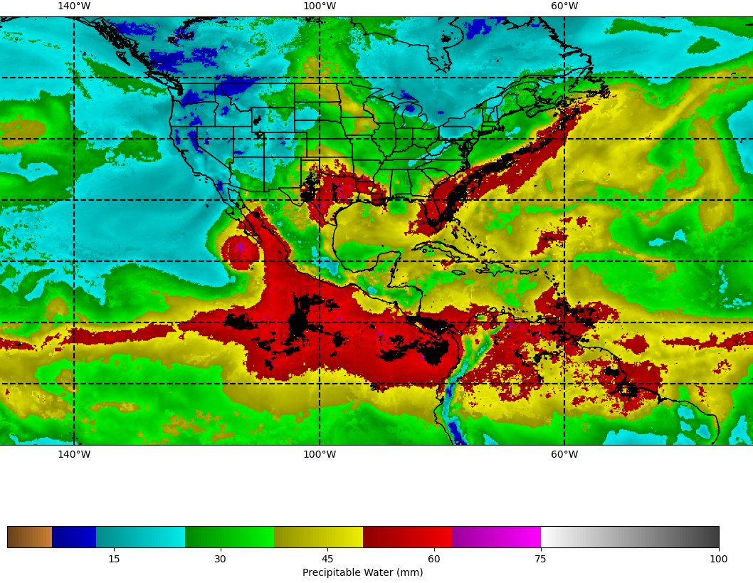
Total Precipitable Water (TPW)
Hurricane Flossie
00 UTC 4 July (~ 8 hours before severe flooding)

Slide 9
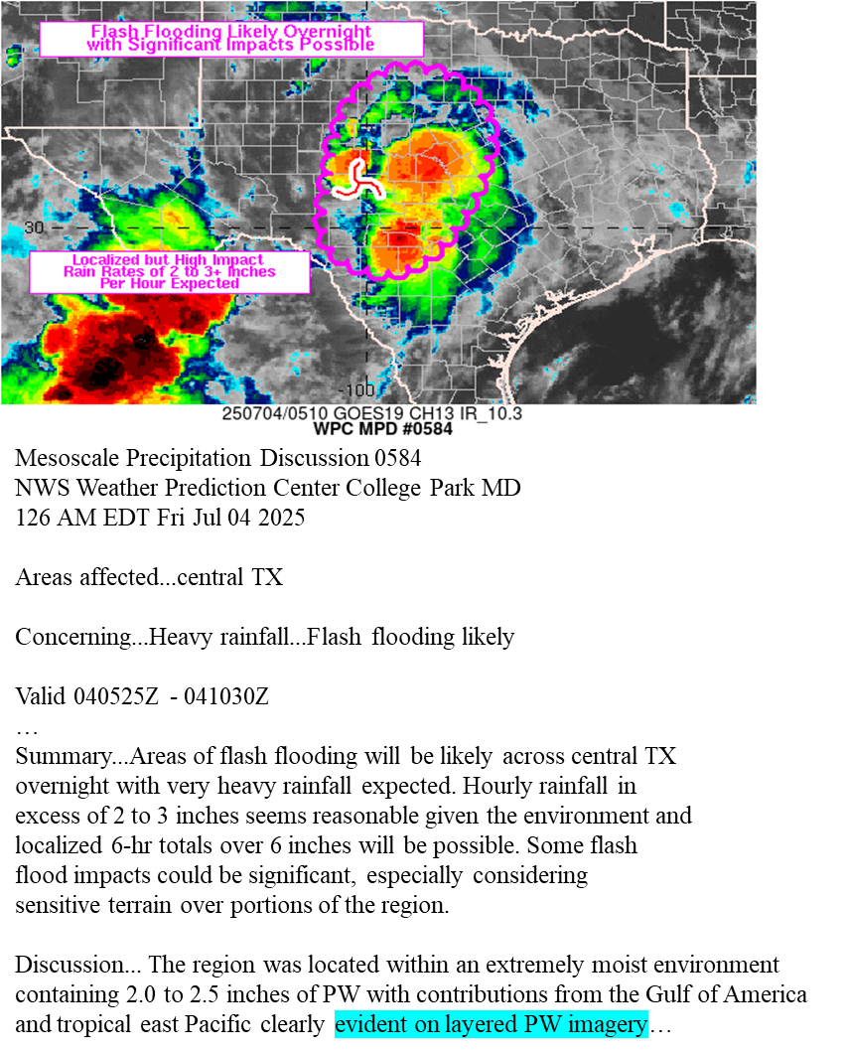
WPC MetWatch Desk is a heavy user of blended satellite water vapor products

Slide 10
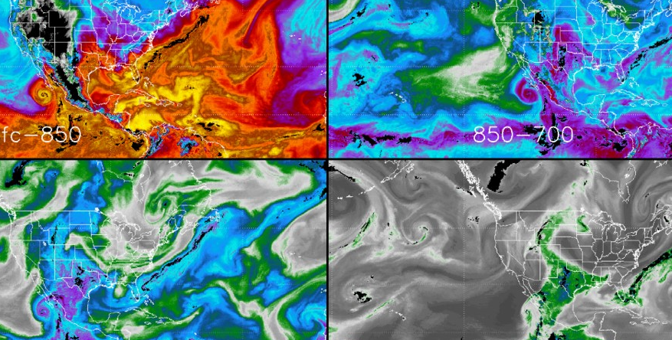

Advected Layer Precipitable Water (ALPW)
Sfc-850
850-700
Layer Precipitable Water (mm)
700-500
500-300
Mid-Upper Moisture from EPAC
00 UTC 4 July 2025

Slide 11
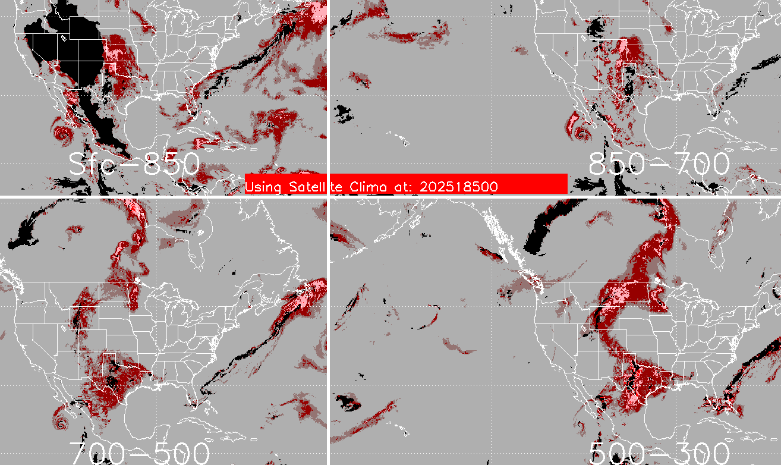

Percentile Ranking Based on 2013-2024 Satellite LPW
Sfc-850
850-700
700-500
500-300
00 UTC 4 July 2025

Slide 12
Advected Layer Precipitable Water (ALPW)
Sfc-850
850-700
TC Flossie
Layer Precipitable Water (mm)
700-500
500-300
Mid-Upper Moisture from EPAC
00 UTC 4 July 2025

Slide 13
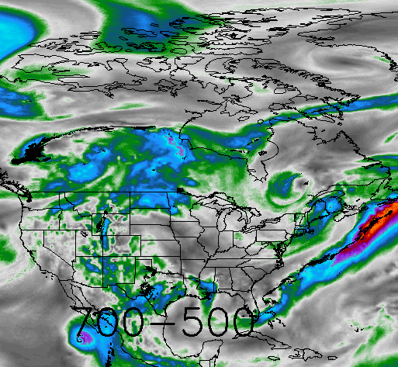

Experimental 700-500 mb Layer Vapor Transport
00 UTC 4 July 2025

Slide 14
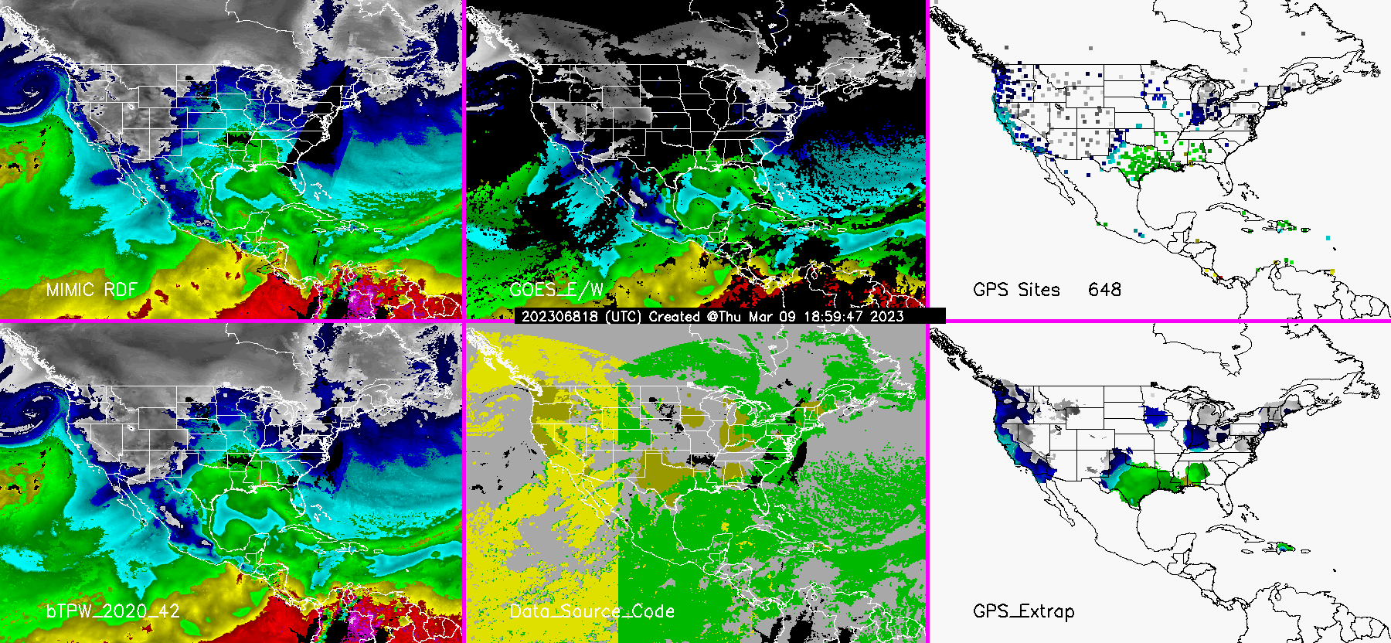

New Version of Blended TPW Operational February 2025
While ALPW is Microwave-Only, Blended TPW Uses Microwave, GOES infrared and Surface GPS Data.
MIMIC
GOES E/W
GPS Sites (via MADIS)
New Product V4.0
Data Source Code
GPS extrapolated
Hourly Loop at https://cat.cira.colostate.edu/btpw_2020/

Slide 15
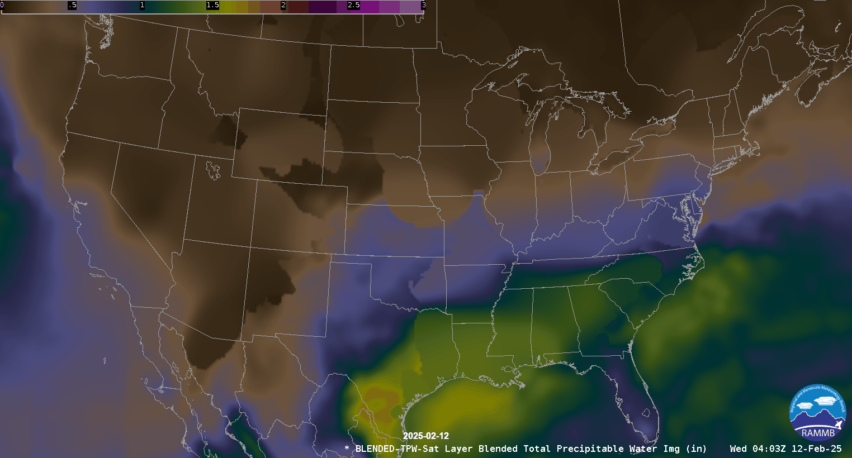
Transition from V3.0 to V4.0 Operational Blended TPW
Note smoother flow at end as V4.0 is implemented
Feb 12 -13, 2025

Slide 16
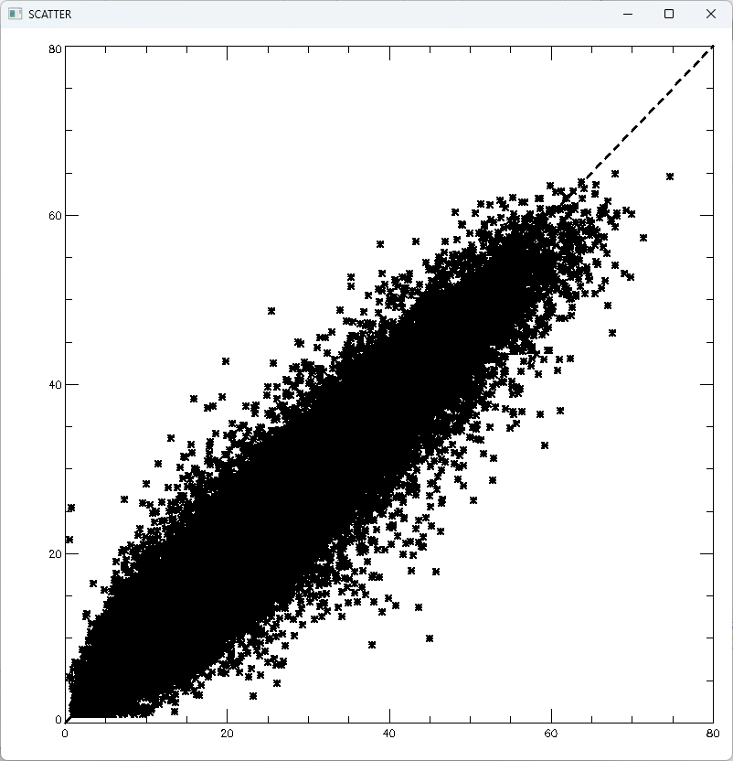
V 3.0 BTPW -
CONUS
Sept. 2022 – Sept 2023 Raob vs BTPW
Blended TPW (mm)
Radiosonde TPW (mm)

Slide 17
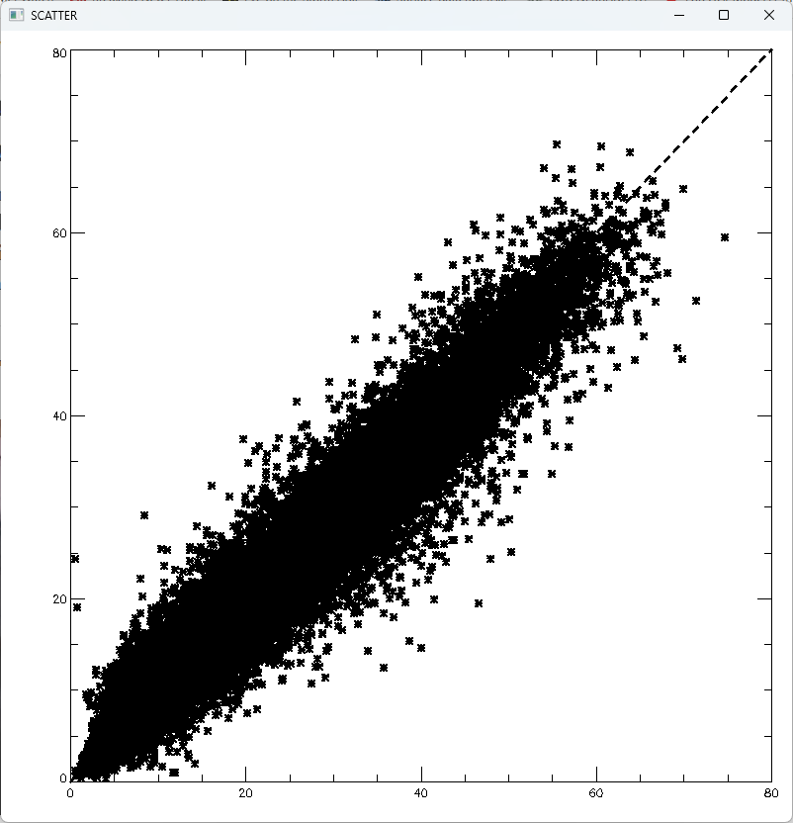
New V4.0 - CONUS
Sept. 2022 – Sept 2023 Raob vs BTPW
Blended TPW (mm)
Radiosonde TPW (mm)

Slide 18
25% improvement
Sept 2022 – Sept 2023 | V3.0 BTPW | BTPW New V4.0
RMS (mm) - CONUS | 3.9 (n=46477) | 3.0 (n=44809)
Bias (mm) - CONUS | -1.2 | -0.8
RMS (mm) - Global | 4.5 (n=193319) | 4.1 (n=169244)
Bias (mm) - Global | -0.2 | -0.4
r² – CONUS | 0.92 | 0.95
r² – Global | 0.92 | 0.92

Slide 19
Summary:
Three operational multisensor satellite water vapor products and two more (LVT, Percentile) potentially transitioning.
Blended TPW upgrades have improved RMS error by 25%
Useful to show moisture flows for heavy precipitation.
Future: Can smallsats with microwave radiometers improve the products?
https://www.cira.colostate.edu/science-stories/understanding-flood-danger-both-imminent-and-in-the-future-cira-researchers-at-the-forefront/
Hourly .nc operational files available at :
https://noaa-jpss.s3.amazonaws.com/index.html

Slide 20
Links
https://cat.cira.colostate.edu/SPoRT/Layered/Advected/ALPW_Hourly.htm <- ALPW CONUS Hourly
http://cat.cira.colostate.edu/ALPX/ALPW_Percentile/index.html <- LPW 5th, 95, 99th and max percentiles
http://cat.cira.colostate.edu/ALPX/LVT/lvt.htm <- ALPW vapor transport (GFS winds)
http://cat.cira.colostate.edu/ALPX/ADVLUT/ALPX_ADVLUT_212.png <- full resolution global 4-panel image (Large)
https://rammb-slider.cira.colostate.edu/?sat=goes-18 <- GOES-West view, use menu for ALPW layers

Slide 21
Backup Slides

Slide 22
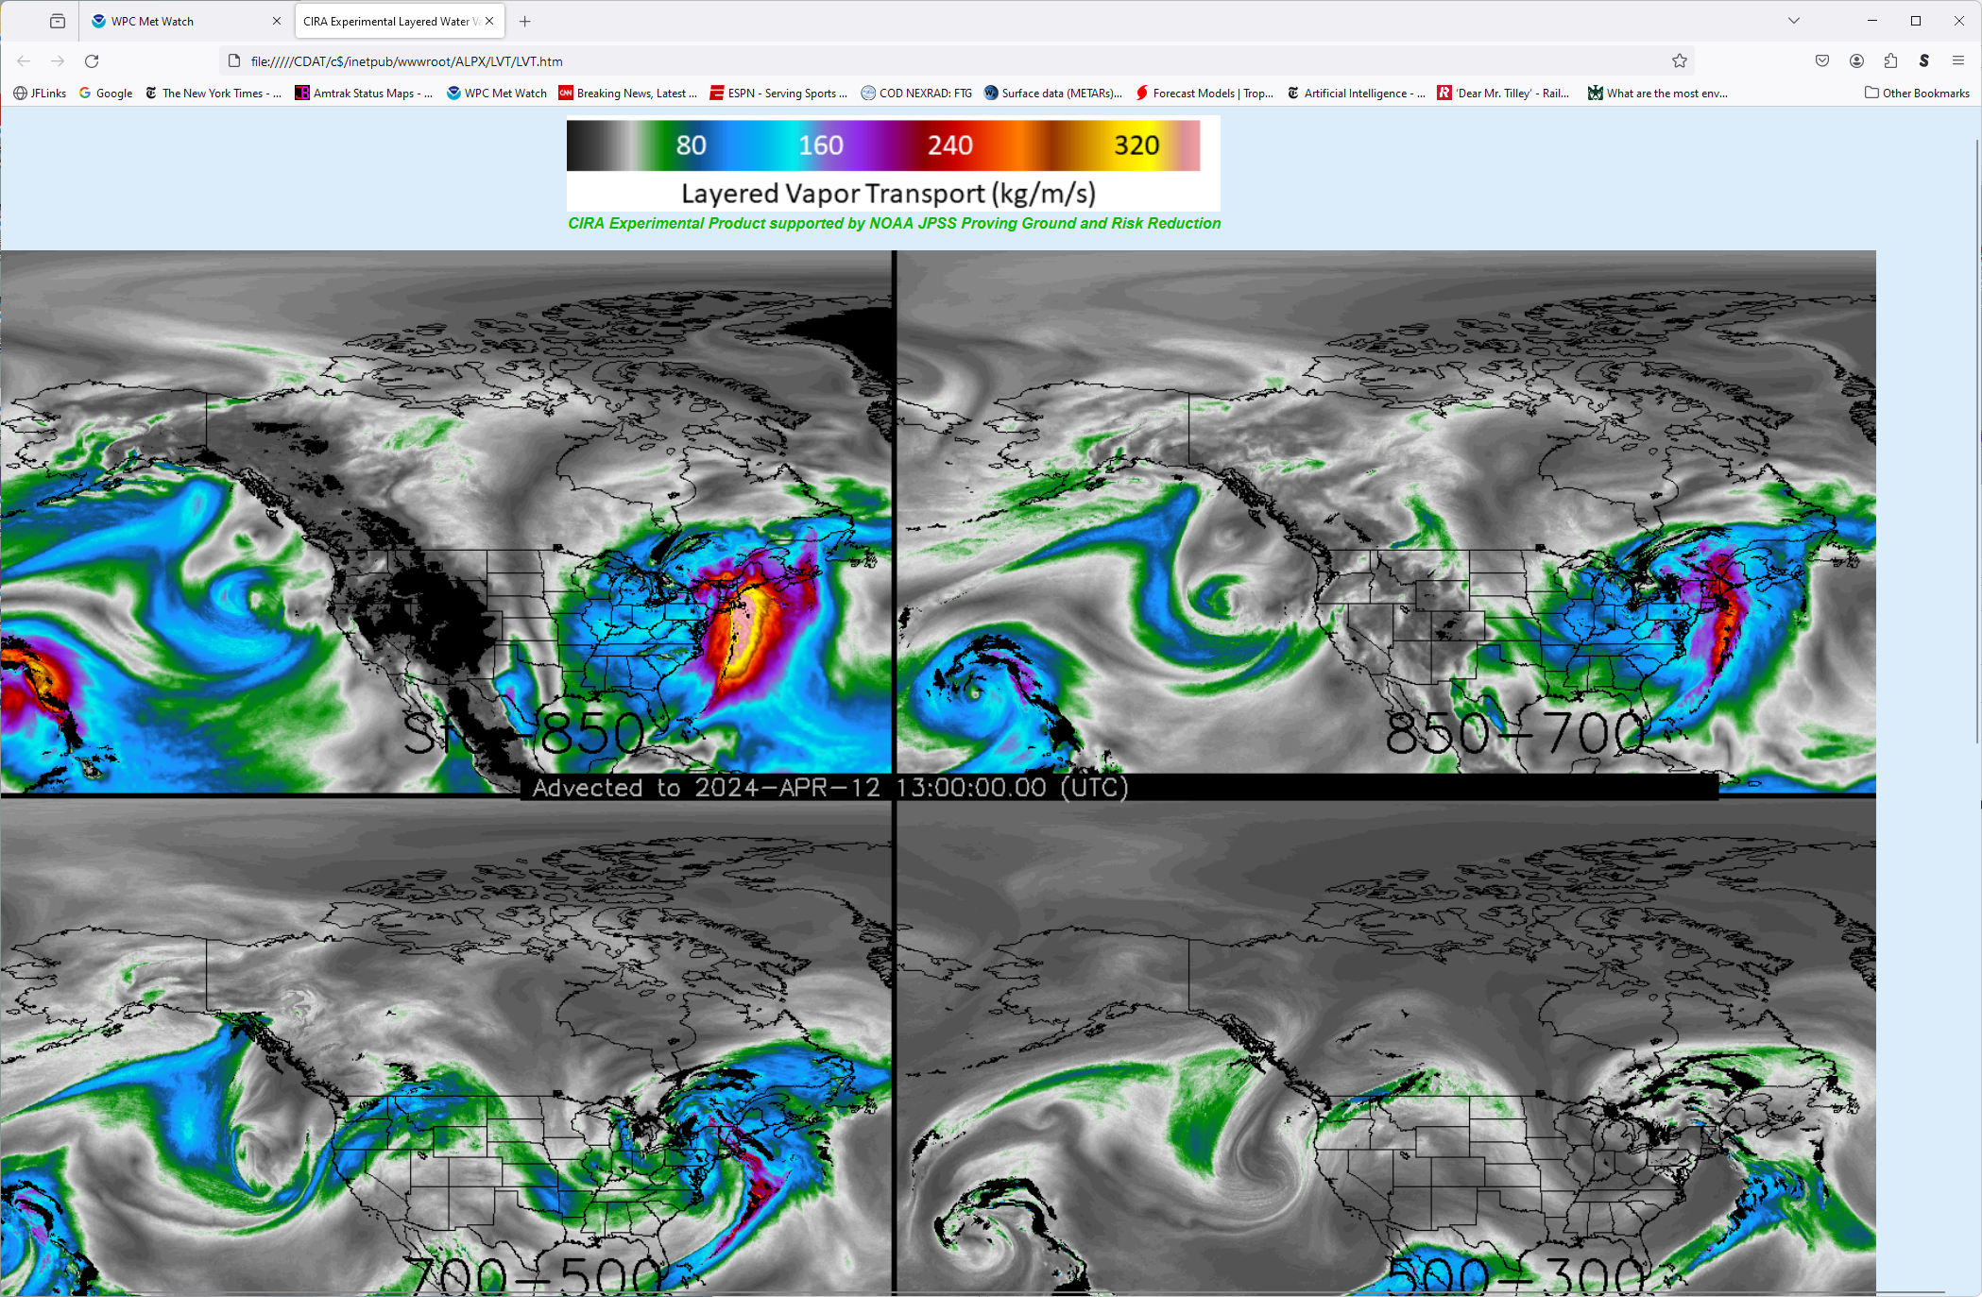
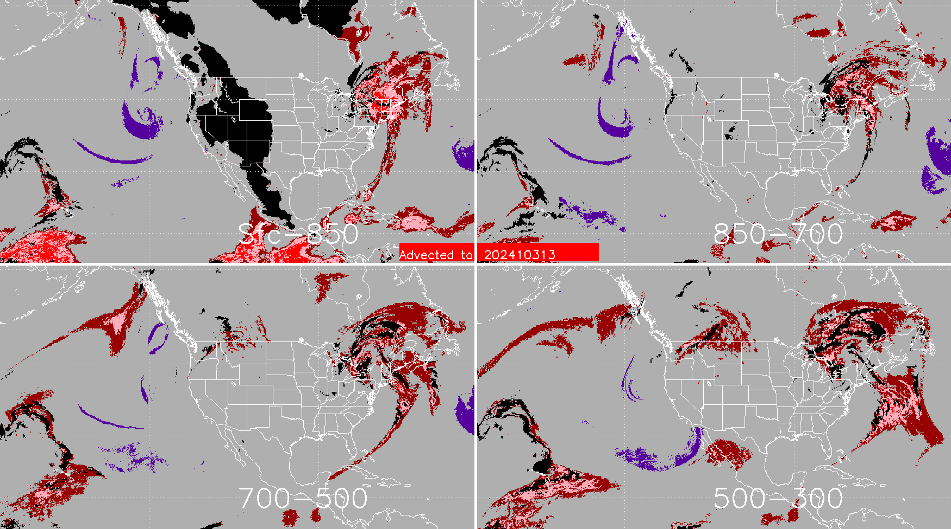
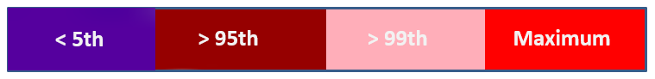
Working towards getting forecasters to routinely use the products…
Mesoscale Precipitation Discussion 0155
NWS Weather Prediction Center College Park MD
845 AM EDT Fri Apr 12 2024
Areas affected...Northern New England
Concerning...Heavy rainfall...Flash flooding likely
Valid 121245Z - 121845Z
…
DISCUSSION...A deep layer trough of low pressure continues to
advance into the Northeast U.S. this morning with a surge of
strong warm air advection and moisture transport lifting up across much of New England. In fact, a warm front continues to surge northward across the interior of New England which is yielding the arrival of a notably warm/moist airmass in off the western Atlantic Ocean…
The early morning CIRA-ALPW data shows the LPW in the SFC/700mb layer exceeding the 95th percentile of climatology, and this will play a key role in conjunction with a southerly low-level jet of 50 to 60+ kts in driving efficient rainfall processes for elevated rainfall rates. The CIRA-LVT magnitudes below 700 mb are particularly strong right now nosing up across areas of
central/eastern MA and southern NH, with magnitudes exceeding 300 kg/m/s.
…
Orrison
ATTN...WFO...BOX...CAR...GYX...
ATTN...RFC...NERFC...NWC
“These were very helpful in assessing the heavy rainfall evolution that was unfolding on the morning of April 12th.”
- Andrew Orrison, WPC
Sfc-850
850-700
Sfc-850
850-700
Percentile Ranking 2013-2023
13 UTC 12 April 2024

Slide 23
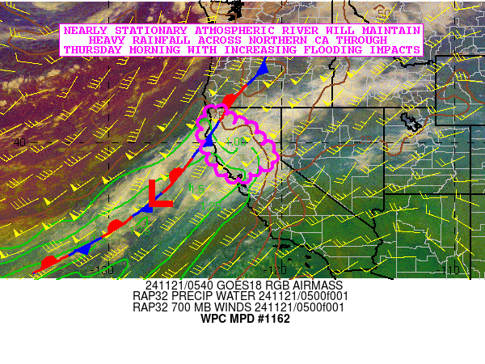
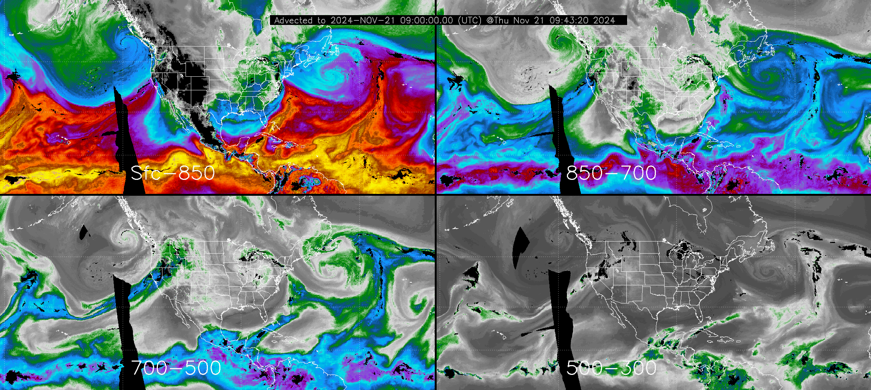
Hourly Advected Layer Precipitable Water (ALPW) –
Now operational!
Mesoscale Precipitation Discussion 1162
NWS Weather Prediction Center College Park MD
100 AM EST Thu Nov 21 2024
Areas affected...Northern California
Concerning...Heavy rainfall...Flash flooding possible
Valid 210600Z - 211800Z
SUMMARY...Nearly stationary atmospheric river will maintain heavy
rainfall across northern CA through Thursday morning with
increasing concerns for widespread areal flooding and possibly
some burn scar flash flooding.
DISCUSSION...The latest GOES-W Airmass RGB satellite imagery in
conjunction with CIRA-ALPW data shows a well-defined atmospheric
river and an associated front currently stalled over northern CA
and the adjacent offshore waters extending southwestward off the
West Coast…
Sfc-850
850-700
700-500
500-300
Layer Precipitable Water (mm)

Slide 24
“Water vapor is a limiting factor in the amount of extreme precipitation more than the intensity of the weather causing the event” (Kunkel et al. 2020)
Compared > 3000 Co-op stations to NCEP and MERRA-2 reanalysis from 1949 – present.
Noted disproportionately large effect on extreme precipitation at higher TPW values

Slide 25
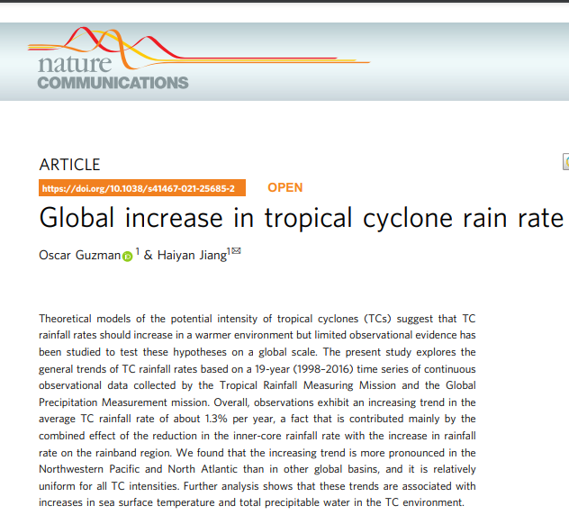
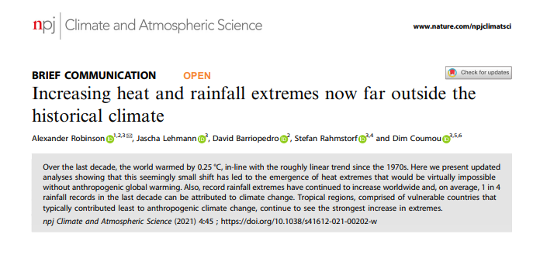
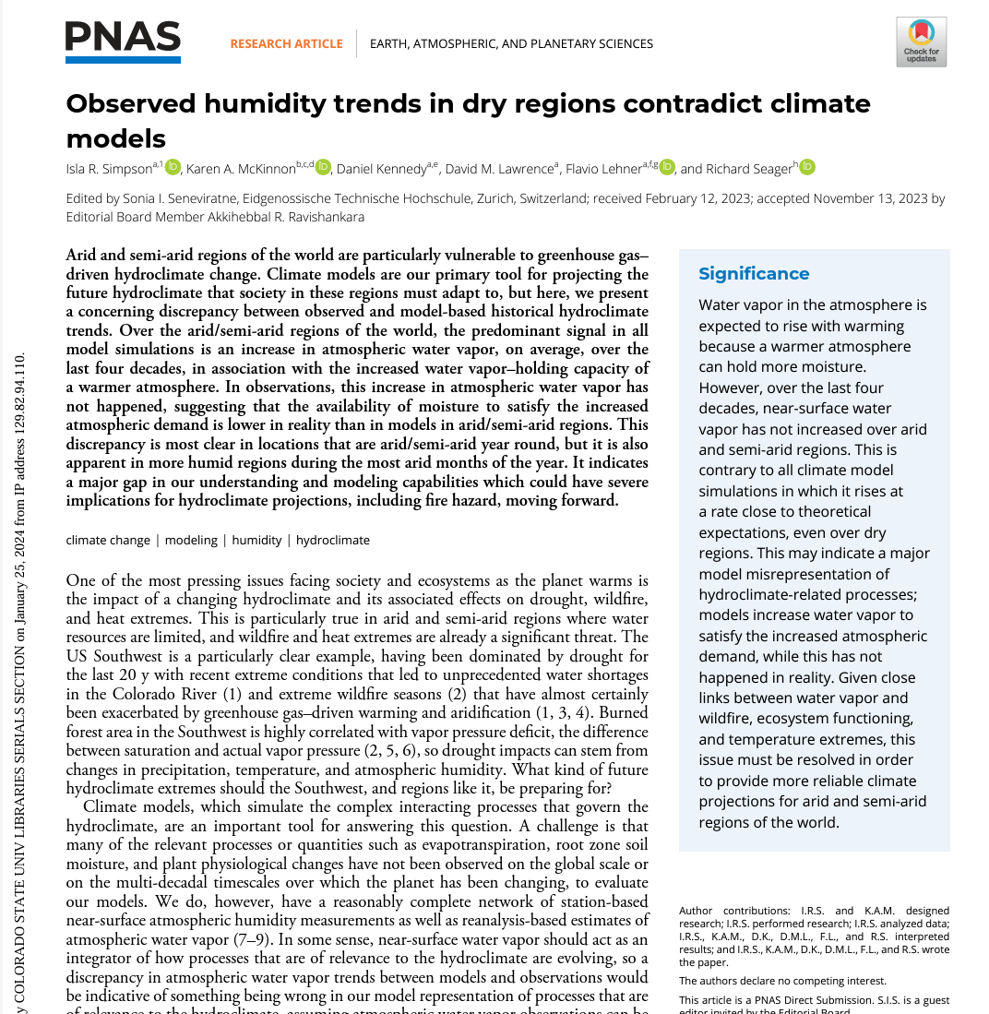
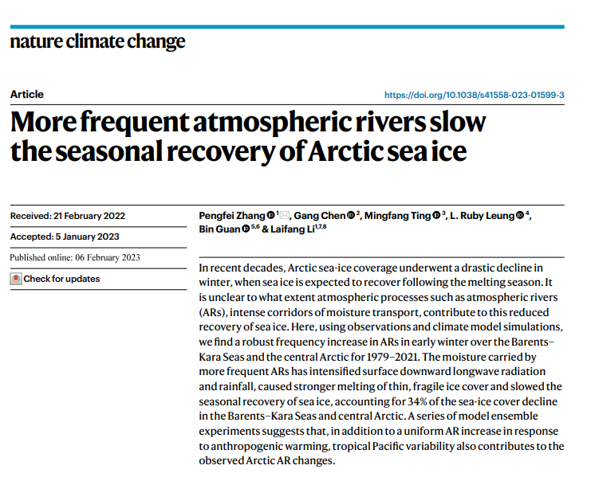
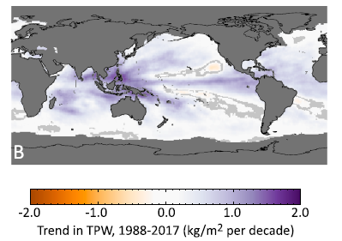
Water Vapor Fuels Climate Change Impacts
Global Mean TPW is ~26 mm
+1.5% / decade increase over global oceans observed (Mears et al 2018)
Highest I’ve ever observed is 91 mm (GPS site, Slidell LA, Hurricane Katrina)
Mears et al, 2018, Earth and Space Sciences

Slide 27
Challenge – Passive Microwave Sensors Do Not Sample at Regular Intervals
Polar MiRS constellation when ALPW operations commence (expect Fall 2024)
QuickSounder will fill a key gap
Currently, 9 hour reachback window used for each hourly analysis
SmallSats in other planes welcome!
MetOp-B/C
NOAA QuickSounder ~2026 launch
Advection Fills in Between Satellite Overpasses
Key point – undesirable periods of high and low sampling throughout the day
NOAA-20/21

Slide 28
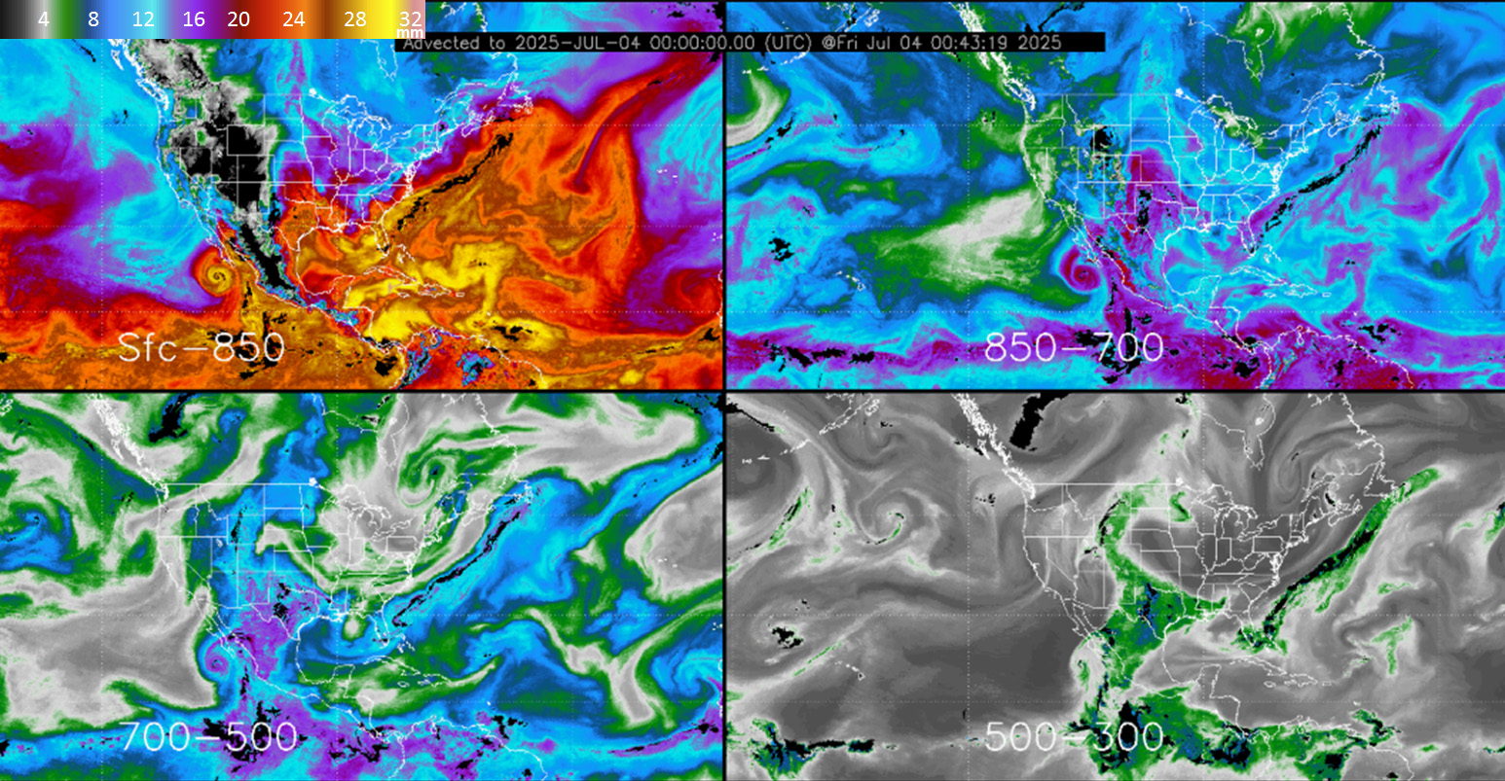

Slide 29
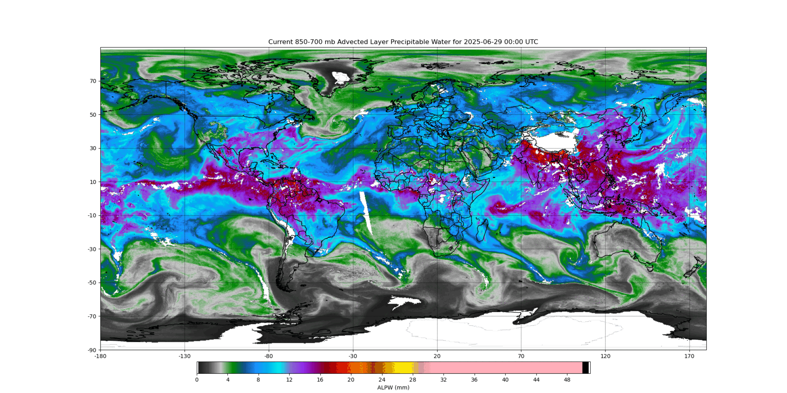
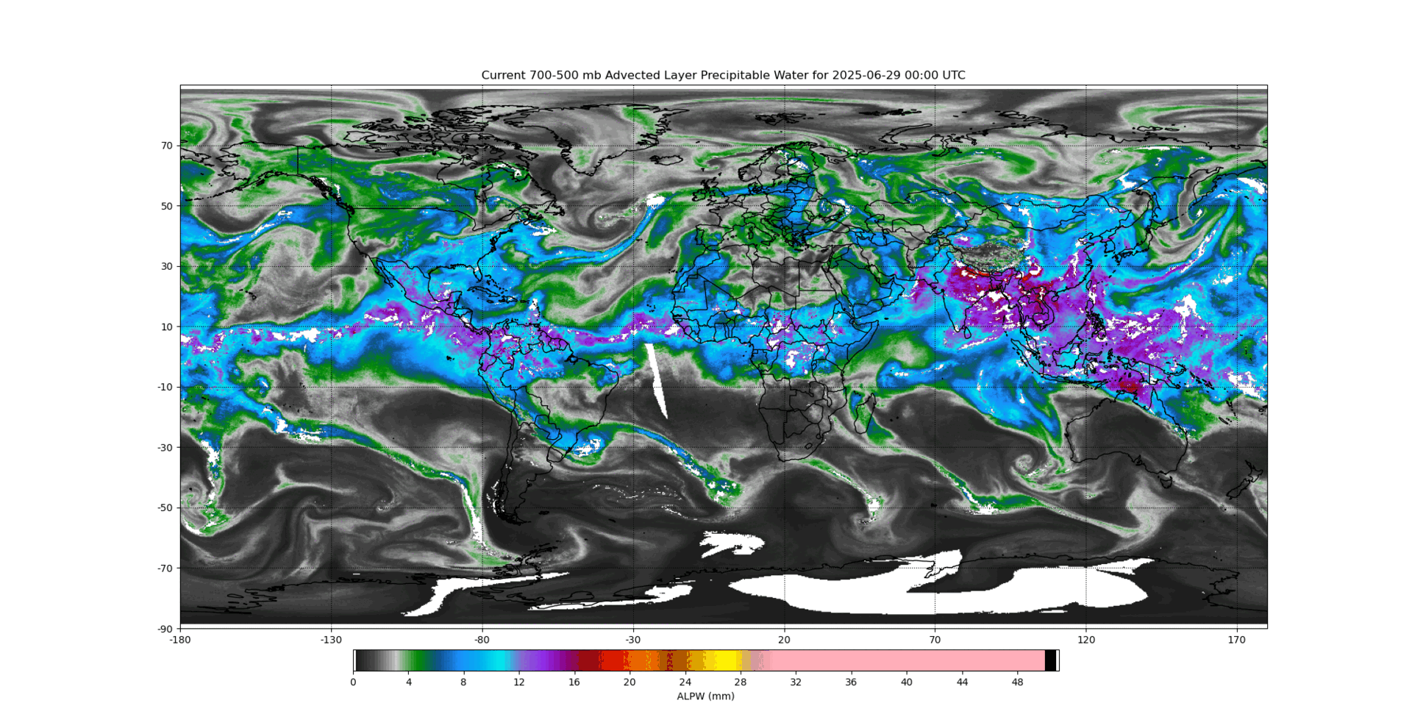
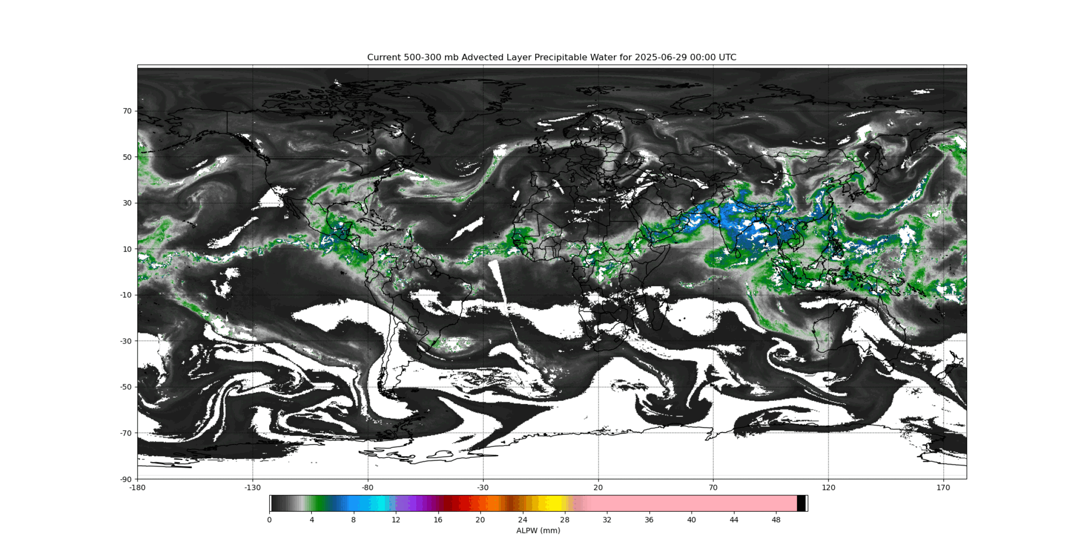
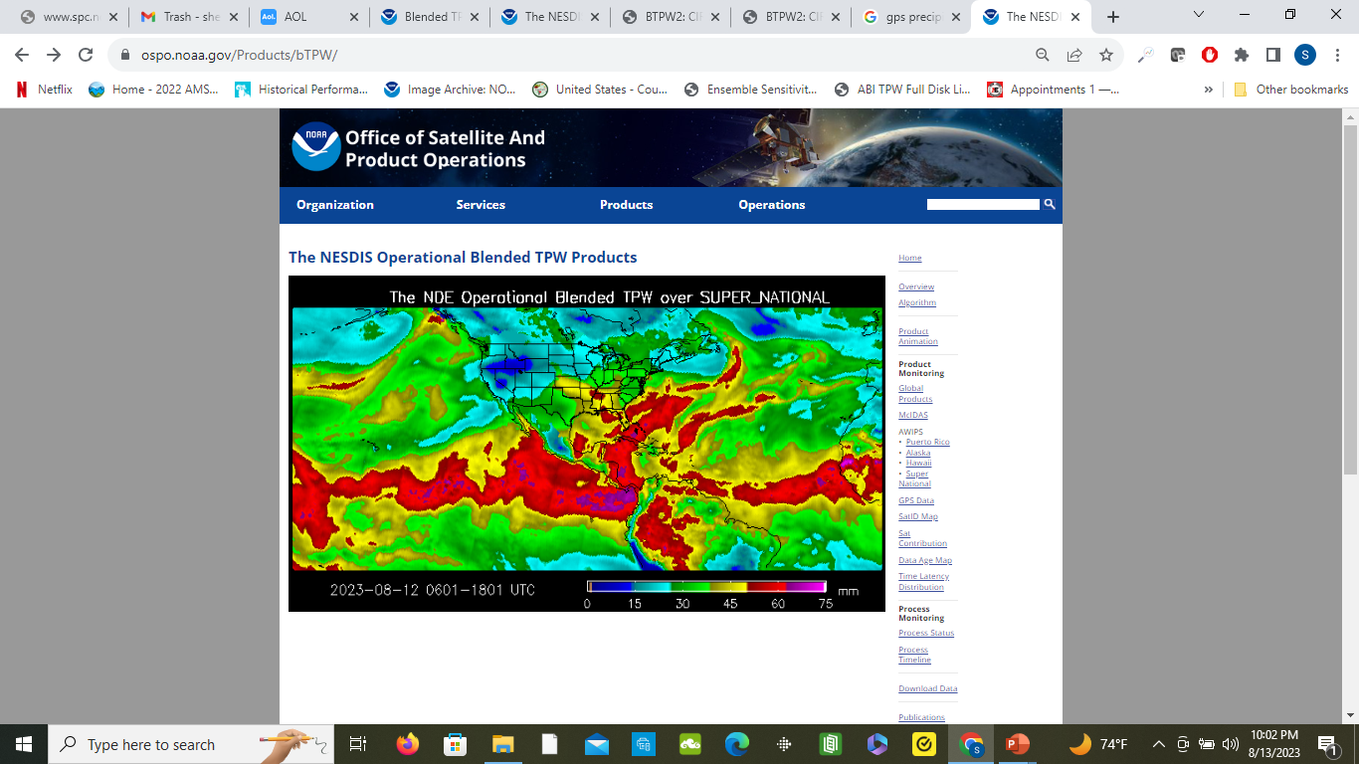
NOAA/NESDIS Advected Layer Precipitable Water (ALPW) for the Period 00 UTC 29 June to 18 UTC 4 July 2025
850-700
700-500
500-300
Hurricane
Flossie
Hurricane
Flossie
Hurricane
Flossie
Unfortunately, I did not save the surface to 850 layer so that I could include. But 700-500 and 500-300 layer shows the contribution of Hurricane Flossie and its remnant moisture that crossed over the Mexican mountains into Texas near the last quarter of the loop.

