Slide 1
Extending and Reprocessing the NASA NVAP-M Water Vapour Dataset
John Forsythe, Steve Fletcher, Shuyan Liu, Tom Vonder Haar
Cooperative Institute for Research in the Atmosphere (CIRA) Colorado State University, Fort Collins, CO
John.Forsythe@colostate.edu
ESA WV_CCI 2nd User Workshop, 15 October 2024
Supported by NASA MEaSUREs Program

Slide 2
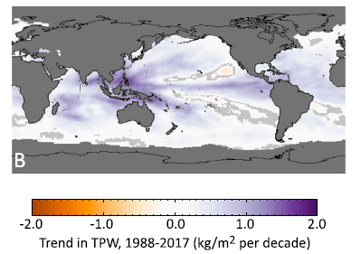
Water Vapor Fuels Climate Change Impacts
Global Mean TPW is ~26 mm
+1.5% / decade increase over global oceans observed (Mears et al 2018)
Highest I’ve ever observed is 91 mm (GPS site, Hurricane Katrina)
Mears et al, 2018, Earth and Space Sciences

Slide 3
A new product for weather forecasters:
Advected Layer Precipitable Water (ALPW)

Slide 4
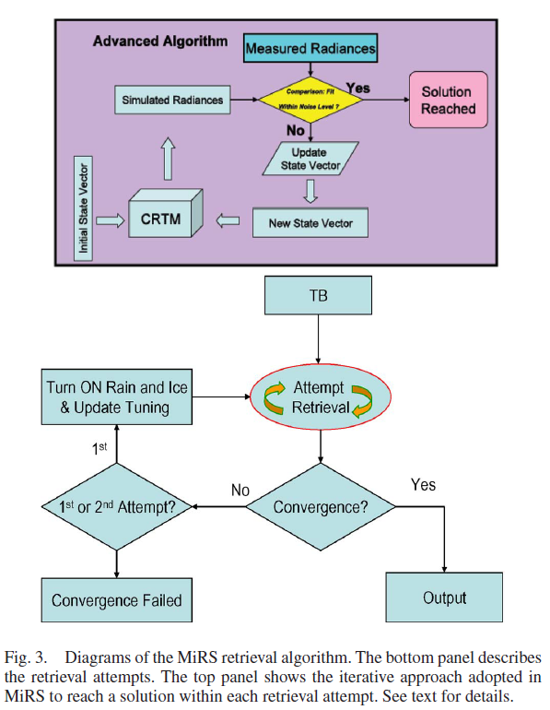
Key Feature: MiRS does not use a dynamic NWP model and retrieves in cloudy conditions
NOAA operational MiRS retrieval system used to produce TPW and LPW
Uses passive microwave data including 183 GHz water vapor absorption line

Slide 5
Advection Fills in Between Satellite Overpasses
Polar MiRS constellation when ALPW operations commence (expect Fall 2024)
QuickSounder will fill a key gap
Currently, 9 hour reachback window used for each hourly analysis
SmallSats in other planes welcome!
MetOp-B/C
NOAA QuickSounder ~2026 launch
Key point – undesirable periods of high and low sampling throughout the day
NOAA-20/21

Slide 6
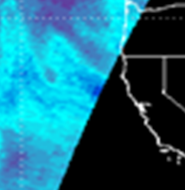
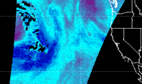
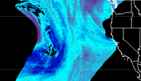
Schematic of how the back-trajectory method works for advection
LPW (mm)
Reverse wind vector
SNPP field of view time is 11:10 UTC which is > trajectory time of 11:00 UTC. Solution achieved.
Before
Target time 15:00
14:00
11:00
After
13:00
12:00
S-NPP 700-500 LPW April 20, 2016 advected to 1500 UTC (~4 hour advection)
Winds are from the GFS
Gitro et al. J. Op. Meteor. 2018

Slide 7
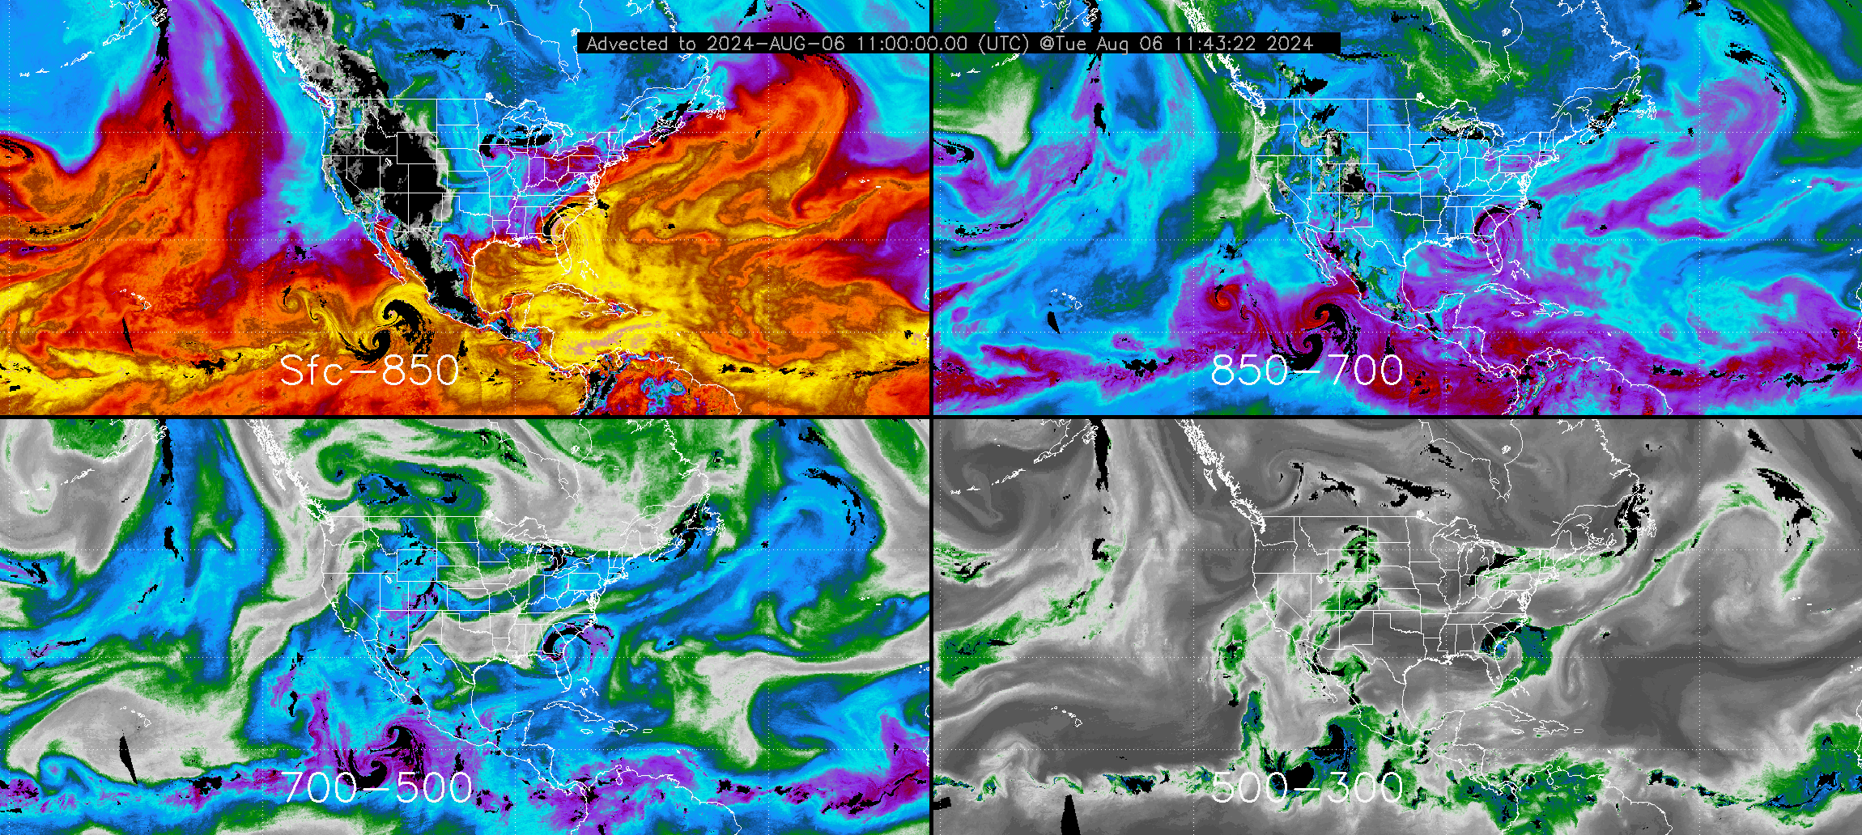
Hourly Advected Layer Precipitable Water (ALPW)
Now Operational at NOAA
Tropical Storm Debby
Sfc-850
850-700
700-500
500-300
Layer Precipitable Water (mm)

Slide 8
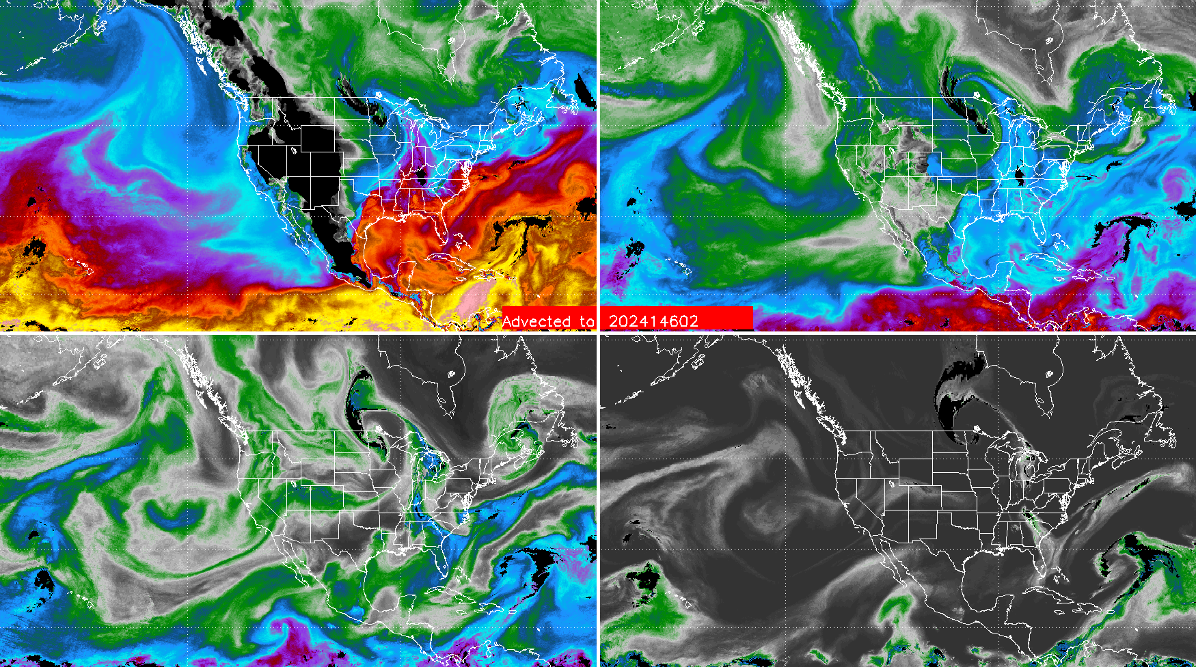
Layered Precipitable Water (mm)
Sfc-850
850-700
700-500
500-300
02 UTC 25 May 2024

Slide 9
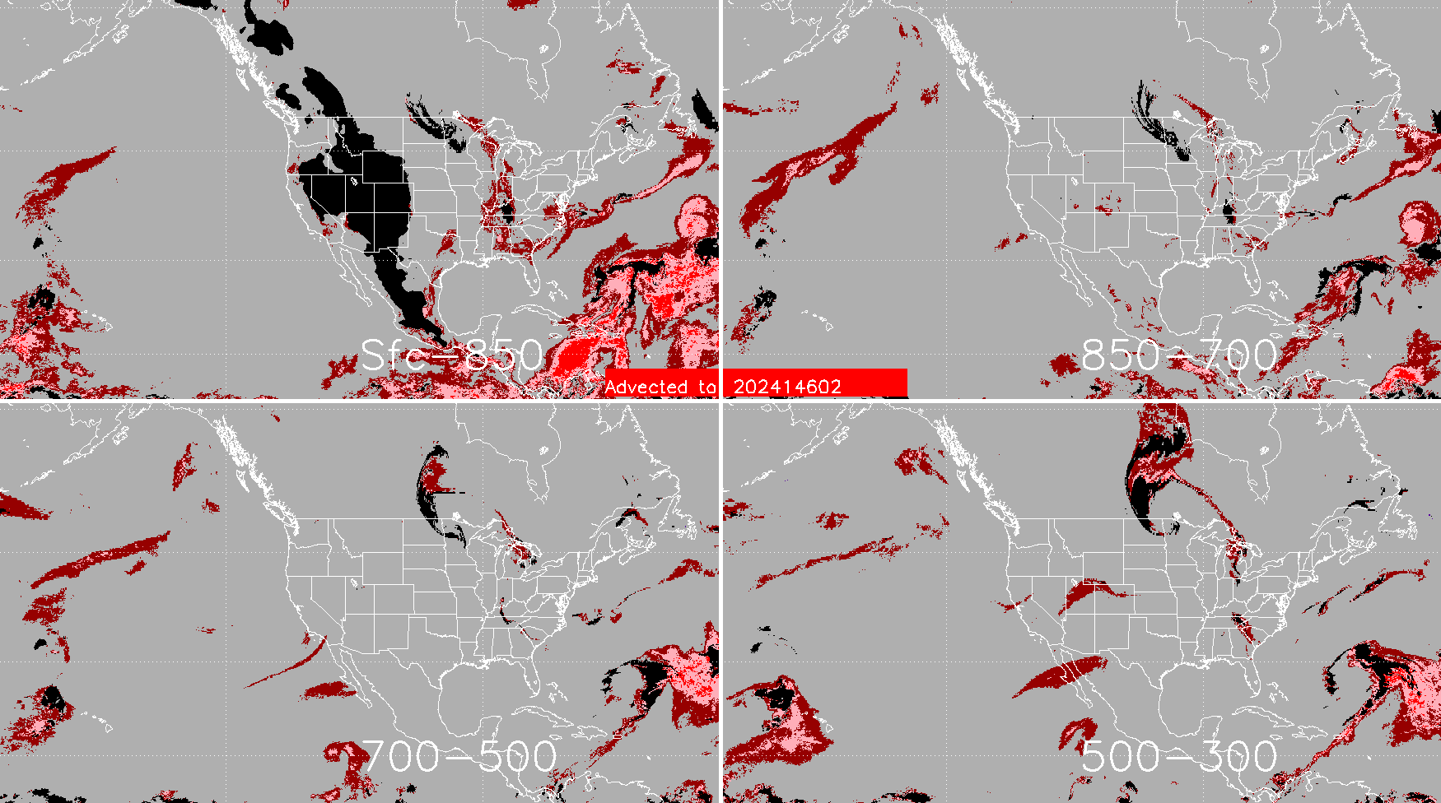
Percentile Ranking
Sfc-850
850-700
700-500
500-300
Large area of 10-year monthly maxima in Caribbean
02 UTC 25 May 2024

Slide 10
NASA MEaSUREs NVAP Project
New effort which began this year.
Will create a 40-year (1988-2027) record of TCWV (commonly called TPW in U.S.) and layered water vapour.
Reprocessing and extension of the NVAP-M dataset which spanned 1988-2009 and was used in G-VAP. Called NVAP 2.0.

Slide 11
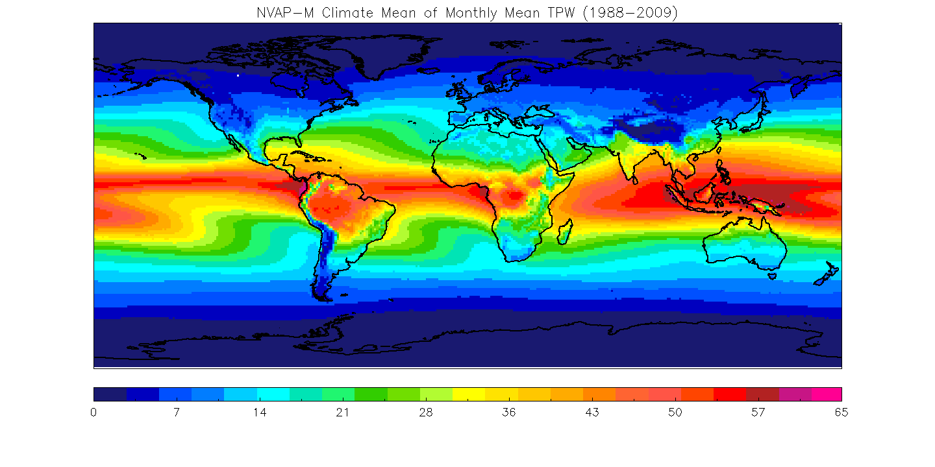
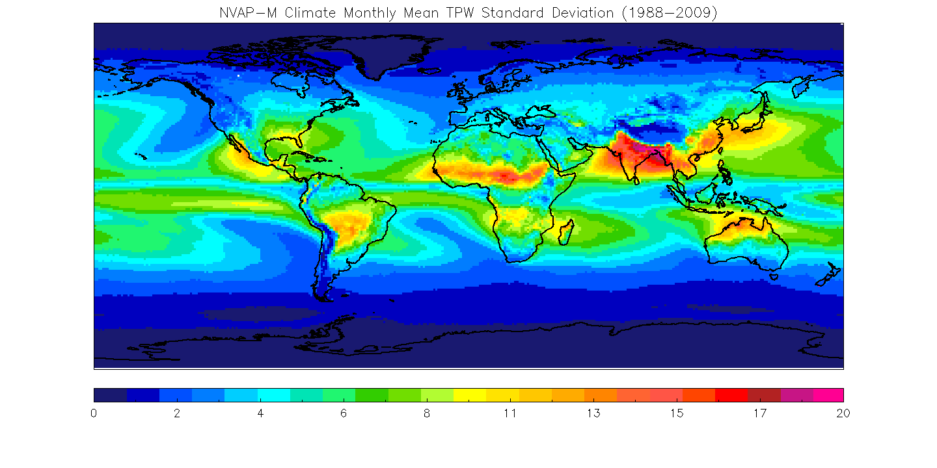
NASA Water Vapor Project – MEaSUREs
NVAP-M (1988-2009) ( Vonder Haar et al. GRL 2012)
Total (TPW or TCWV) and layered (LPW) precipitable water
Designed to be observationally-driven, minimal dynamic model dependence. SSM/I a primary ocean sensor. Supplemented with HIRS / AIRS (2002+) infrared retrievals over land and ocean.
Challenges with different sampling of clear and cloudy regimes
Data fusion of many sensors to provide a global picture at 6-hour resolution.
Mean 1988-2009
Standard Dev.

Slide 12
NVAP-M Global Monthly TPW
Pinatubo eruption
Large ENSO

Slide 13
Some Candidate Sensors to Be Used in NVAP-2.0
Sensor | Time Span | Retrieval Algorithm | Published Uncertainty
Special Sensor Microwave Imager (SSM/I) | 1988 - | Elsaesser and Kummerow (2008); | 3-5 mm TPW
Advanced Microwave Sounding Unit (AMSU-A/B), Special Sensor Microwave Water Vapor Profiler (SSM/T-2), Advanced technology Microwave Sounder (ATMS) | 1994- | Lee et al. 2022, Boukabara et al. 2011, Kliewer 2016 non-Gaussian | 4-5 mm for TPW via ATMS
NOAA HIRS | 1988- | Engelen and Stephens (1999) | 6 mm TPW 4 mm 700-500 hPa; 0.6mm 500-300 hPa
Global Navigation Satellite System (GNSS) | 1995- | Wang et al. (2007) | 1 mm TPW
CLIMCAPS | 2008- | Roman et al. (2016) Smith et al. (2019) | 2 mm TPW
Radiosonde | 1988- | Durre et al. (2008) | 2 mm TPW
Also considering others (MODIS, MERIS NIR retrievals)
Microwave sounders provide total column and ~3 layers. Not used in NVAP-M, radiance record is now more mature.

Slide 14
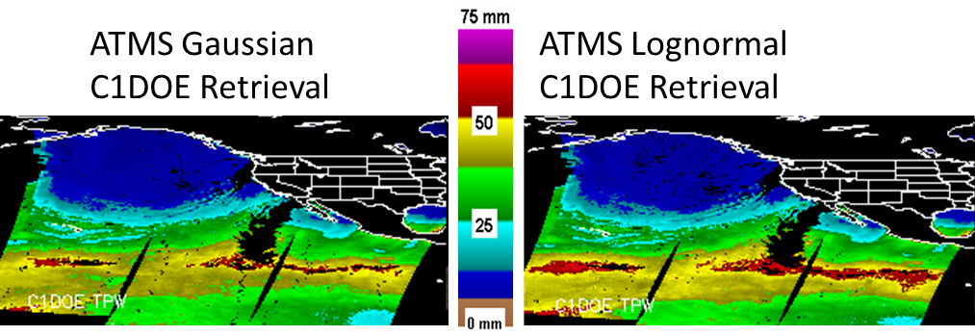
CIRA will run a non-Gaussian framework microwave retrieval (C1DOE: Fletcher, Kliewer et al. QJRMS 2016) for NASA NVAP project
1DVAR retrieval similar to NOAA MiRS
Should better retrieve extreme values
Will also run MiRS (Gaussian) and validate the two
Total Precipitable Water
09 UTC 1 Feb 2021

Slide 15
1988-2008 TPW trend and error estimate from 10 records
±60°N/S ocean only
Trend (mm/year)
An excellent analysis of breakpoints and the challenge of using operational sensors for climate.
Recommendations include need for reprocessed radiance records
Observational, SSM/I-driven datasets more closely agree than reanalyses
Schröder, M., Lockhoff, M., Shi, L., August, T., Bennartz, R., Borbas, E., Brogniez, H., Calbet, X., Crewell, S., Eikenberg, S., Fell, F., Forsythe, J., Gambacorta, A., Graw, K., Ho, S.-P., Höschen, H., Kinzel, J., Kursinski, E.R., Reale, A., Roman, J., Scott, N., Steinke, S., Sun, B., Trent, T., Walther, A., Willen, U., Yang, Q., 2017: GEWEX water vapor assessment (G-VAP). WCRP Report 16/2017; World Climate Research Programme (WCRP): Geneva, Switzerland; 216 pp.

Slide 16
Special Focus Regions for NVAP:
Dry regions
Arctic

Slide 17
Summary:
Observationally-driven blended water vapour datasets are useful for forecasters, show the “plumbing” of the atmosphere.
TCWV is increasing over oceans ==> extreme precipitation events.
New ALPW product available in NOAA operations shows four layers of moisture hourly.
An extension / reprocessing of the NASA NVAP 40-year record is underway. Expect to hear more about this at future WV CCI meetings.
Interested in any collaboration and observational climate records of water vapour for possible inclusion in NVAP-2.
Thanks for your feedback and questions! (John.Forsythe@colostate.edu)

Slide 18
Backup Slides

Slide 19
Continue Multi-tiered Product Approach
NVAP-Weather
Used for weather case studies on timescales of days to weeks: Atmospheric rivers, droughts etc.
Use most available sensors at a time, audience is weather event analysis Emphasis on spatial and temporal coverage
NVAP-Climate
Used for studies of climate change and interannual variability
Focus on temporal continuity and well-intercalibrated data Emphasis on consistency across decades
NVAP-Ocean
Microwave imager TPW only. Level 1 C intercalibrated radiances (Berg and Sapiano, CSU)
How do we make a water vapor record for a wide variety for users?
New: NVAP Constant Sampling
Enforce a constant mix of clear / cloudy scenes across decades
Supplemental Fields
Data source codes (DSC) map, indicating the sources used in each grid box .

Slide 20
SmallSat missions with microwave sensors for water vapor profile:
NASA TROPICS (4 satellites launched)
NASA INCUS (~2027) – One MW radiometer
EUMETSAT Arctic Weather Satellite (launched August 2024) / Sterna Program
Commercial (Tomorrow.io)

Slide 21
March 9, 2023 California Atmospheric River

Slide 22
ALPW Percentile Ranking for 10-year Record
Highest values in record
Sfc-850
15 UTC 9 March 2023
850-700
700-500
500-300

