Slide 1

MiRS: Microwave Integrated Retrieval System
Operational at NOAA since 2007
Supported Satellites:
SNPP/ATMS
N18/AMSUA-MHS
N19/AMSUA-MHS
MetopA/AMSUA-MHS
MetopB/AMSUA-MHS
F17/SSMIS
F18/SSMIS
TRMM/TMI
GPM/GMI
Megha-Tropiques/SAPIR
NOAA-20/ATMS
MetopC/AMSUA-MHS
JPSS-2/ATMS
TROPICS
AWS
EPS-SG (proxy data)
Upcoming JPSS series…
Upcoming MW sensors
Inputs
TBs at each channel
Geolocation
Data Preprocessing
Convert input data to common format
Quality control
Instrument NEDT
A Priori background
First guess
Covariance Matrix (EOFs)
Ancillary data
Retrieval: 1DVAR
Forward operator: CRTM
Jocobians
Core retrieval products
Temperature profile
Water vapor profile
Footprint matching across instruments and input channels
Bias correction
EOFs
Forward model uncertainty
Derived products
Total precipitable water
Rain water path
Graupel water profile
Rain water profiles
Emissivity spectrum
Skin temperature (incl. ocean SST)
Ice water path
Cloud liquid water
Sea ice concentration/age
Snow water equivalent
Grain size
Rain rate
Cloud water profile
MW Only, 1D Variational Approach: Find the “most likely” atm/sfc state that: (1) best matches the satellite measurements, and (2) is still close to an a priori estimate of the atm/sfc conditions
Background and First Guess come from a “dynamic climatology” which varies in space and time.

Slide 2
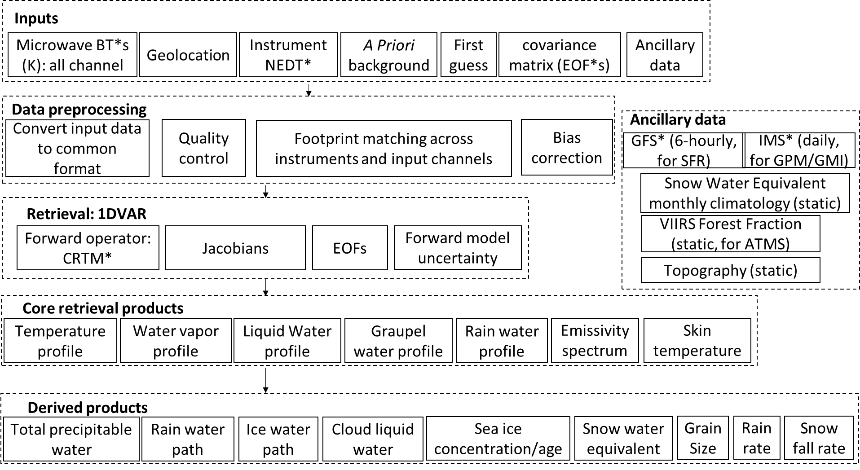

Slide 3

Mathematical Basis: MiRS Cost Function Minimization
Cost Function to Minimize
Rain Rate is based on a post-process parameterization:
X: retrieved state vector
X₀: background
B: error covariance matrix
Y^{m}: observed radiance
Y: simulated radiance
E: instrument and modeling error
x: parameter to be retrieved
K: matrix of Jacobians
(contains the sensitivity of radiances to changes in x)
Bkg-departure normalized by Bkg Error
Measurements-departure normalized by Measurements+Modeling Errors
$${PR}_{clw}=C_{1}×{\left(CLW\right)}^{C_{2}}$$
C₁=2.339, C₂=1.156, C₃=3.897, C₄=1.103
$$PR={PR}_{clw}+C_{3}×{\left(RWP+GWP\right)}^{C_{4}}$$
PR: Precipitation Rate CLW: Cloud Liquid Water
RWP: Rain Water Path GWP: Graupel Water Path
Notes:
The departure from measured radiances normalized by the noise level and the specification of uncertainty in the forward modeling make it possible to use the signal of a particular channel when the geophysical signature is stronger than the noise. Conversely, at other times it may be possible to de-weight the information from same channel when the signal in question is within the noise level. The departure from the background scaled by the uncertainty assigned to the background result in retrievals closer to an a-priori background estimate if it is deemed accurate. The MiRS currently uses a “dynamic background” as an a priori constraint, for temperature, water vapor, and skin temperature, which varies with latitude, longitude, season and time of day. Empirical orthogonal functions are used as basis functions to further reduce the degrees of freedom in the solution and stabilize the retrieval.
The Community Radiative Transfer Model (CRTM) produces radiances and the corresponding Jacobians under clear, cloudy, and precipitating conditions. The model has been validated against various satellite measurements. MiRS uses CRTM as the forward operator to perform retrievals under all these sky conditions. Given a set of radiances, an a priori (background) estimate of the geophysical mean and its associated covariance matrix, and assuming the hypotheses for its mathematical basis are satisfied, MiRS produces a set of self-consistent parameters that are also consistent with the measured parameters. When processing satellite sensor data with a full complement of temperature, water vapor and surface-sensitive channels, the official MiRS products generally include temperature and water vapor vertical profiles, cloud and precipitation parameter vertical profiles (non-precipitating cloud amount, rain, graupel), skin temperature, and the surface emissivity spectrum. Post-processing of elements within the retrieved state vector yield additional retrieval products such as rain rate, total precipitable water (TPW), sea ice concentration and age, snow water equivalent and grain size. An important feature of MiRS is that, as currently configured, retrievals do not require real-time ancillary data such as those coming from Numerical Weather Prediction model forecasts. MiRS products based on various satellite/sensors have been examined, for example [12], [13], [14].

Slide 4
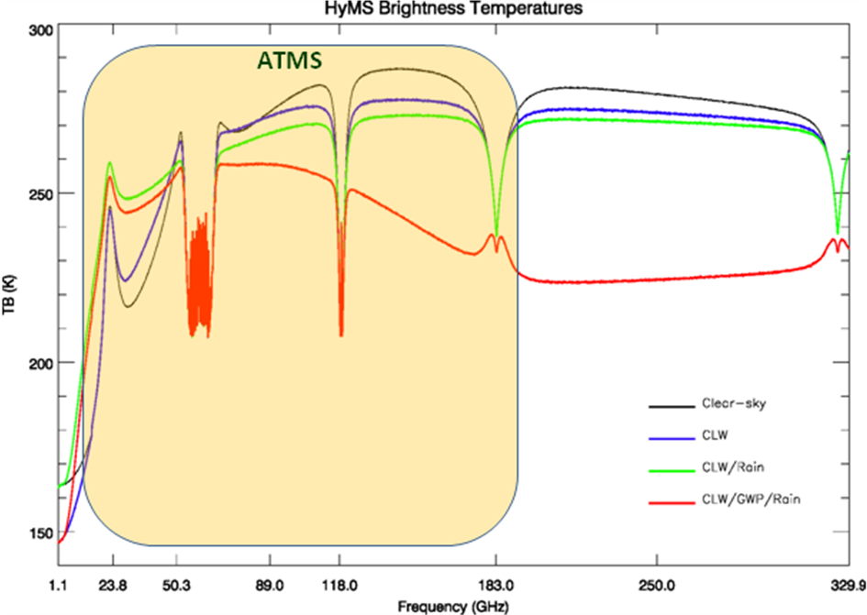
Simulated Microwave Sensitivity to Temperature, Water Vapor, Clouds, and Rain
Over-ocean Simulation
Clouds/Rain
WV absorption (total column)
WV absorption (used for WV profile sounding)
O2 absorption (used for T profile sounding)
ATMS Spectral Range

Slide 5
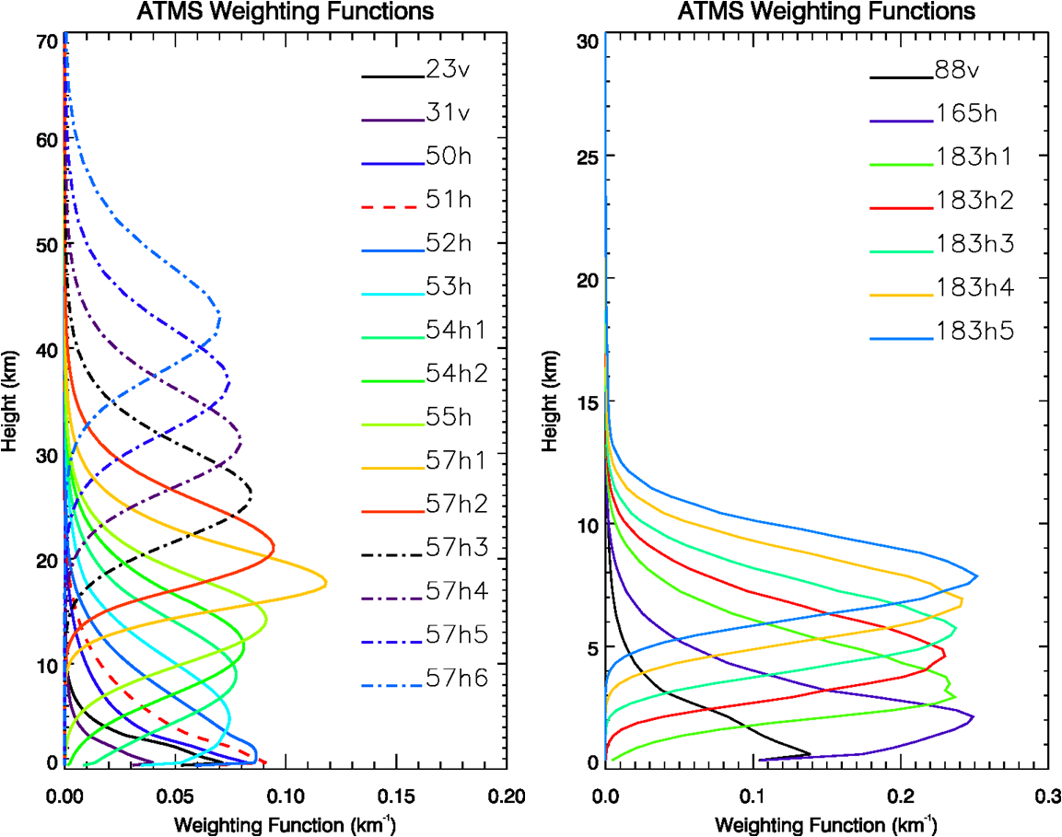
ATMS Instrument Weighting Functions
Temperature
Water Vapor
Weighting functions are smooth and overlap
Reduced information content
So even though there are 13 temperature and 5 water vapor channels, number of independent pieces of info is less than 13 and 5

Slide 6
ATMS Geometry, Resolution, and Sampling

Slide 7
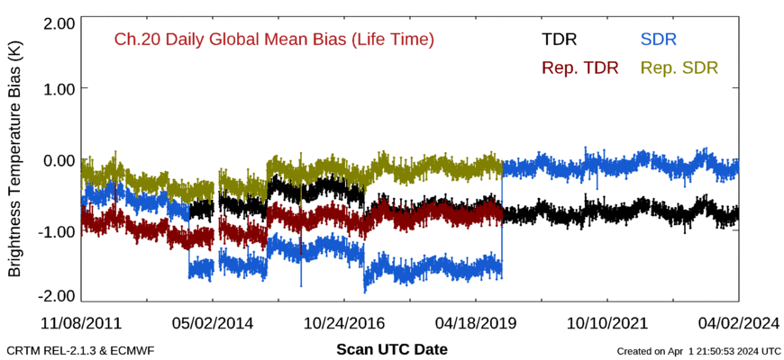
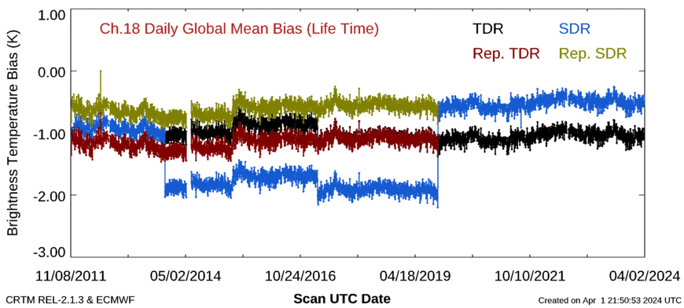
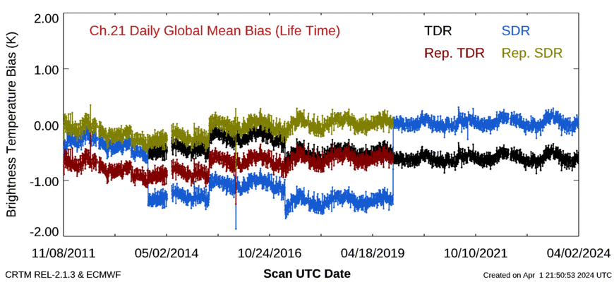
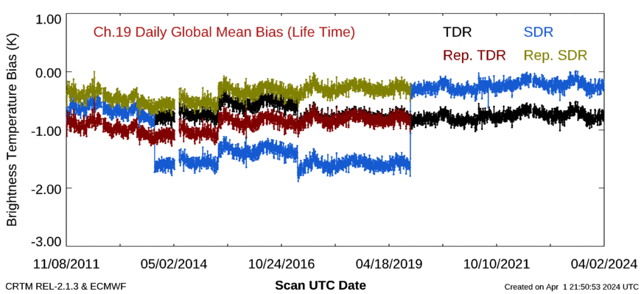
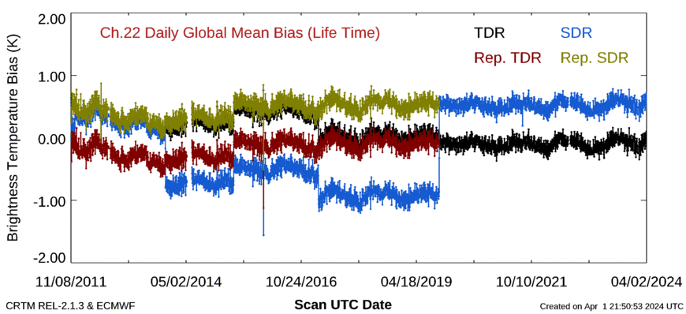
No Channel 3, 16, and 17 available on ICVS webpage. Use the 5 upper and lower troposphere water vapor channels of channel 18 -22 to illustrate the calibration change (5 times).
The calibration algorithm on October 15, 2019 is used in the reprocessing.
From: https://www.star.nesdis.noaa.gov/icvs/status_NPP_ATMS.php

Slide 8
Four surface types: ocean, land, snow, ice
The surface is represented in MiRS by its temperature and its emissivity spectrum.
The surface skin temperature and the effective surface emissivity at all channels are part of the state vector being retrieved in MiRS.
The only difference between the retrievals over the different surfaces is the spectral shape and the amplitude of the emissivity spectrum inverted.
Thus the advantage of using the emissivity in the state vector is to extend the validity of the retrievals to all surfaces.

Slide 9
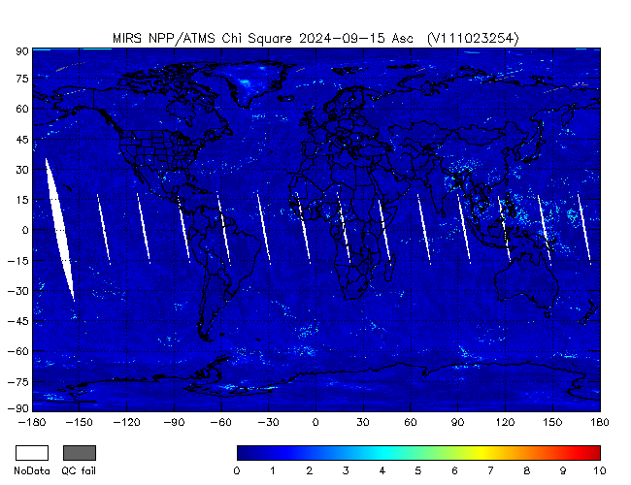
Chi-square: convergence metric to ensure radiometric consistency

Slide 10
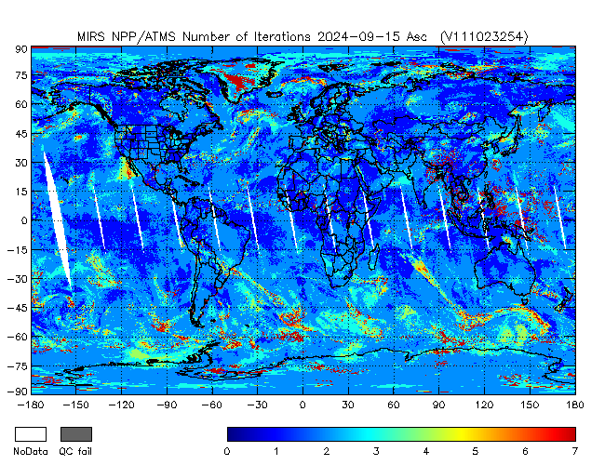
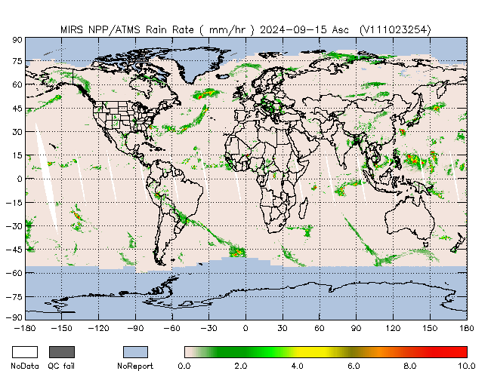

Slide 11
Geophysical parameters: properly constrained and physically consistent with each other
CRTM
Priori information
Strong physical constraint how the inverted parameters are adjusted during the retrieval process Iteration by iteration
Both surface and atmospheric parameters
Emissivity covariance matrix and background are for the four surface types

Slide 12
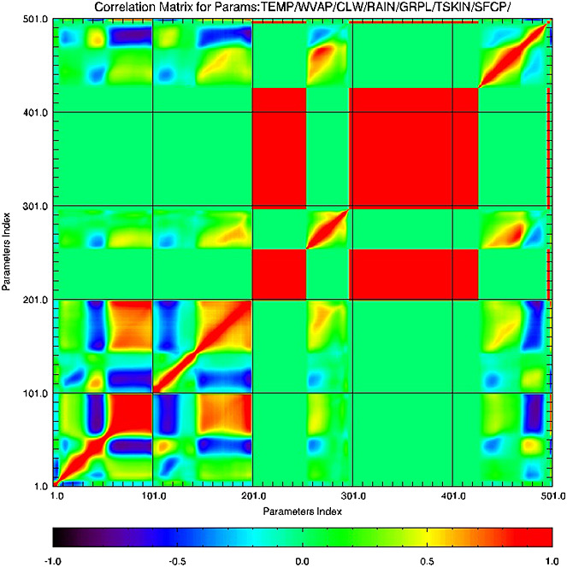
Because the state vector is inverted in one single block, the geophysical background covariance matrix in MiRS plays a critical role.
This matrix represents the natural correlations between all parameters
The actual retrieval is performed in a reduced space using an EOF projection, therefore ensuring a stable and fast inversion
No information from forecast runs is used in MiRS, including surface pressure.

Slide 13
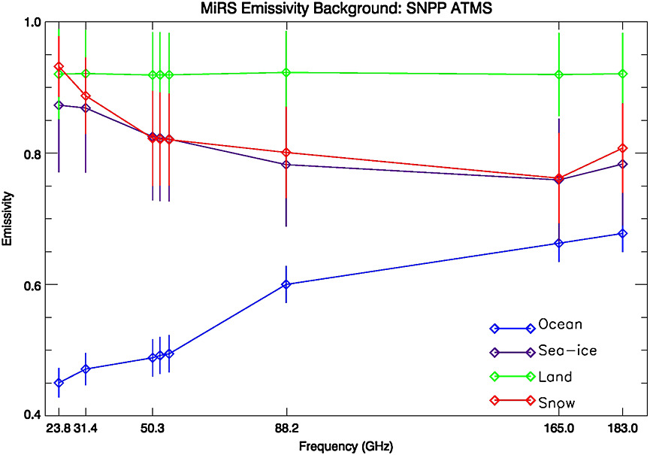
It is important that the variance is adequate to allow emissivity departures from the background values if the signal from surface-sensitive channels (determined from CRTM jacobians)
For example, heavy rainfall events and the resulting added soil moisture to land surface dramatically affects the magnitude and shape of the land emissivity spectrum.
The loose constraint in the background covariance will allow accommodating this situation and will permit the algorithm to converge toward the solution.

Slide 14
Extension to new sensors
CRTM (be provided)
Footprint matching
Coefficients for the sensor
Covariance Matrix
AMSUA and MHS have different resolutions
ATMS channels have different resolutions
Surface parameters
Bias correction
Four days with one day for each season based on ECMWF and forward operator CRTM
Fine tuning based on the initial results
Emissivity Catalog
Tuning parameters for both 1st and 2nd attempts
Over snow and ice surfaces

