Slide 1




Multi-satellite Water Vapor Products at the Weather Climate Interface
John Forsythe, Stan Kidder, Sheldon Kusselson, Dan Bikos, Natalie Tourville, Jorel Torres, Steve Fletcher, Shuyan Liu, Tom Vonder Haar
Cooperative Institute for Research in the Atmosphere (CIRA) Colorado State University, Fort Collins, CO
Thanks to many forecasters for collaboration and to the NOAA MiRS team for data!
John.Forsythe@colostate.edu
NASA Joint AIRS / Sounder Science Team Meeting. Sept. 27, 2024
Supported by NASA MEaSUREs, JPSS Proving Ground and NOAA Climate Program Office

Slide 2
Outline
Water vapor in the atmosphere
Blended Multisensor Satellite Products: Advected Layer Precipitable Water (ALPW) and Total Precipitable Water (TPW)
Recent historical record of ALPW
Extending the NVAP Global Water Vapor Climate Data Record to 40 Years (1988-2027)

Slide 3
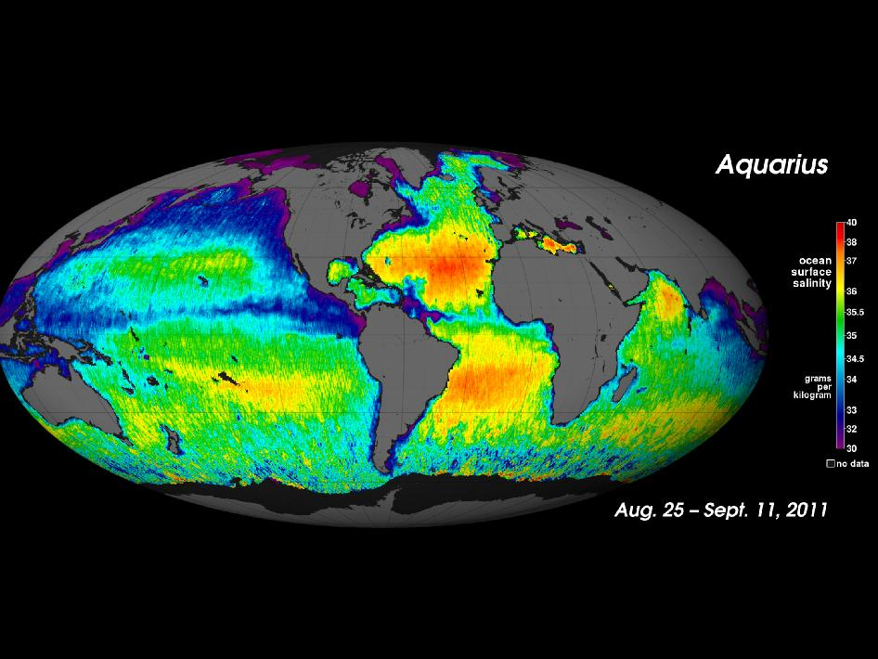
Ocean Salinity a Proxy for Evaporation
“The chief source of atmospheric water vapor is evaporation over the ocean, which makes conventional observations difficult. As a result, satellite observations of atmospheric water vapor have been made since the earliest days of satellites.” (- Stan Kidder, CIRA)

Slide 4
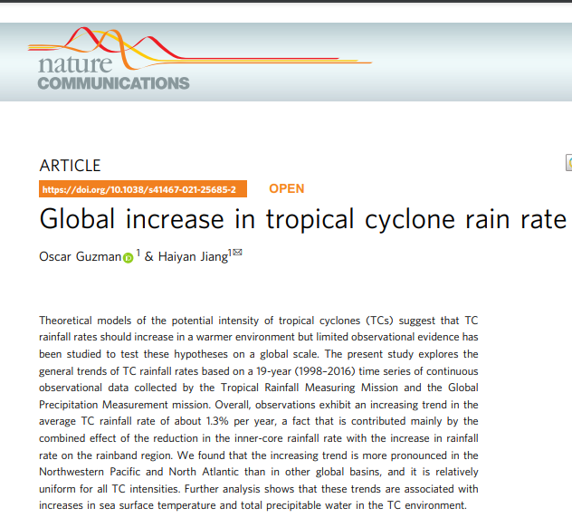
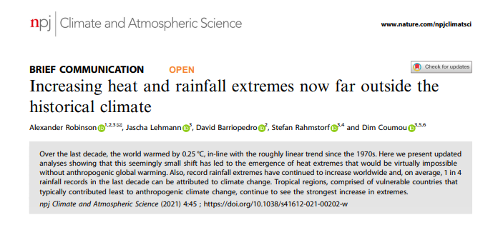
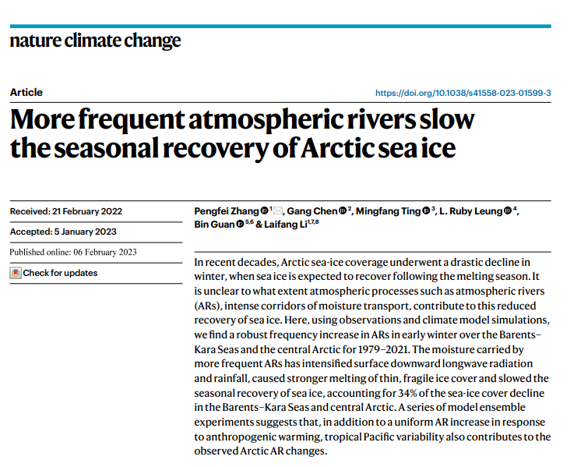
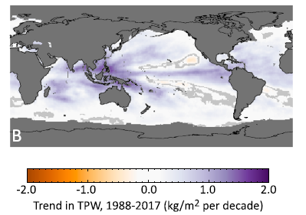
Water Vapor Fuels Climate Change Impacts
Global Mean TPW is ~26 mm
+1.5% / decade increase over global oceans observed (Mears et al 2018)
Highest I’ve ever observed is 91 mm (GPS site, Slidell LA, Hurricane Katrina)
Mears et al, 2018, Earth and Space Sciences

Slide 5
“Water vapor is a limiting factor in the amount of extreme precipitation more than the intensity of the weather causing the event” (Kunkel et al. 2020)
Compared > 3000 Co-op stations to NCEP and MERRA-2 reanalysis from 1949 – present.
Noted disproportionately large effect on extreme precipitation at higher TPW values

Slide 6
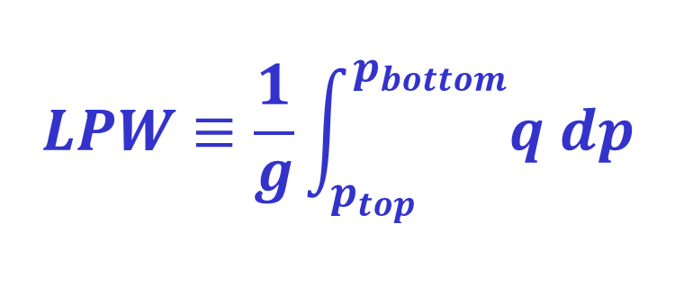
Some Definitions
TPW: Total Precipitable Water. The condensed depth of water from the surface to space. Also referred to as PWAT, TCWV, IPW, IWV…
LPW: Layer Precipitable Water: The condensed depth in some specified pressure layer
ALPW: Advected LPW – use winds to move LPW to common time
Layered precipitable water is defined as the integral of the mixing ratio q profile through a pressure layer, divided by gravity:
So LPW is proportional to layer mean mixing ratio.

Slide 7
Two Operational Blended Satellite Water Vapor Products for Forecasters
Product | Operational? | Inputs | Details
Blended TPW and TPW anomaly | Yes (since 2009) | Microwave retrievals from 7 spacecraft. ~ 400 surface GPS stations each hour. No GOES-16/18 currently | Hourly 16 km near-global Polar data non-advected
Advected Layered Precipitable Water | No* *CIRA distributes in NRT to WPC, NHC, and 27 WFO’s *Should become operational in Fall 2024 | MiRS retrievals from 5 polar orbiters | Hourly Four layers: sfc-850 mb 850-700 700-500 500-300 mb 16 km spatial

Slide 8
Blended Multisensor Satellite Products
(TPW and ALPW)

Slide 9
2022 JPSS Science Digest

Slide 10
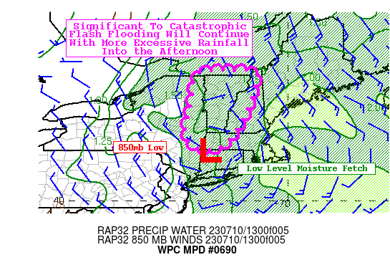
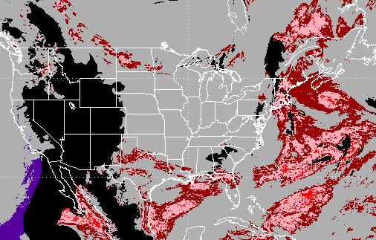
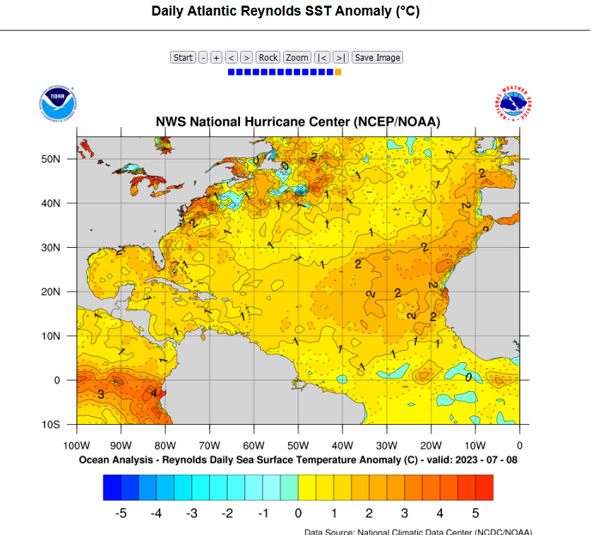
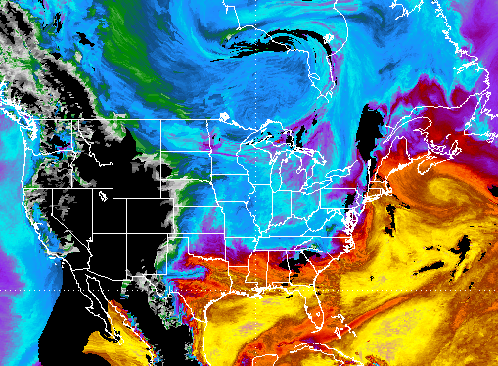

New England Floods, July 10 2023
July 2013-2022 percentiles
Sfc-850 ALPW
Layered Precipitable Water (mm)

Slide 11
First attempt at blended TPW: 1996
Used GOES-8 Sounder, Two SSM/I’s over ocean, Eta model
29” rainfall event near Houston!

Slide 12
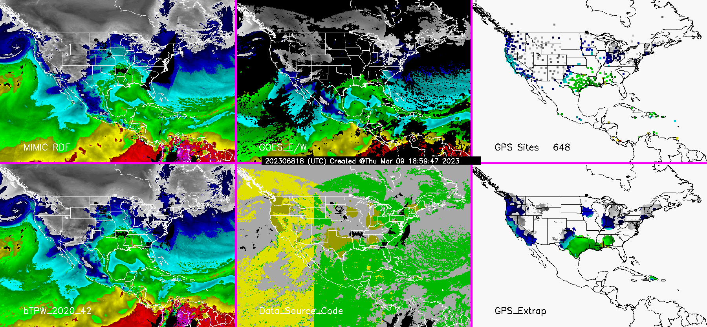

New Version of Blended TPW Being Implemented in Operations
- While ALPW is Microwave-Only, Blended TPW Uses Microwave with MIMIC advection, GOES infrared and Surface GPS Data.
MIMIC
GOES E/W
GPS Sites (via MADIS)
New Product V4.0
Data Source Code
GPS extrapolated
Hourly Loop at https://cat.cira.colostate.edu/btpw_2020/

Slide 13
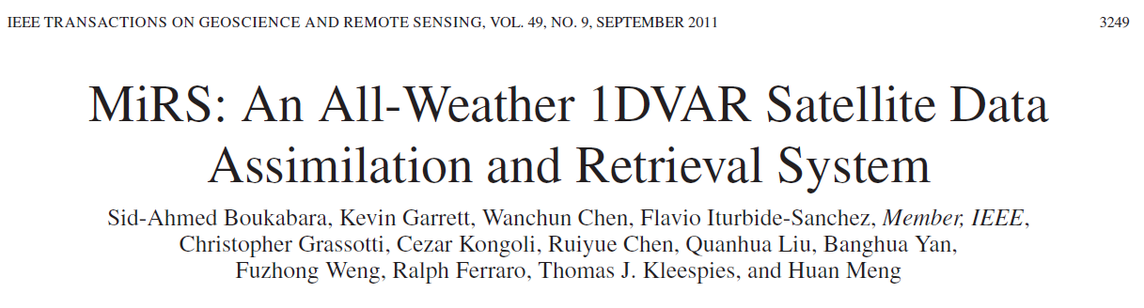
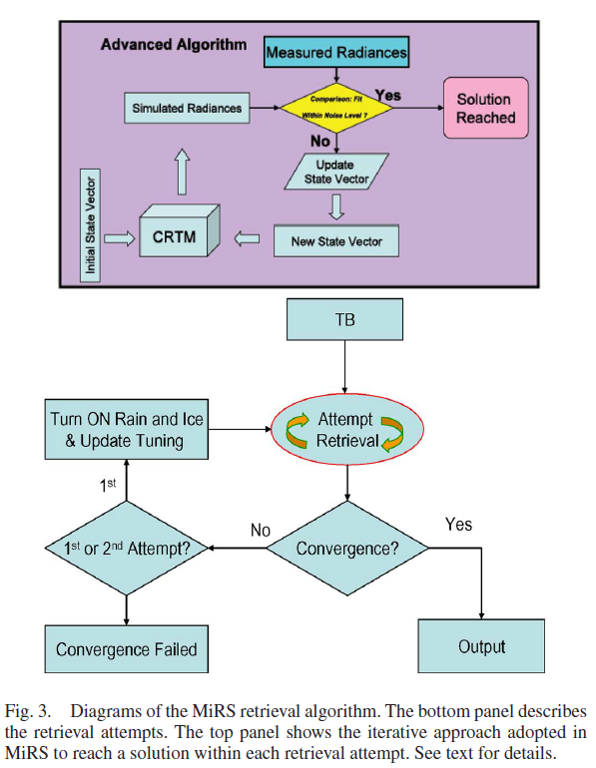
Key Feature: MiRS does not use a dynamic NWP model and retrieves in cloudy conditions
NOAA operational MiRS retrieval system used to produce TPW and LPW
Uses passive microwave data including 183 GHz water vapor absorption line

Slide 14
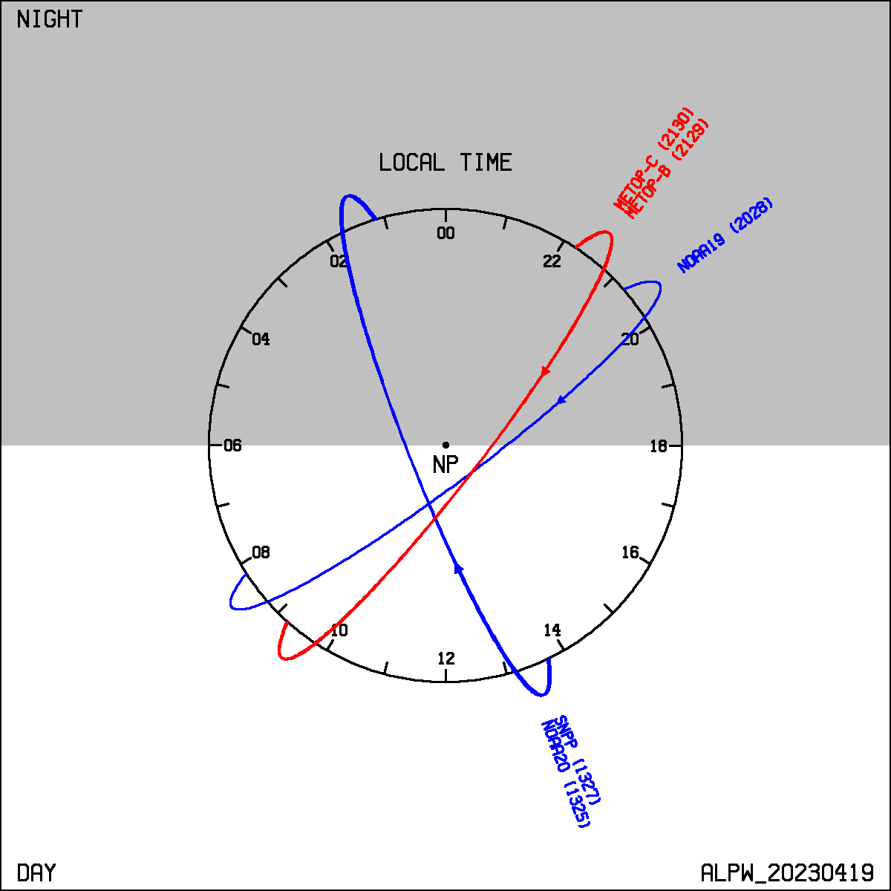
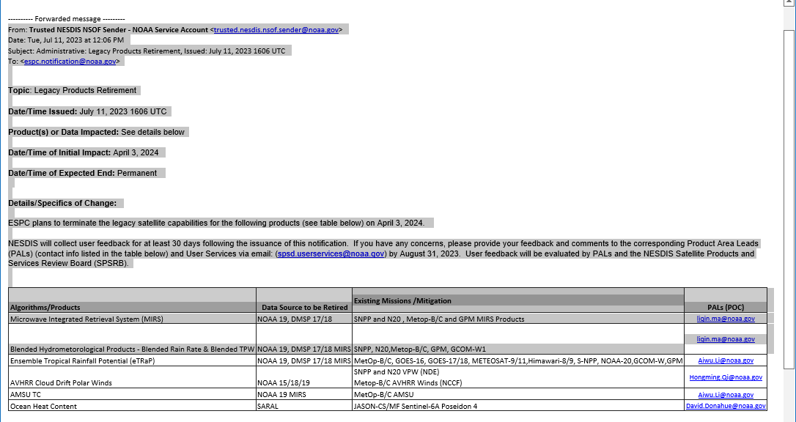
Current ALPW Constellation – 5 Satellites
MetOp-B/C
The battle to keep older data sources operating goes on...
NOAA-19
NOAA-20/21

Slide 15
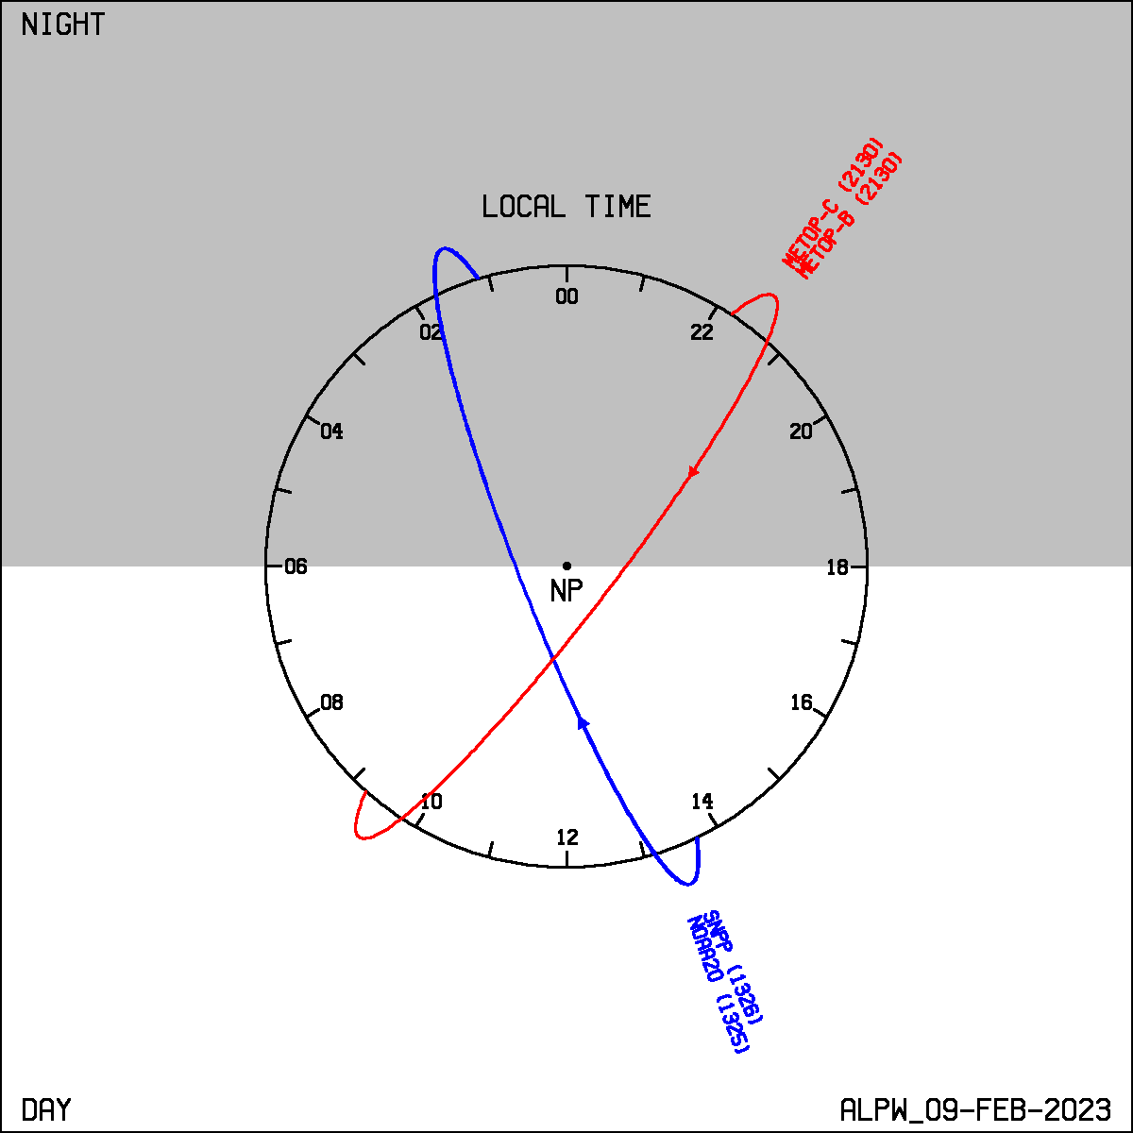
Advection Fills in Between Satellite Overpasses
Polar MiRS constellation when ALPW operations commence (expect Fall 2024)
QuickSounder will fill a key gap
Currently, 9 hour reachback window used for each hourly analysis
SmallSats in other planes welcome!
MetOp-B/C
NOAA QuickSounder ~2026 launch
Key point – undesirable periods of high and low sampling throughout the day
NOAA-20/21

Slide 16

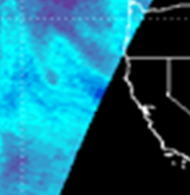
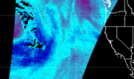
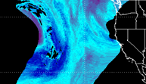
Schematic of how the back-trajectory method works for advection
LPW (mm)
Reverse wind vector
SNPP field of view time is 11:10 UTC which is > trajectory time of 11:00 UTC. Solution achieved.
Before
Target time 15:00
14:00
11:00
After
13:00
12:00
S-NPP 700-500 LPW April 20, 2016 advected to 1500 UTC (~4 hour advection)
Winds are from the GFS
Gitro et al. J. Op. Met. 2018

Slide 17
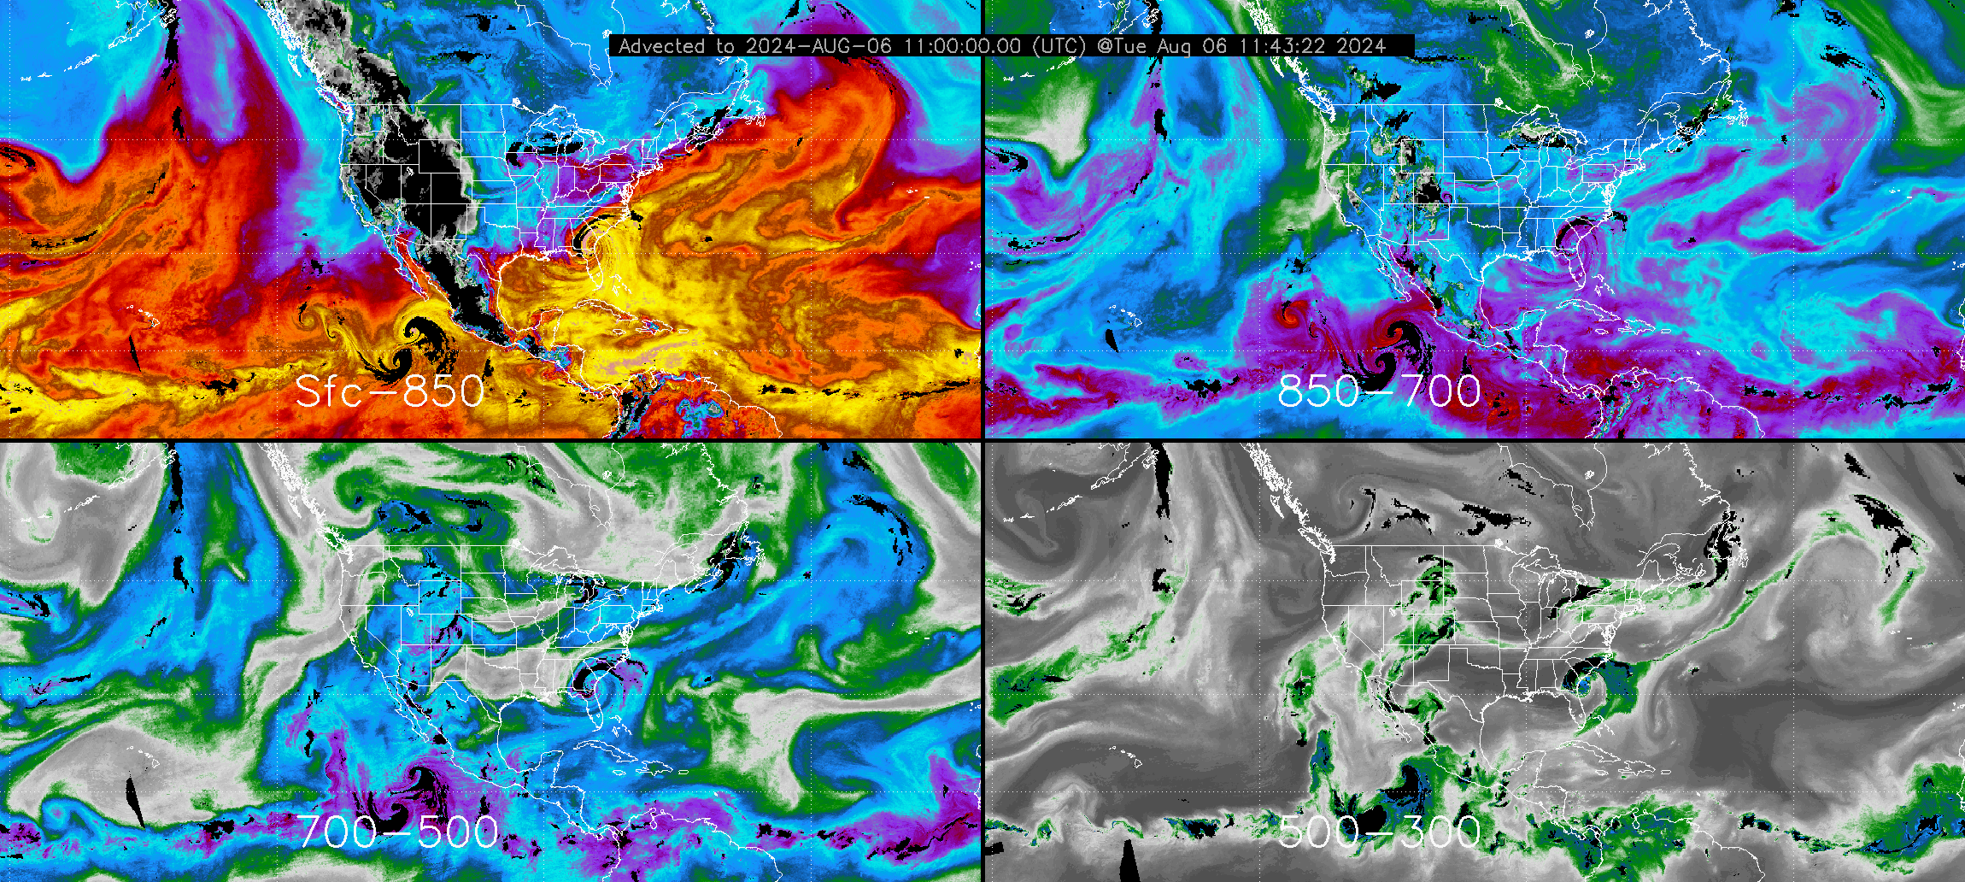
T.S. Debby
Sfc-850
850-700
700-500
500-300
Layer Precipitable Water (mm)

Slide 18
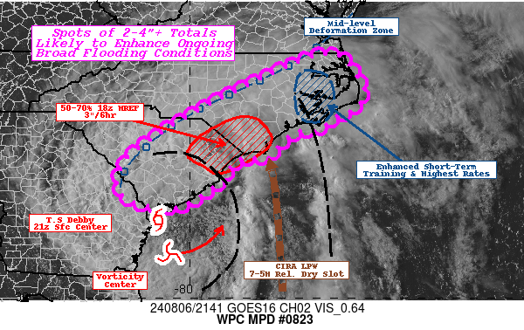
ALPW is Used for a Variety of Purposes
Mesoscale Precipitation Discussion 0823
NWS Weather Prediction Center College Park MD
547 PM EDT Tue Aug 06 2024
Areas affected...Coastal Plains of the Carolinas...
Concerning...Heavy rainfall...Flash flooding likely
Valid 062145Z - 070345Z
DISCUSSION... GOES-Visible and RAP analysis denote a broad area of generally stable with relative vertical lapse rates in an southwest of the center generally aligned with CIRA LPW suite of highest values and totals near 2.5-2.75". However, a mid-level 700-500mb dry slot is detected along the southeast and eastern quadrants lifting northward across the Gulf Stream. GOES-E Visible delineates this very well…
The most important ALPW product validation:
It makes sense when viewed by forecasters and compared to other data

Slide 19
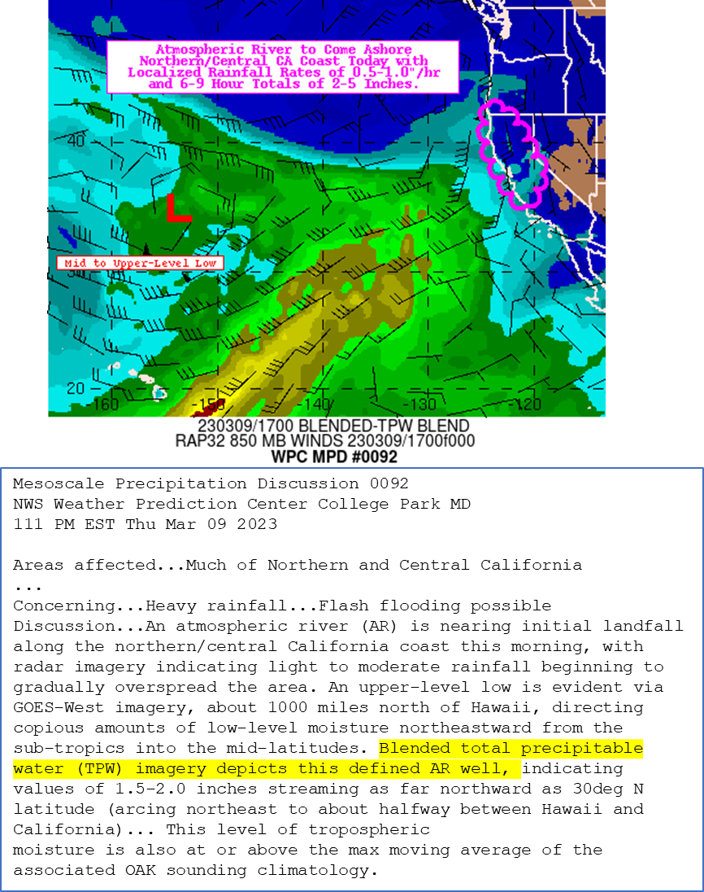
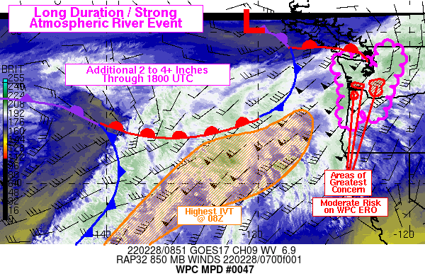
Typical Uses of Blended TPW (Total Precipitable Water) and ALPW (Advected Layer Precipitable Water)
ALPW products have proven to be a very useful diagnostic tool at WPC for operational forecasters at WPC’s Quantitative Precipitation Forecast (QPF), Rainfall Hazards and MetWatch desks...
...ALPW products have been utilized operationally at the MetWatch desk to identify areas of enhanced rainfall efficiency (e.g. warm rain and “seeder-feeder” processes) and to query the depth of Pacific atmospheric river events.
-Andrew Orrison
NOAA WPC Oct. 2022
“So many uses, especially for mesoscale analysis and supporting our partners' needs in the critical first 12 hours of the forecast.”
- WFO Norman, OK June 2023
Mesoscale Precipitation Discussion 0047
NWS Weather Prediction Center College Park MD
358 AM EST Mon Feb 28 2022
...
DISCUSSION...Over the past 6 hours, GOES West 6.9 micron and CIRA
Layered Precipitable Water imagery have shown a complex pattern of
mid-level vorticity centers over the northeastern Pacific, but one

Slide 20
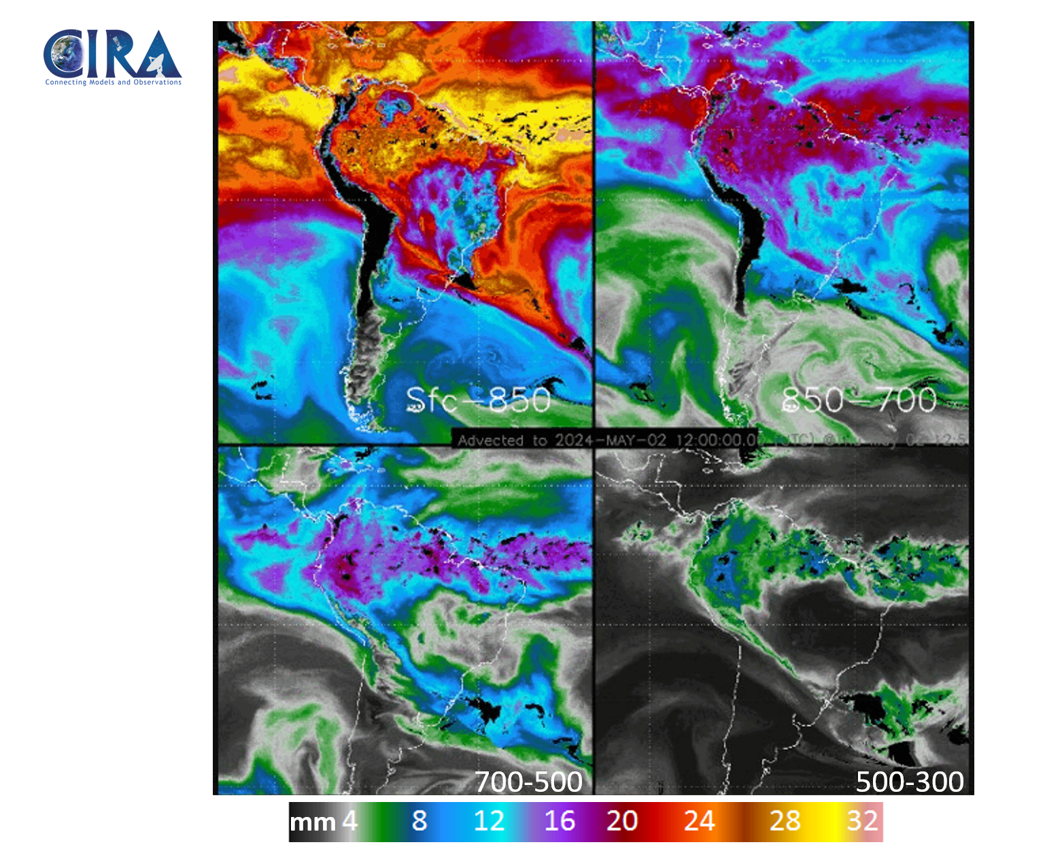
ALPW reveals long-distance trajectories of water vapor for heavy precipitation.
Brazil floods early May 2024.
Main moisture source is tropical Atlantic.

Slide 21
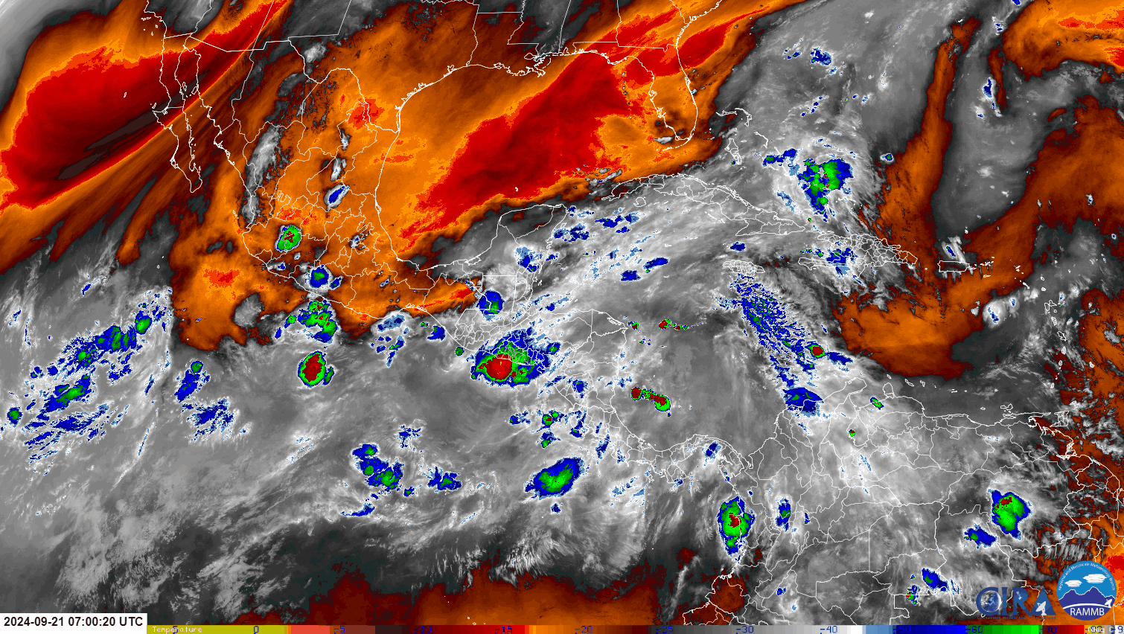
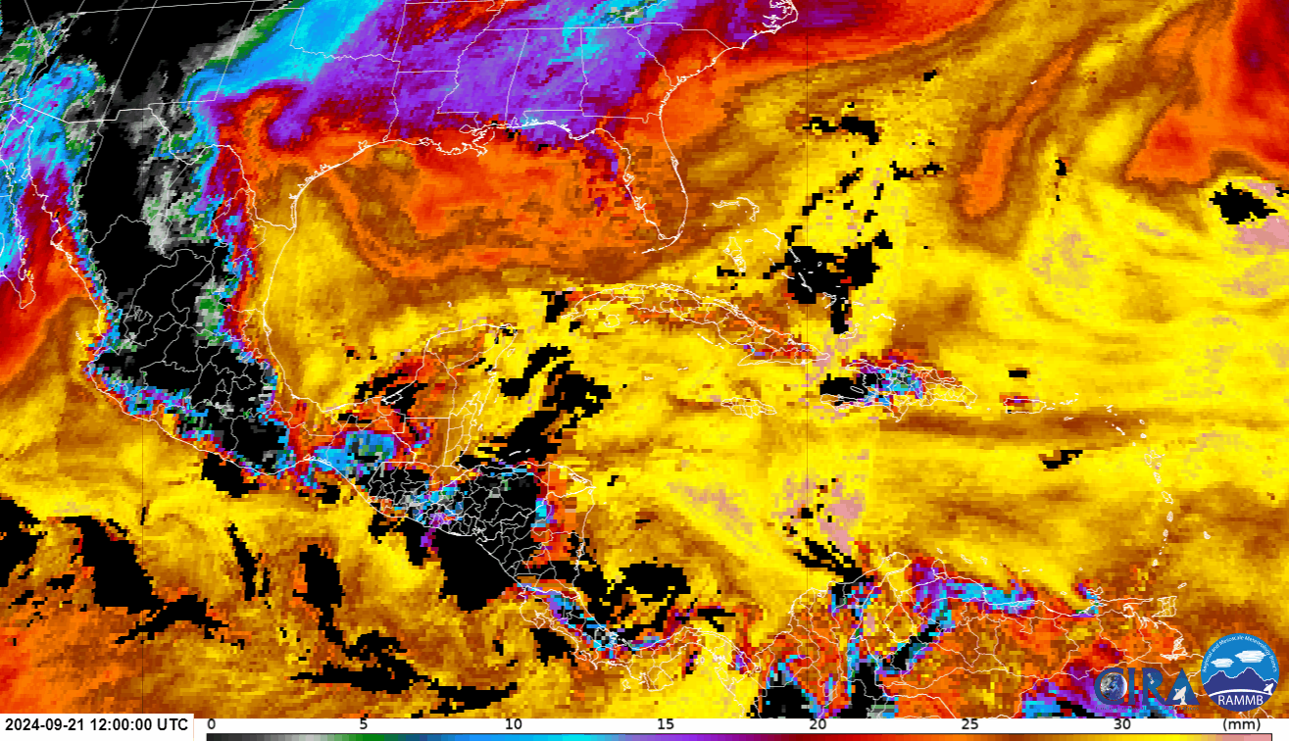
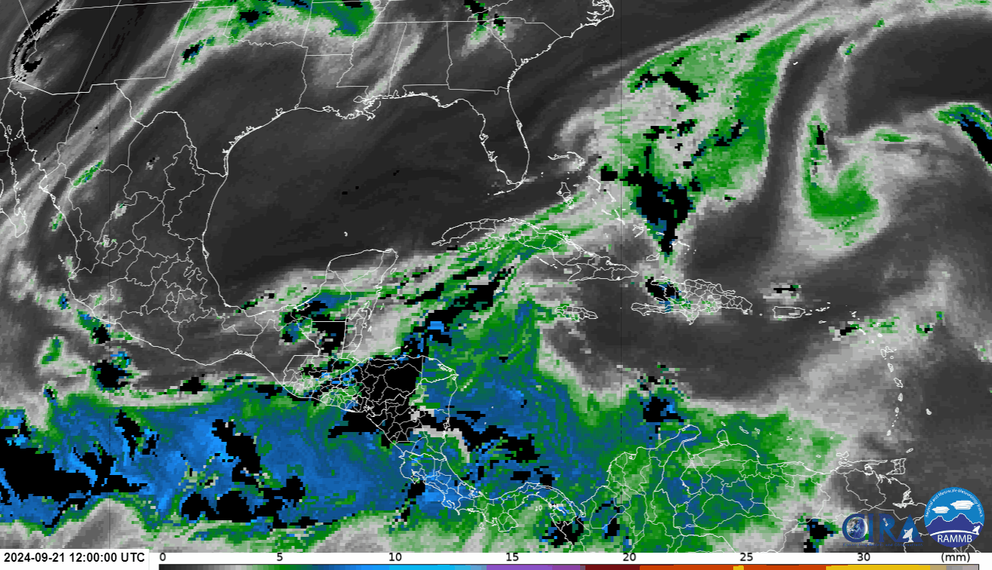
GOES-16 6.9 µm and low and high-layer ALPW for tropical wave
Sept. 21, 2024
Sfc-850
500-300
Layer Precipitable Water (mm)

Slide 22
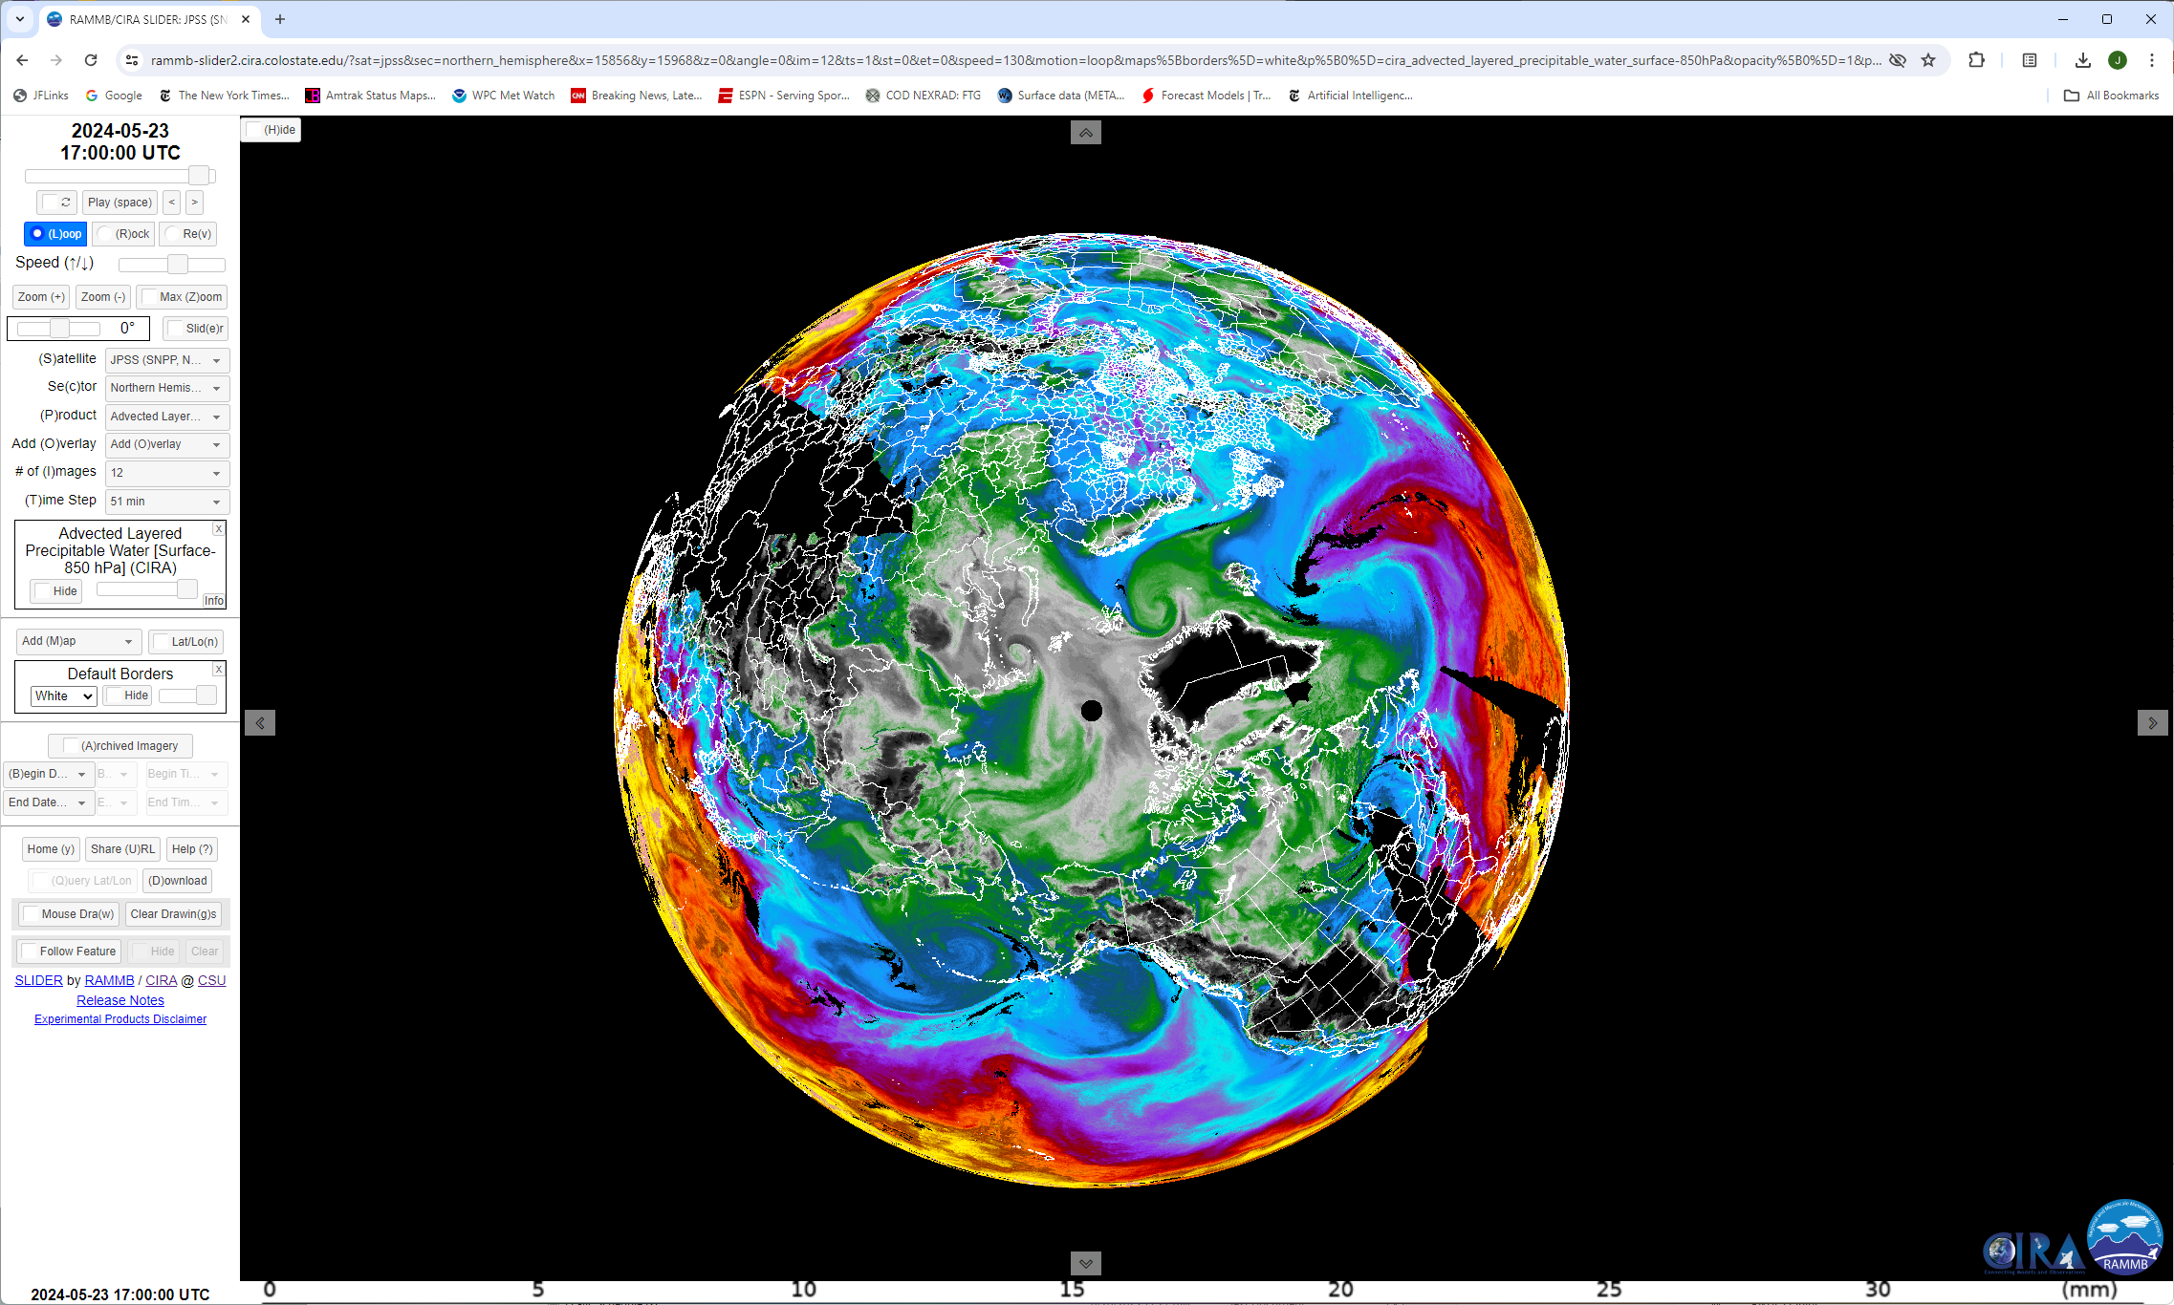
Polar view of Blended TPW and ALPW available at https://rammb-slider.cira.colostate.edu/
Sfc-850 mb layer
Layer Precipitable Water (mm)

Slide 23
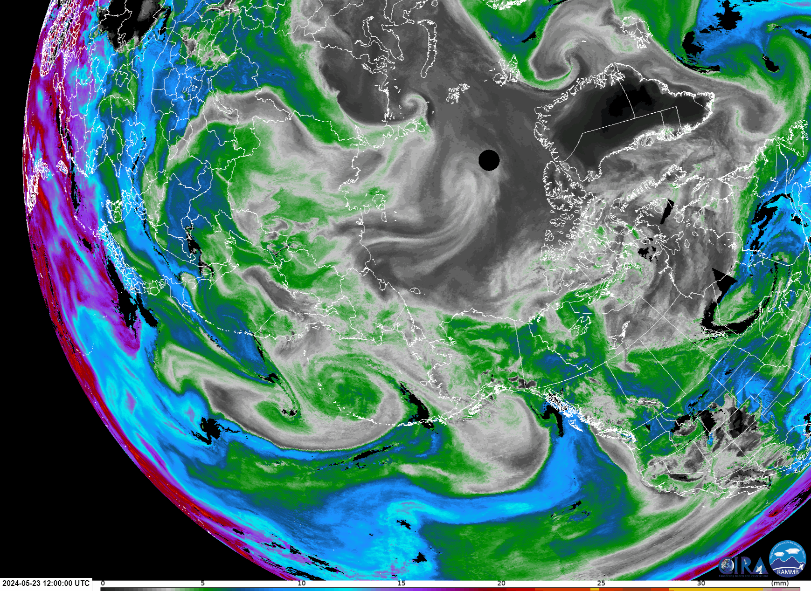
6-hour loop of 700-500 mb ALPW from CIRA SLIDER

Slide 24
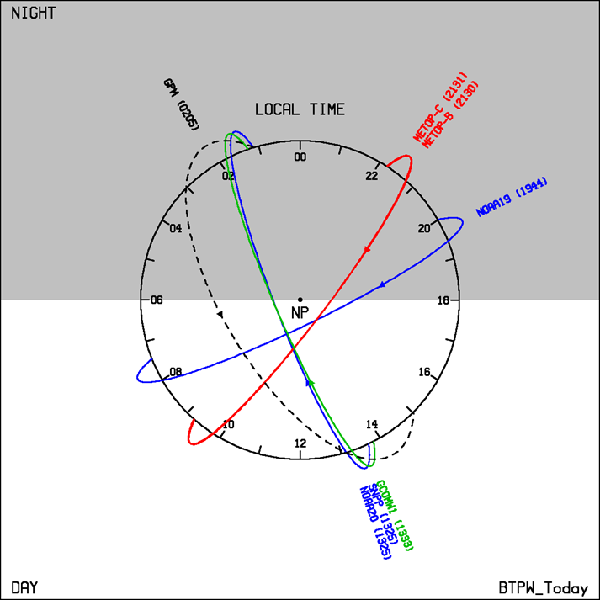
Current Blended TPW LEO Constellation
NOAA-20/21 GCOM-W1

Slide 25
Much of what we are doing with blended products is trying to mimic the functionality of a geostationary microwave sounder.
Why don’t we have one?

Slide 26
1985
Vonder Haar presented idea at first AMS Satellite Meteorology Conference
4.4 m
“Plans and budgets were in place for the instrument on at least one satellite in the GOES - NEXT series. And then came the Challenger disaster (1986)... NOAA had to move on with the operational GEO satellites and arranged for conventional launch vehicles for all the GOES-NEXT. We thus lost the opportunity to fly a sizeable antenna on those spacecraft due to smaller payload shrouds”. (Tom Vonder Haar, pers. comm.)

Slide 27
SmallSat missions with microwave sensors for water vapor:
NASA TROPICS (4 satellites launched, data not released)
NASA INCUS (~2025) – One MW radiometer
EUMETSAT Arctic Weather Satellite (launched August 2024) / Sterna Program
Commercial (Tomorrow.io)
Data access in near real time and rapid integration into operational products are needed to realize potential.

Slide 28
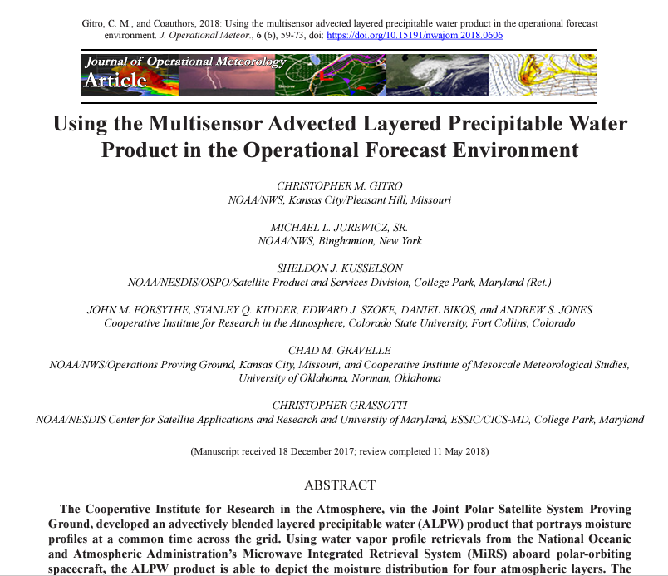
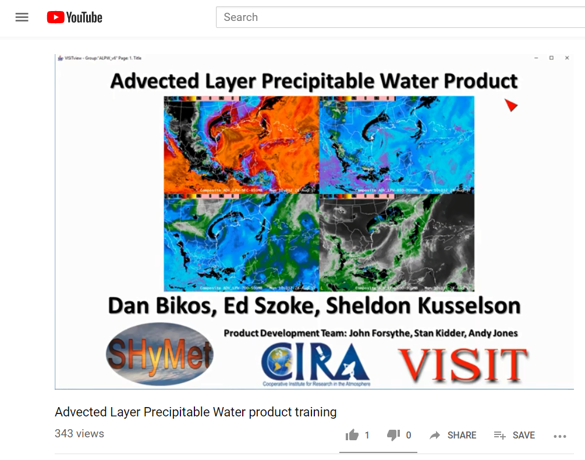
User Training Available in Commerce Learning Center
http://rammb.cira.colostate.edu/training/visit/training_sessions/advected_layer_precipitable_water_product/

Slide 29
Recent Historical Record of ALPW

Slide 30
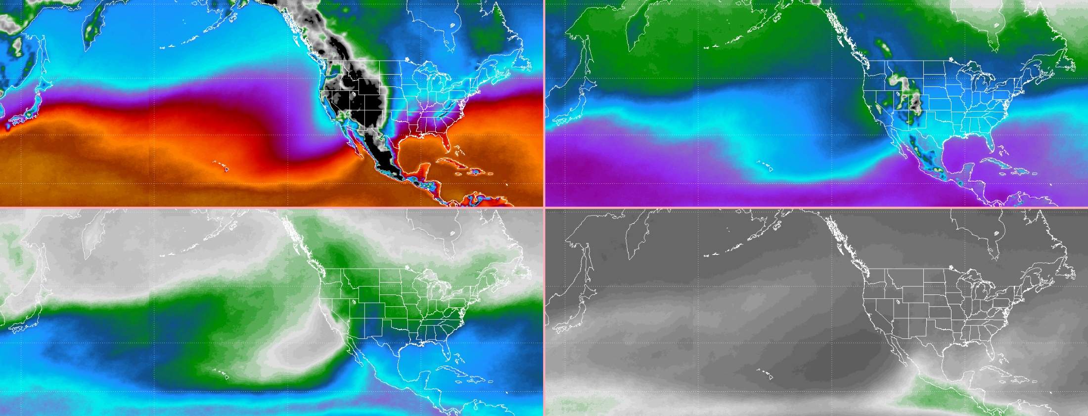
September 2013 – 2023 Median LPW from LPW data
Sfc-850
850-700
700-500
500-300
Layered Precipitable Water (mm)

Slide 31
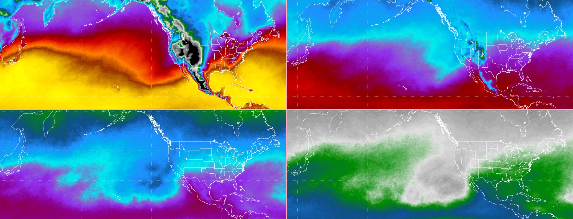
September 2013 – 2023 95th percentile LPW
Sfc-850
850-700
700-500
500-300
Layered Precipitable Water (mm)

Slide 32
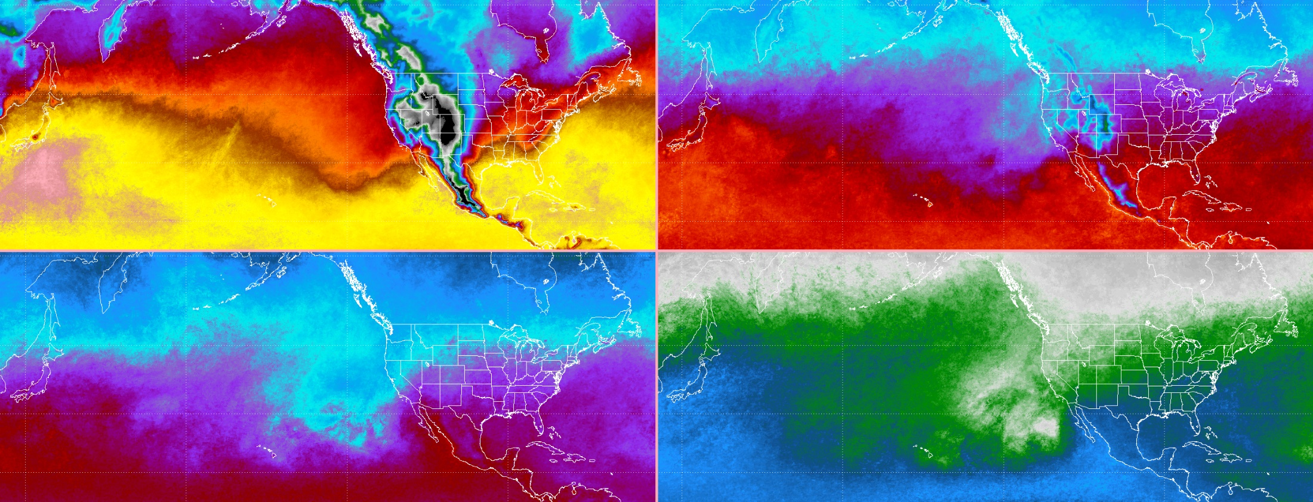
September 2013 – 2023 99th percentile LPW
Sfc-850
850-700
700-500
500-300
Layered Precipitable Water (mm)

Slide 33
New Derived Products Being Evaluated
Percentile Ranking
Layered Vapor Transport (LVT)
Reanalysis records

Slide 34
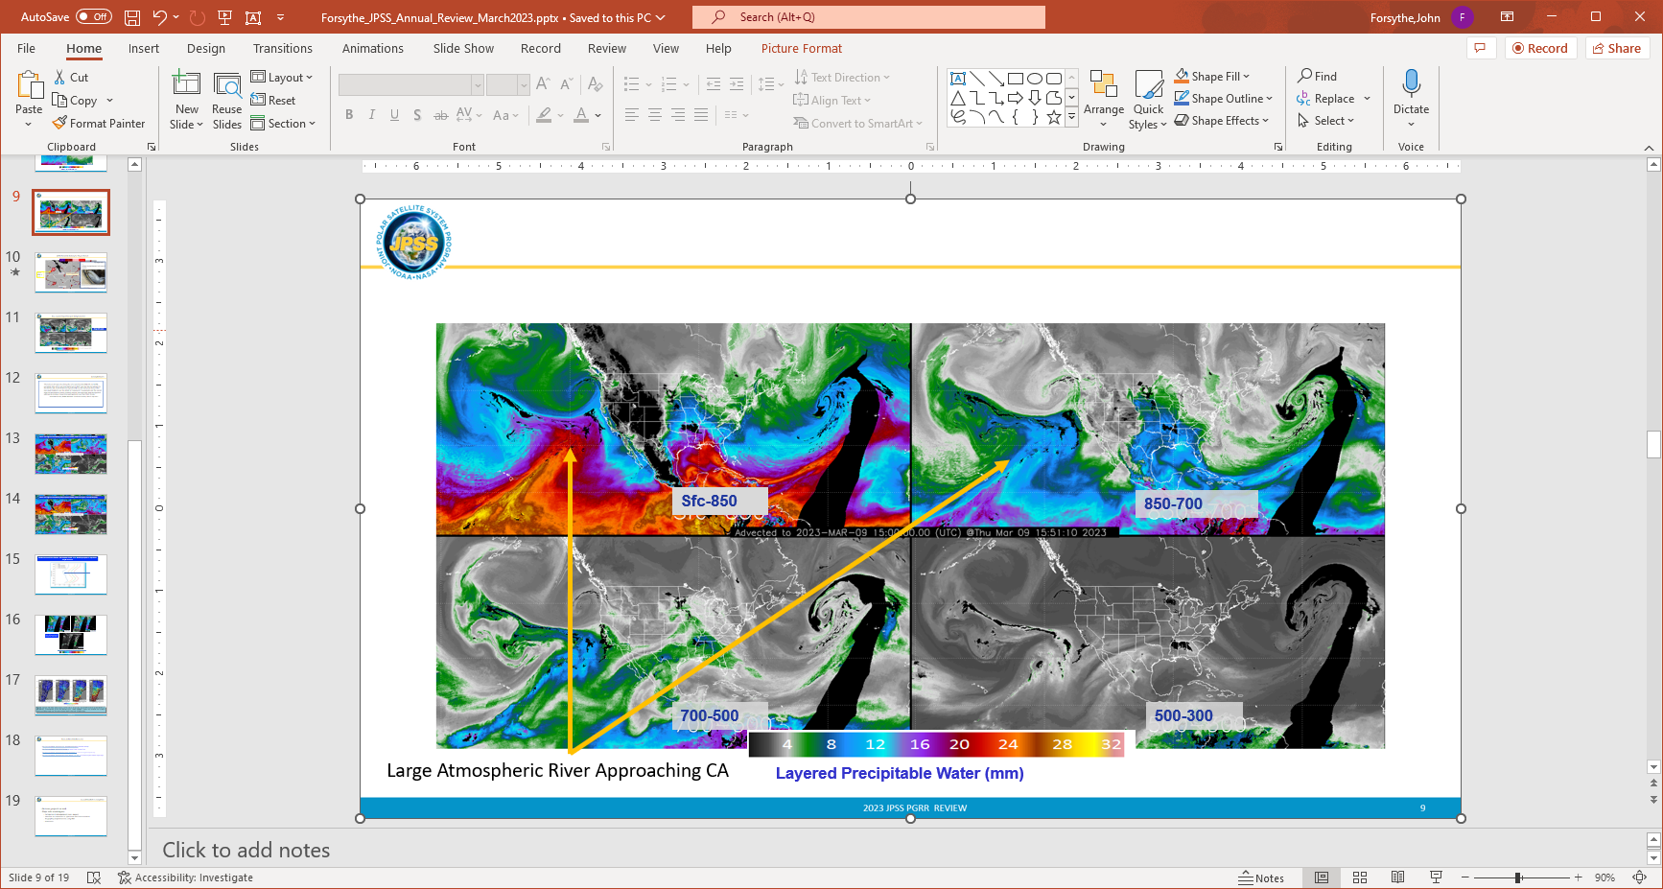
March 9,2023 California Atmospheric River

Slide 35
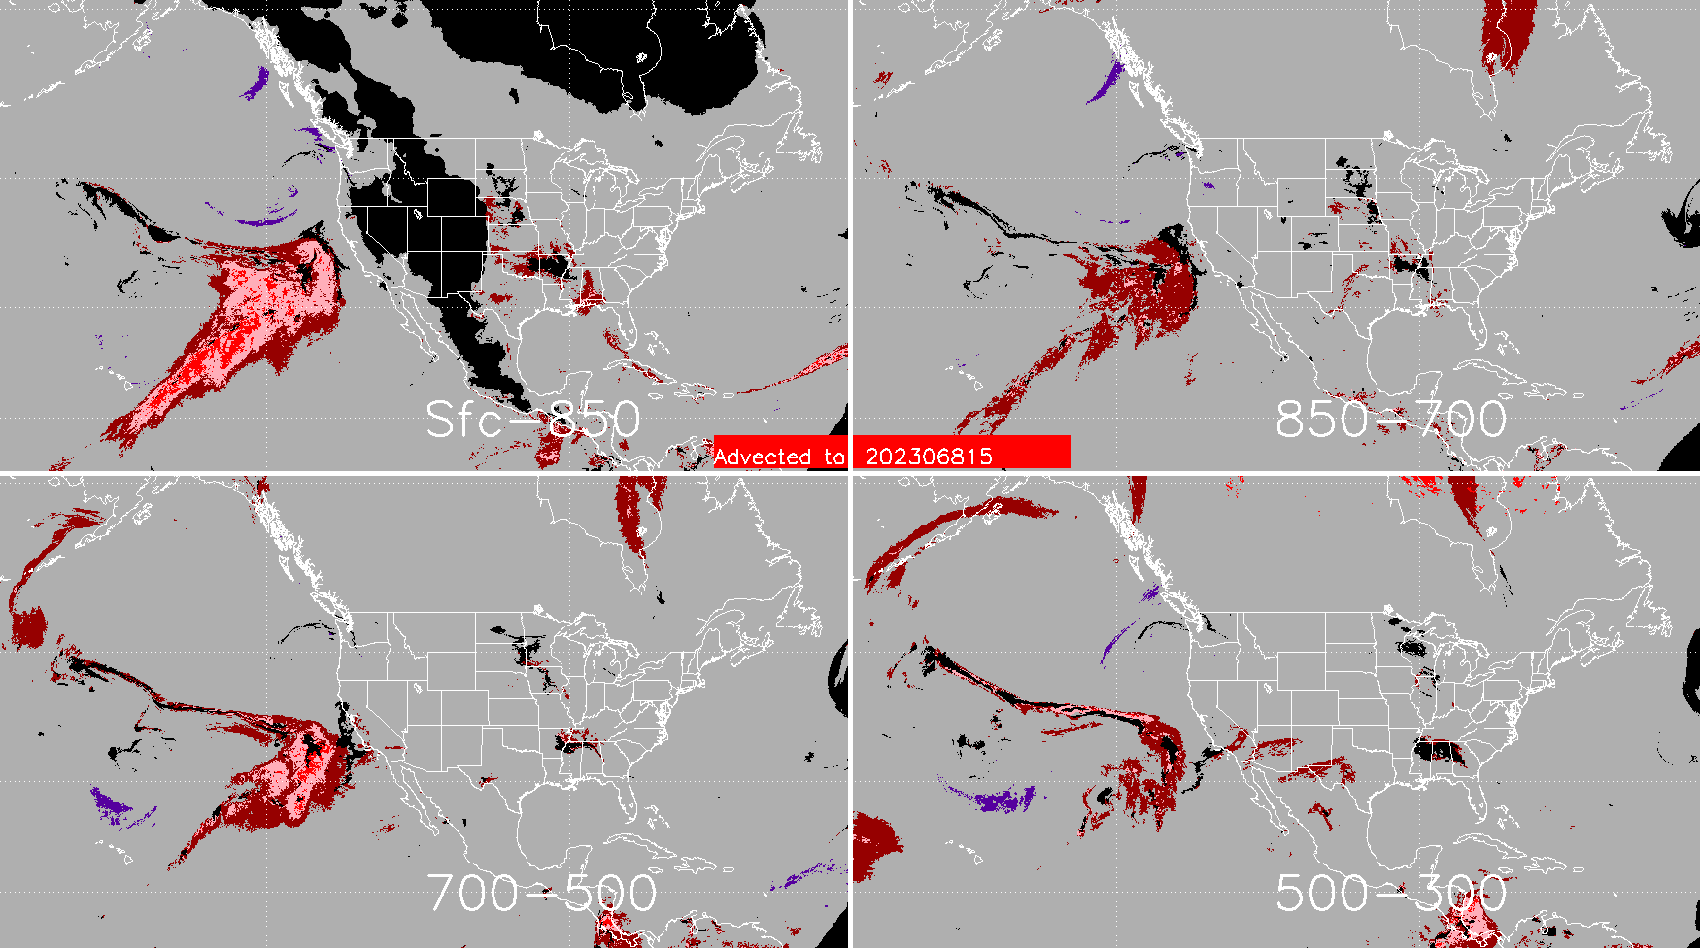
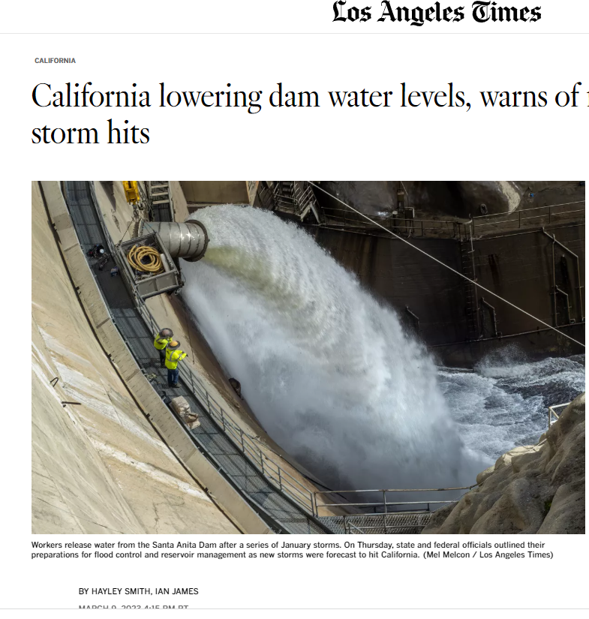
ALPW Percentile Ranking for 10-year Record
Highest values in record
Sfc-850
15 UTC 9 March 2023
850-700
700-500
500-300

Slide 36
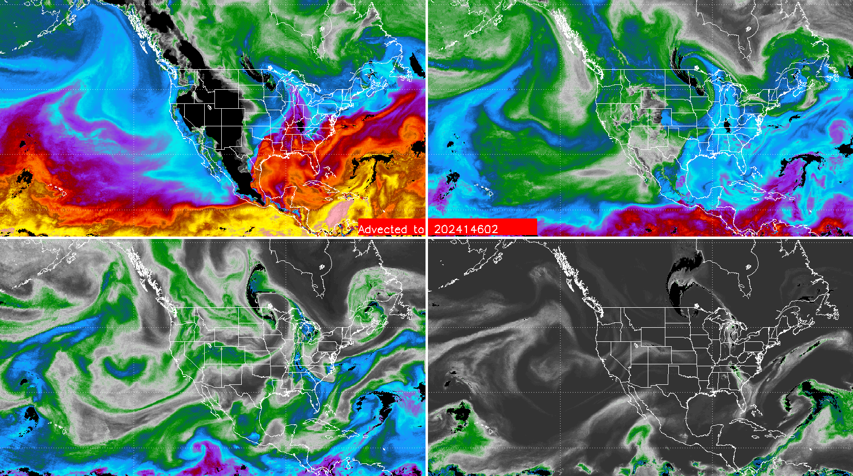
Layered Precipitable Water (mm)
Sfc-850
850-700
700-500
500-300
02 UTC 25 May 2024

Slide 37
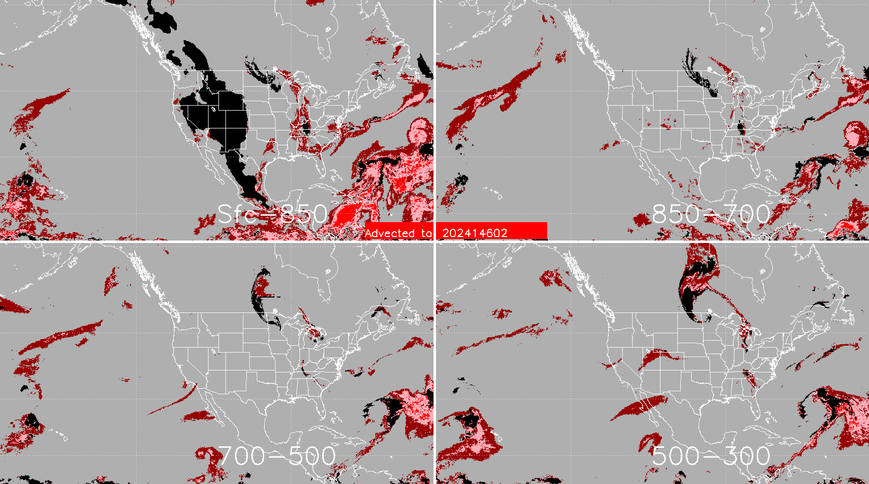
Percentile Ranking
Sfc-850
850-700
700-500
500-300
02 UTC 25 May 2024

Slide 38
NASA MEaSUREs NVAP Project

Slide 39
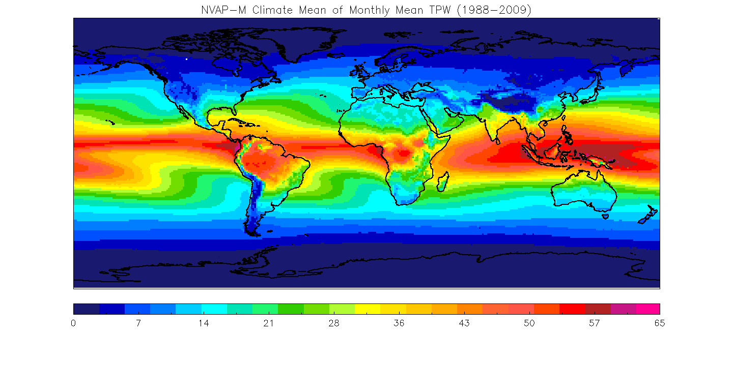
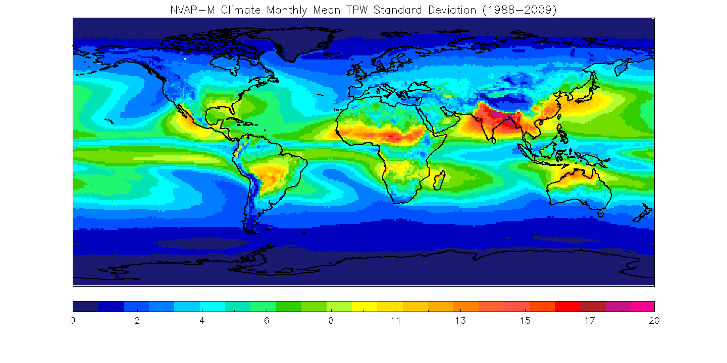
NASA Water Vapor Project – MEaSUREs
Several incarnations:
  1988-1992
  1993-2001
  NVAP-M (1988-2009) ( Vonder Haar et al. GRL 2012)
Total (TPW) and layered (LPW) precipitable water
Designed to be observationally-driven, minimal dynamic model dependence. SSM/I (an operational, DoD sensor with no climate mission) was always the backbone instrument to retrieve total precipitable water (TPW) over ocean only.
Supplemented with HIRS / AIRS (2002+) infrared retrievals over land and ocean.
  Challenges with different sampling of clear and cloudy regimes (Fetzer et al).
Available at NASA Langley Atmospheric Science Data Center (ASDC)
Similar in concept to GPCP, ISCCP…
Mean 1988-2009
Standard Dev.

Slide 40
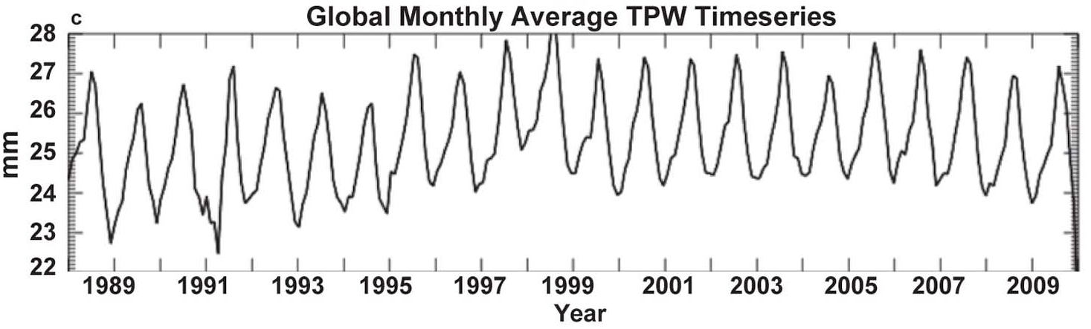
NVAP-M Global Monthly TPW
Pinatubo eruption
Large ENSO

Slide 41
Candidate List of Sensors to Use
Sensor | Time Span | Retrieval Algorithm | Published Uncertainty
Special Sensor Microwave Imager (SSM/I) | 1988 - | Elsaesser and Kummerow (2008); | 3-5 mm TPW
Advanced Microwave Sounding Unit (AMSU-A/B), Special Sensor Microwave Water Vapor Profiler (SSM/T-2), Advanced technology Microwave Sounder (ATMS) | 1994- | Lee et al. 2022, Boukabara et al. 2011, | 4-5 mm for TPW via ATMS
AIRS V7 | 2002- | Olsen et al. (Yue et al. 2020) | 15% of mixing ratio in 2-km layers
NOAA HIRS | 1988- | Engelen and Stephens (1999) | 6 mm TPW 4 mm 700-500 hPa; 0.6mm 500-300 hPa
Global Navigation Satellite System (GNSS) | 1995- | Wang et al. (2007) | 1 mm TPW
CLIMCAPS | 2008- | Roman et al. (2016) Smith et al. (2019) | 2 mm TPW
Radiosonde | 1988- | Durre et al. (2008) | 2 mm TPW
Also considering others (MODIS TPW…)
Microwave sounders provide total column and ~3 layers. Not used in NVAP-M, radiance record is now more mature.
Well-validated hyperspectral IR
Well-validated hyperspectral IR

Slide 42
Continue Multi-tiered Product Approach
NVAP-Weather
Used for weather case studies on timescales of days to weeks: Atmospheric rivers, droughts etc.
Use most available sensors at a time, audience is weather event analysis Emphasis on spatial and temporal coverage
NVAP-Climate
Used for studies of climate change and interannual variability
Focus on temporal continuity and well-intercalibrated data Emphasis on consistency across decades
NVAP-Ocean
Microwave imager TPW only. Level 1 C intercalibrated radiances (Berg and Sapiano, CSU)
How do we make a water vapor record for a wide variety for users?
New: NVAP Constant Sampling
Enforce a constant mix of clear / cloudy scenes across decades
Supplemental Fields
Data source codes (DSC) map, indicating the sources used in each grid box .

Slide 43
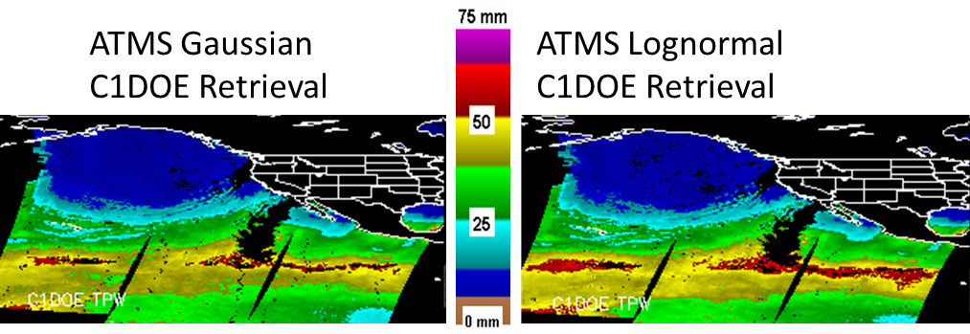
CIRA will run a non-Gaussian framework microwave retrieval (C1DOE: Fletcher, Kliewer et al. 2016) for NASA NVAP project (40-year instrumental record)
  1DVAR retrieval similar to NOAA MiRS
  Should better retrieve extreme values
  Will also run MiRS (Gaussian) and validate the two
Total Precipitable Water
09 UTC 1 Feb 2021

Slide 44
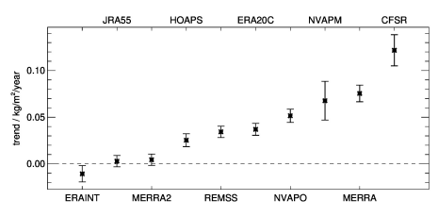
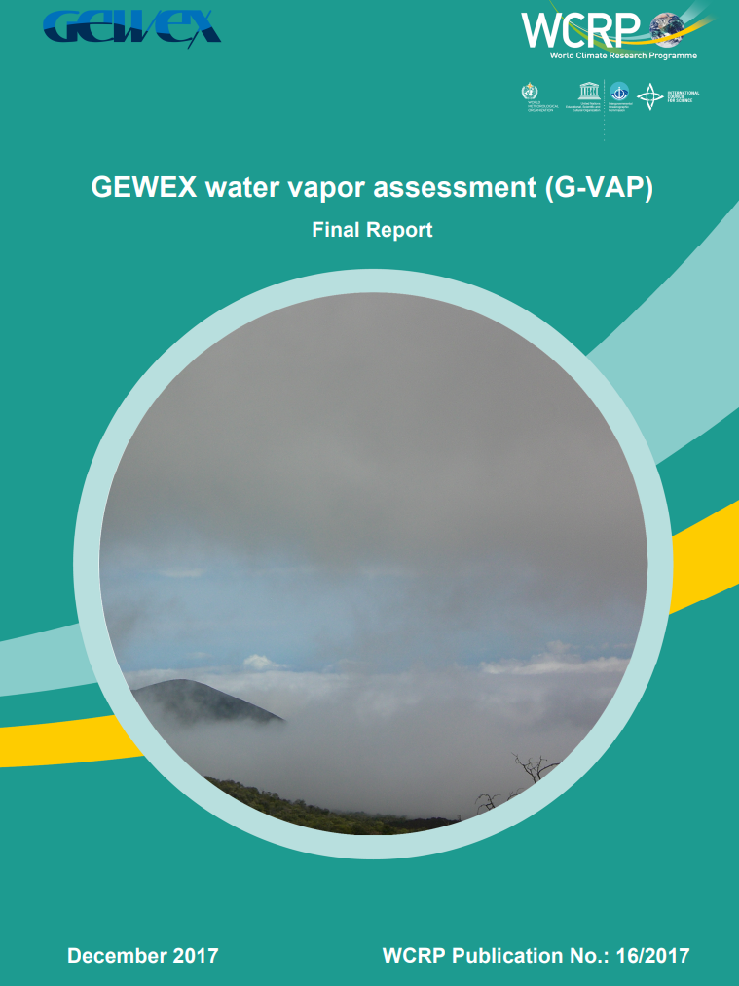
1988-2008 TPW trend and error estimate from 10 records
±60°N/S ocean only
Trend (mm/year)
An excellent analysis of breakpoints and the challenge of using operational sensors for climate.
  Recommendations include need for reprocessed radiance records
Observational, SSM/I-driven datasets more closely agree than reanalyses
Schröder, M., Lockhoff, M., Shi, L., August, T., Bennartz, R., Borbas, E., Brogniez, H., Calbet, X., Crewell, S., Eikenberg, S., Fell, F., Forsythe, J., Gambacorta, A., Graw, K., Ho, S.-P., Höschen, H., Kinzel, J., Kursinski, E.R., Reale, A., Roman, J., Scott, N., Steinke, S., Sun, B., Trent, T., Walther, A., Willen, U., Yang, Q., 2017: GEWEX water vapor assessment (G-VAP). WCRP Report 16/2017; World Climate Research Programme (WCRP): Geneva, Switzerland; 216 pp.

Slide 45
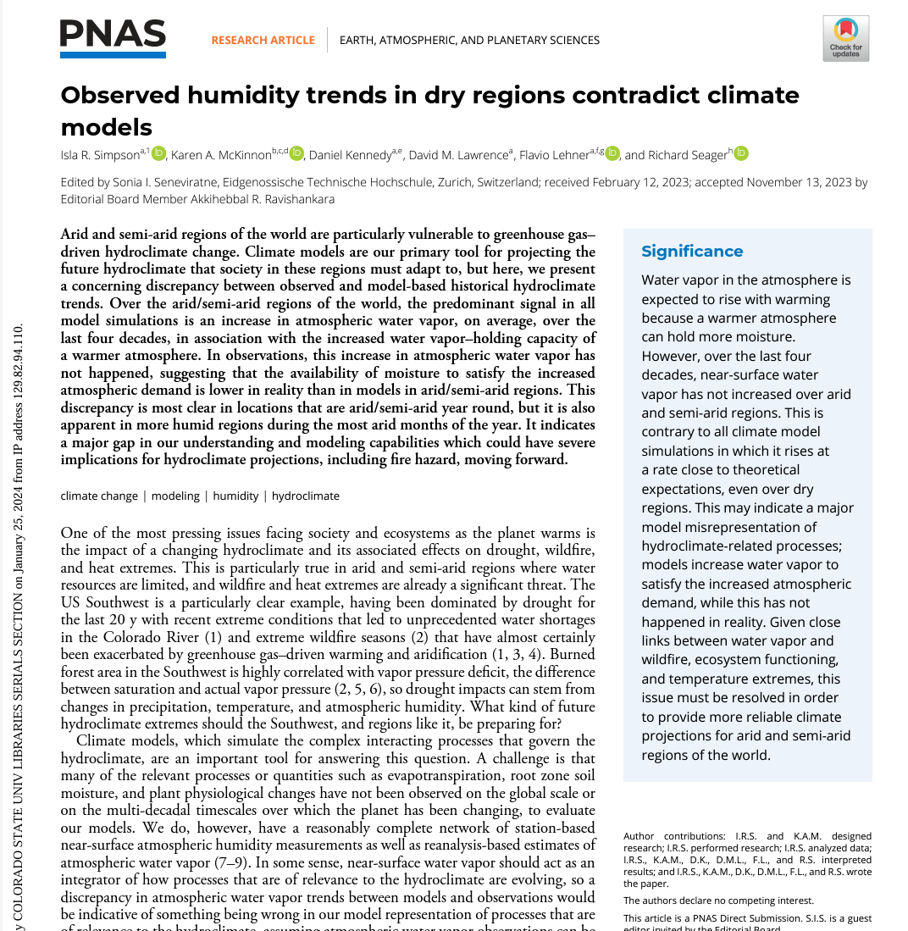
Special Focus Regions for NVAP:
Dry regions
Arctic

Slide 46
Summary:
Observationally-driven blended water vapor datasets are useful for forecasters, show “plumbing” of the atmosphere.
TPW is increasing over oceans ==> extreme precipitation events.
New ALPW product and upgraded blended TPW available in operations in 2024.
Historical records provide forecasters new context / communication in advance of flood threats.
An extension / reprocessing of the NASA NVAP 40-year record is underway. Expect to hear more about this at future AIRS / Sounder meetings.
Happy to have feedback and questions! (John.Forsythe@colostate.edu)

Slide 47
Backup Slides

Slide 48

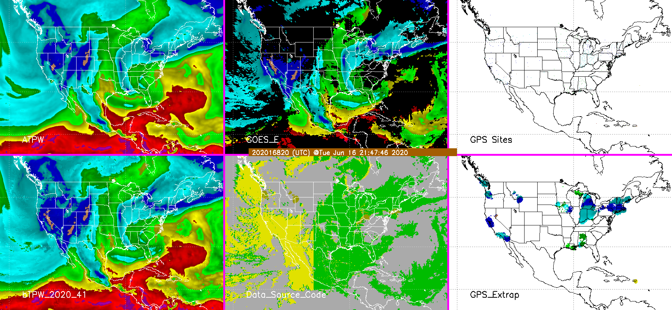
Towards the Next Generation of Blended TPW Products
http://cat.cira.colostate.edu/btpw_2020/
Microwave-only advected
GOES-16/17
GPS Sites (look closely!)
New Blended Product
Data Source Code
GPS short-range extrapolation
Blends inputs according to hierarchy. Version 2.0: GOES > GPS > Advected Microwave

Slide 49
Why not just use the model water vapor?
The NOAA Joint Center for Satellite Data Assimilation (JCSDA) has
six primary scientific research priority areas:
One of these is:
“Assimilation of satellite data impacted by clouds and precipitation”
The ALPW and TPW products directly use all of the satellite microwave radiance data. Data assimilation systems for NWP are still evolving to use cloudy radiances.
Satellite-only products not be affected by model initialization / missing data issues like a model cycle.

Slide 50
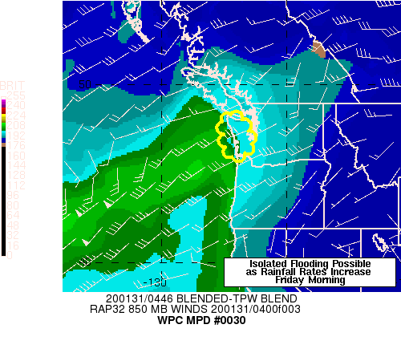
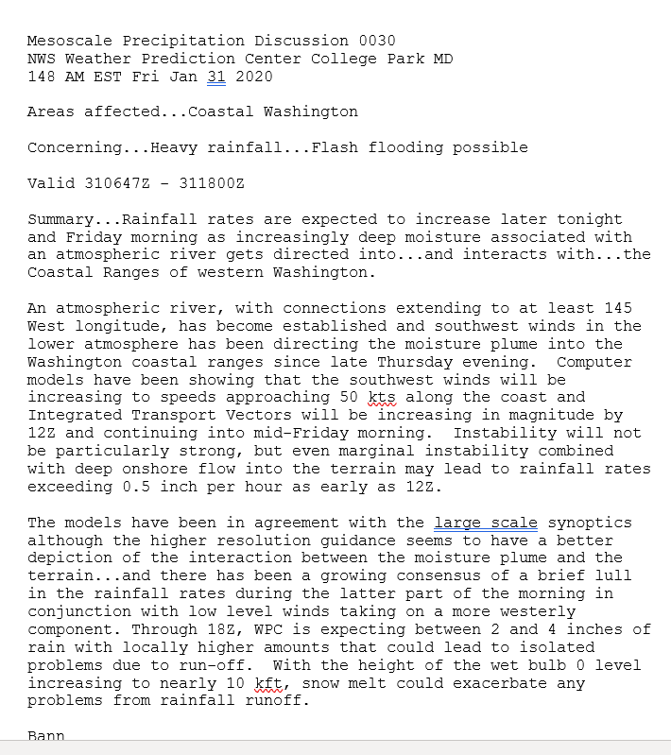
Typical Use of Blended TPW – Atmospheric Rivers
Also commonly used by NHC / TAFB to analyze tropical waves, Saharan Air Layer

Slide 51


Performance Estimates
May-June 2022 ALPW radiosonde comparison over CONUS.
Most importantly, improvements in MiRS retrievals help ALPW.
CIRA Blended Hydro products science team reports anomalies to MiRS team (e.g. high TPW bias over cold land in winter, incorrect Aral Sea landmask).
CIRA maintains NRT radiosonde ingest and is supported by NOAA JPSS and DACS for science monitoring, improvements and validation.

Slide 52

BAMS State of the Climate Year 2022

Slide 53

March 2013 – 2021 Maximum LPW
Sfc-850
850-700
700-500
500-300
Layered Precipitable Water (mm)

Slide 54


New Layered Vapor Transport (LVT) evaluated at WPC FFaIR* Experiment (Jun. – Aug. 2023)
Waiting for final evaluation
NWS Alaska Region has also looked at this product
Derived using GFS winds
Sfc-850
850-700
Work in progress on comparing to IVT
700-500
500-300
15 UTC 9 March 2023
*Flash Flood and Intense Rainfall Experiment

Slide 55

https://www.spc.noaa.gov/exper/soundingclimov2/

Slide 56
Sample of Questions Being Posed to NWS Alaska Forecasters
Did the percentile ranking focus your attention on areas which received heavy rain?
    “The areas which were shown as being around the 95th percentile or greater did coincide with areas that reported moderate to heavy rain”
Do you think the percentile ranking tool could be useful in communicating threats to the public?
    “…when communicating to the public we can more confidently draw comparisons to previous extreme events and thus be more proactive in communicating potential impacts…”
Did the LVT product help you see how much moisture was being transported over mountains?
    “Moisture that was being transported over the mountains was only viewable for heights above 700mb while everything below was blocked by the terrain of the Coast mountains.”

Slide 57

https://rammb.cira.colostate.edu/training/visit/blog/
Many examples of applications of satellite products around the world.
If you have a specific heavy precipitation case you’d like us to look at please let us know.

Slide 58
Links
https://cat.cira.colostate.edu/SPoRT/Layered/Advected/ALPW_Hourly.htm <- ALPW CONUS Hourly
https://cat.cira.colostate.edu/ALPX/ALPW_Percentile/index.html <- LPW 5th, 95, 99th and max percentiles
https://cat.cira.colostate.edu/ALPX/LVT/lvt.htm <- ALPW vapor transport (GFS winds)
https://cat.cira.colostate.edu/ALPX/ADVLUT/ALPX_Hourly.htm <- reduced size global 4-panel loop
https://cat.cira.colostate.edu/ALPX/ADVLUT/ALPX_ADVLUT_212.png <- full resolution global 4-panel image (Large)
https://cat.cira.colostate.edu/SPoRT/Layered/Advected/LPW_Alaska.htm <- Alaska / N.Pacific ALPW sector

